Slide 1
Welcome

Slide 2
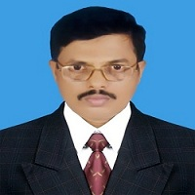
Md. Saiful Islam Chowdhury
Senior Teacher
C. J. M High School,
Mohara, Chandgaon , Chattogram..
saifulcjm@gmail.com Mob: 01991945882
ENGLISH FOR TODAY
Class : Nine-Ten
Unit-Four
Time: 40 minute

Slide 3
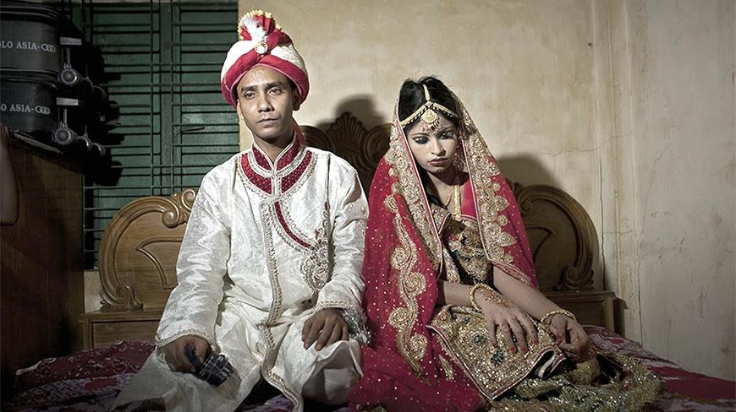
Look at the picture
Do you think it is a social problem?
What is the name of this problem?
CHILD MARRIAGE

Slide 4
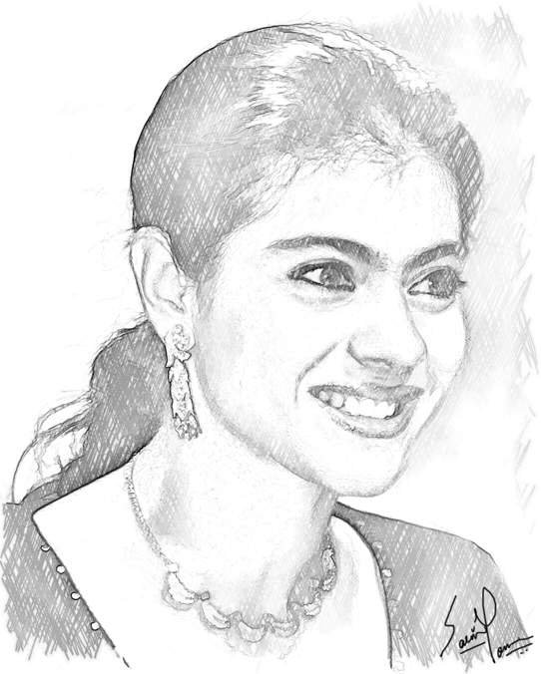
Today our Lesson is
THE STORY OF LIPI
Unit-Four, Lesson – Four

Slide 5
Learning outcomes
After completing the Lesson students will be able to –
1. Read and understand texts through silent reading;
2. Ask and tell about problem;
3. Seek and give suggestions;
4. Listen for specific information;
5. Narrate something in writing .

Slide 6
Listen the text attentively.
Teacher’s Model reading.
In the next class Ms Chowdhury tells her students the story of Lipi.
The year before last, Lipi, a 14-year old girl was in class 9 in a rural school in Rangpur . Lipi is the eldest of five children– three daughters and two sons. Their father is a day labourer working on other people’s land and mother is a homemaker and a part-time worker at other people’s homes. The parents, particularly the mother ,found it real difficult to raise five children on the small income the father could earn. Perhaps that is why Lipi’s father wanted to marry her off. But Lipi was not ready to accept what her parents wanted to impose on her. She wanted to pursue her education . Her mother stood by her, though secretly. When her father arranged her marriage with Tara Mia the only son of a farmer in the same village, she became greatly upset. Tara Mia was a widower-illiterate , but well off His father had a few acres of arable land and was influential in the village .The marriage seemed to be inevitable.

Slide 7
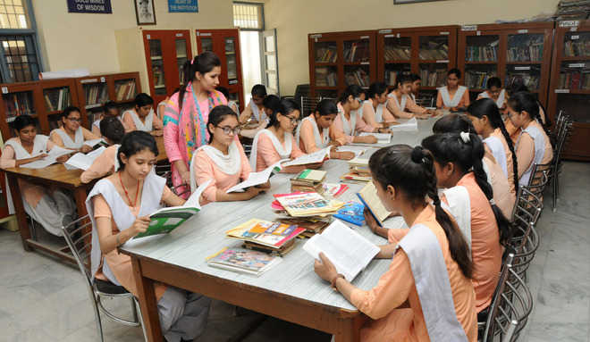
Student’s Model reading.
Go to the section “B” and start silent reading.

Slide 8
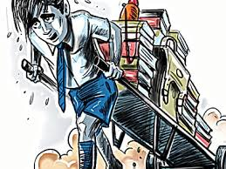
Vocabulary
Key word
Impose
Meaning:
force
His boss imposed too much work on him.

Slide 9
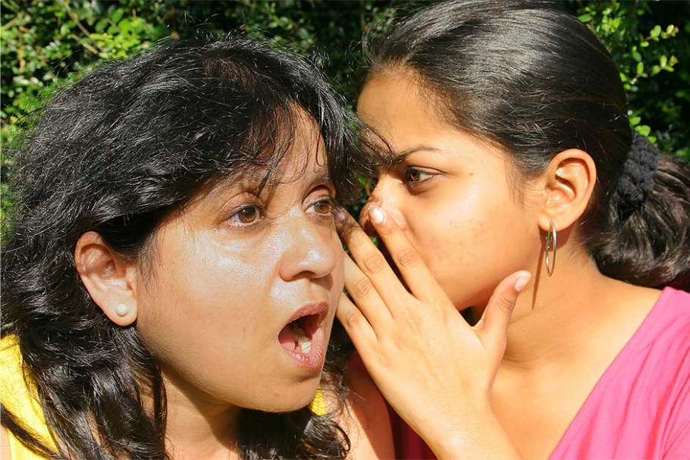
Vocabulary
Key word
Secretly
Meaning:
Covertly
Rima told Shima about the matter secretly.

Slide 10
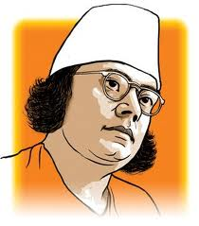
Vocabulary
Key word
influential
Meaning:
prominent
As a writer, Kazi Nazrul Islam was hugely influential.

Slide 11
Vocabulary
Key word
Upset
Meaning:
Distressed
He is feeling upset

Slide 12
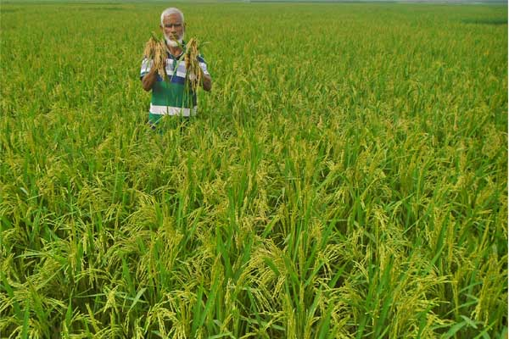
Vocabulary
Key word
Arable
Meaning:
Cultivable
Most of the farmers grow arable crops.

Slide 13
Choose the correct answer from the alternative.
1. Lipi was a _______ student.
a) primary
b) Higher secondary
c) secondary
d) university
2. Lipi had _____ sisters and two brothers.
a) Two
b) one
c) three
d) four

Slide 14
Choose the correct answer from the alternative.
3.What is the closest meaning of ‘raise.’?
a) lift
b) rear up
c) nurture
d) elevate
4. Her father was a_____________
a) trader
b) Wage earner
c) businessman
d) carpenter

Slide 15
Choose the correct answer from the alternative.
5. 5. Lipi’s mother is a__________?
a) Service holder.
b)labourer
c)seamstress
d)homemaker.
6. Lipi wanted to______her education.
a) discontinue
b) utilze
c) continue
d) pause

Slide 16
Lipi’s parents have four more children.
Lipi is the eldest child of her parents,. Her parents have four more children. Two of them are sons and two others are daughters.

Slide 17
Individual work
a) Who is Lipi ?
a) Lipi is a teenage student in a rural school in Rangpur.
b) How old is she?
b) She is 16 years old .

Slide 18
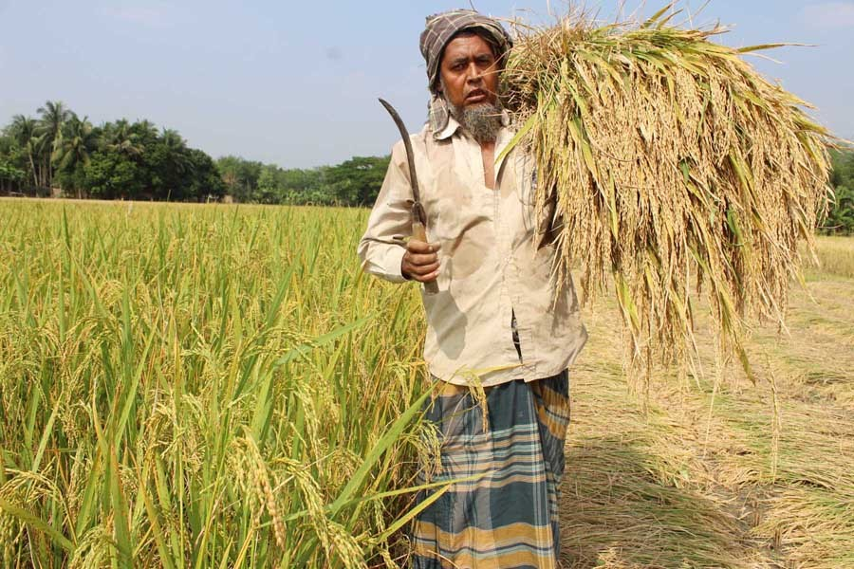
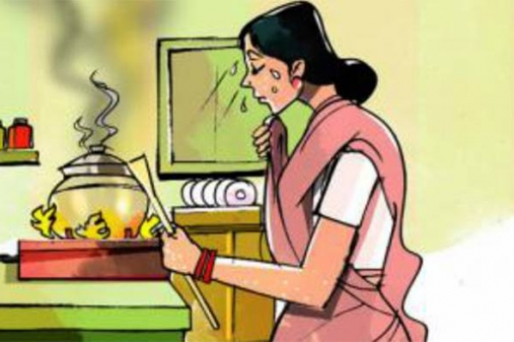
Lipi’s parents.
Lipi’s family is not well off Her father works as a day labourer on other’s land. Her mother works as a part-time worker at other people’s house. It was so difficult For Lipi’s mother to manage the family with their very limited income . So Lipi’s father wanted to marry her off.

Slide 19
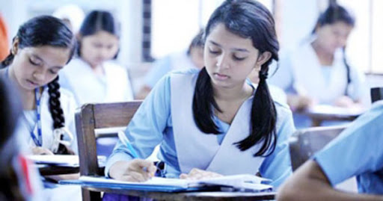
Group Work.
Discuss the social condition of Lipi’s parents.

Slide 20
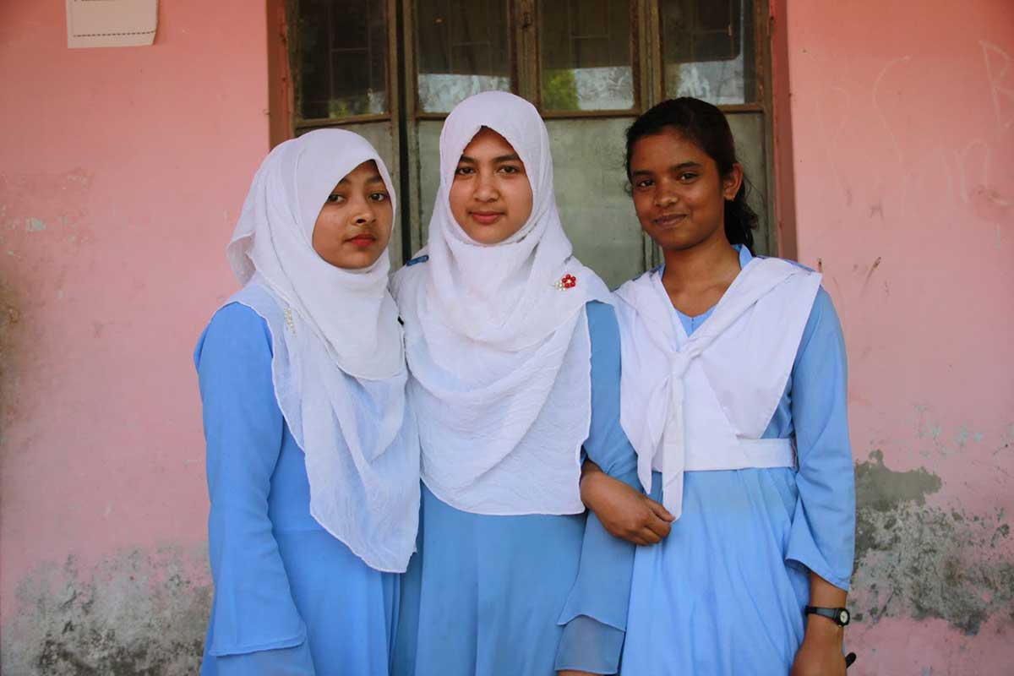
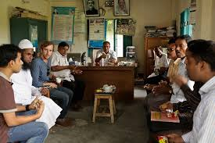
Lipi was not ready to accept the proposal . Lipi first talked with her classmates and then with the Headmaster..
The Headmaster intended to arrange a meeting because he wanted to stop the early marriage of Lipi . He knew the consequences of early marriage and so , he wanted to save her.

Slide 21
Read the passage carefully and answer the following questions.
1. Why did bridegroom’s father think that Lipi would be very happy ?
2.How could Lipi’s future shattered ?
3.Why did the Headmaster intended to arrange a meeting ?
4.Describe the impact of early marriage on a girl in 2/3 sentences.

Slide 22
1. Why did bridegroom’s father think that Lipi would be very happy?
Bridegroom’s father thought that Lipi would be very happy because she would have everything- money , clothes , home and status in the society.
2.How could Lipi’s future shattered?
If Lipi got married at her early age, her education would stop and it might shatter her future dream.

Slide 23
3.Why did the Headmaster intended to arrange a meeting ?
The Headmaster intended to arrange a meeting because he wanted to stop the early marriage of Lipi . He knew the consequences of early marriage and so , he wanted to save her.
4. Describe the impact of early marriage on a girl in 2/3 sentences.
The impact of early marriage on a girl may be very severe. An early married may have children at an early age of 15 or 16. It may cause constant health hazards to the girl.

Slide 24
Fill in the blanks with the correct words
eldest
four
sons
off
works
Lipi is the (a) ………… child of her parents. Her parents have (b)............ more children. Two of them are (c)............ and two others are daughters. Lipi’s family is not well (d)........... Her father (e)............. as a day labourer on other’s land. Her mother works as a part-time worker at other people’s house.

Slide 25
Evaluation
1) Why did Lipi’s father want to marry her off ?
Due to poverty Lipi’s father wanted to marry her off.
2) Why didn’t Lipi agree to get married?
Lipi wanted to pursue her education so she didn’t agree to get married.
3) Who is Tara Mia?
Tara Mia is the only son of a rich Farmer. He is widower, unconscious and uneducated man.

Slide 26
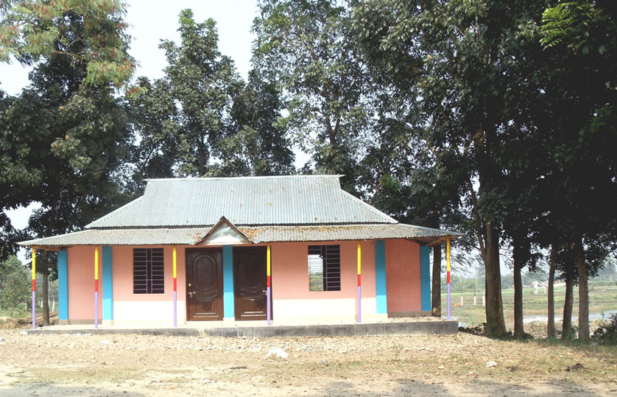
Home Work
Read the beginning of the story . Write ten new sentences to complete the story in a way you would like.
Nahar , an 18 years old garments worker lives with her family in a slam. She dreams of having a life full of joy . One day while going to her work place, she found a piece of gold in front of the factory gate.

Slide 27
Thank you all

