Slide 1
WELCOME

Slide 2
Introduction
Teacher Identity
Subject introduction
Mohammed Nasir Uddin
Senior Teacher
Burischer Zia Ul Ulum Fazil (Degree)Madrasha.
Hathazari,Chattagram.
Class:-Seven
Subject:-English 2nd paper
Unit:-Three
Topics:-Grammer.

Slide 3
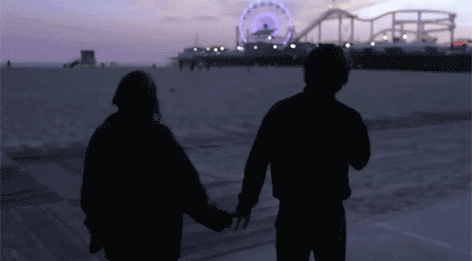
Look at the pictures

Slide 4
Todays Lesson
Tense
and
the form of tenses

Slide 5
Learning outcomes:-
Students will be able to
(1)Explain different kind of tenses
(2)Describe structure of the eight form of tenses
(3)Form sentences using structure of eight forms of tenses.

Slide 6
TENSE
PAST TENSE
PRESENT TENSE
FUTURE TENSE
Indefinite
Perfect
Indefinite
Perfect
Continuous
Perfect Continuous
Perfect Continuous
Continuous
Indefinite
Continuous
Perfect Continuous
Perfect

Slide 7
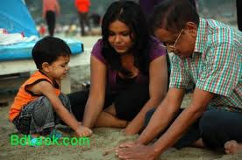
Structure of present indefinite tense
Subject+verb(present form) +object +others
We walk early in the morning.
We are well.
He is a young man
He goes there everyday.
They come here every afternoon.
He waits for me.
They eat bread everyday.
They sit on the floor.
They play criket everyday.
You help them.

Slide 8
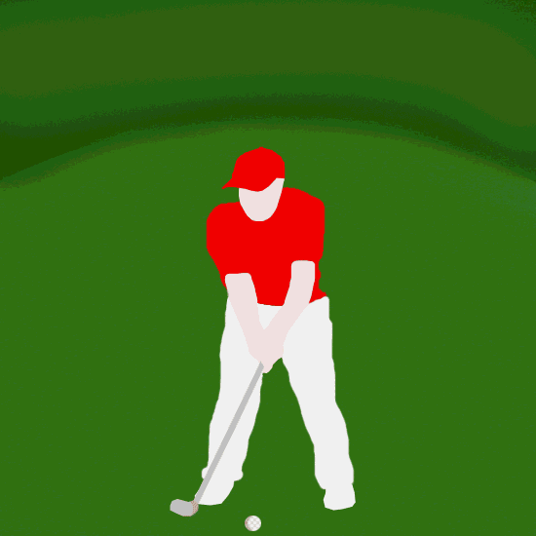
Structure of present continuous tense
Subject+am/is/are+verb(present form)ing +object +others
They are walking together.
They are running.
They are laughing.
You are going.
They are comeing here.
They are visitting.
They are helping one another.
We are waitting.
He is playing hoky.
The man is playing.

Slide 9
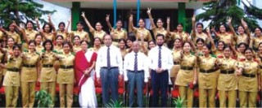
Structure of present perfect tense
Subject+have/has+verb(past participle form) +object +others
They have assembled together.
We have seen him.
The Principal has attented in assembly.
The students have worn their dresses.
He has worn a coat.
He has stumbled.
You have helped him.

Slide 10
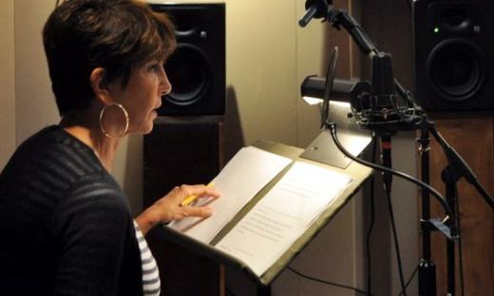
Structure of present perfect continuous tense
Subject+have been/has been+verb(present form)ing +object +others
They have been helping one another for an hour.
They have been going to park for an hour.
They have been walking for an hour.
We have been following them since morning.
The lady has been delivering speech for half an hour.
We have been listenning to the speech for an hour.
She has been reading a noble since morning.
[Period of time must]

Slide 11
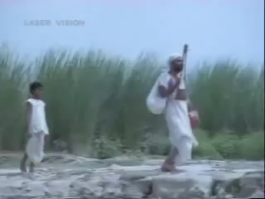
Structure of past indefinite tense
Subject+verb(past form) +object +others
They assembled together.
We saw them.
The Principal and three professor were present.
The students swore together.
He sang a Lalongiti
There were bushes by the side of the river.
They wore white dress
It was the scenery of a village.

Slide 12
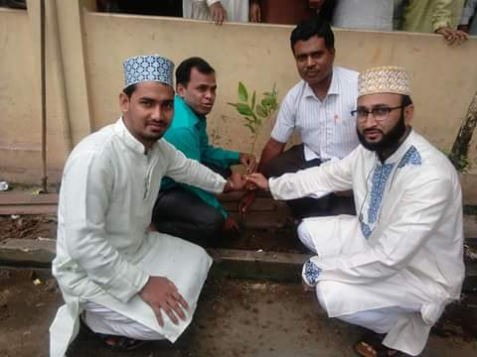
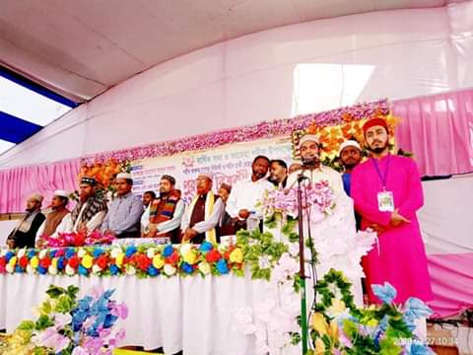
Structure of past continuous tense
Subject+was/were+verb(present form)ing +object +others
They were walking by the village road.
He was singing Lalongiti
We were planting plants.
Our prize giving ceremony was starting.
The guests were coming.
A student was reciting the Holly Quran.

Slide 13
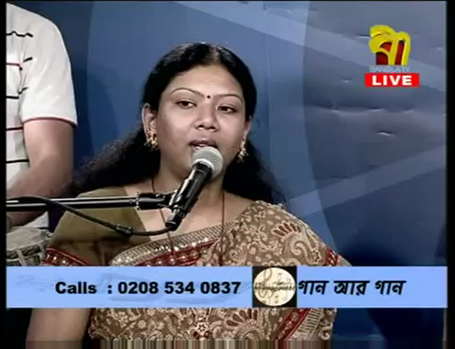
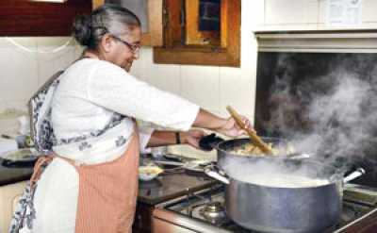
Structure of past perfect tense
Subject+had+verb(past participle form) +object +others
She had delivered an important speech before the chief guest came.
We had reached the meeting before the president came
She presided over the meeting after she had delivered a short speech .
The old lady had cooked for the chief guest before he came.
[Two activities of past tense]

Slide 14
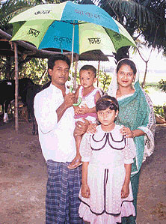
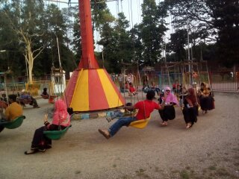
Structure of Future indefinite tense
Subject+shall/will+verb(present form)+object +others
The children will go with their parents
We shall follow them.
They will go to market.
I shall help them.
They will buy new dresses
They will return at the afternoon.
They will go to park.
She will play
We shall help the children.
He will go there.

Slide 15
Thank you
Thank you
Thank you

