Slide 1
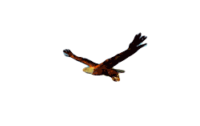
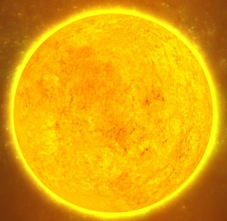
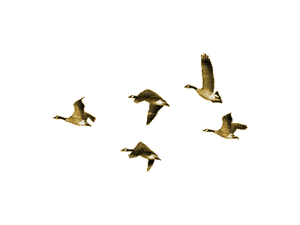
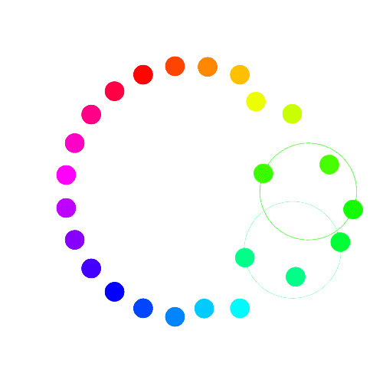
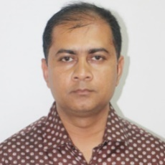
Welcome to today’s class
Bibek Biswas, Assistant Teacher, Rameshworpur Government Primary School, Narail Sadar, Narail. Email: bibekmitna@gmail.com, fbook: bibekbiswas, contact: 01914244847

Slide 2
Lesson’s Information
Class: Five
Unit: 2, See you!
Lessons: 5-6, H & I
Page No: 8
Teacher’s Information
Bibek Biswas
Assistant Teacher
Rameshworpur GPS
Sadar, Narail.
Email: bibekmitna@gmail.com
fbook: bibekbiswas
Contact: 01914244847

Slide 4
Good Morning Song
Good morning song from EIA song/any song.

Slide 5
What is your nick name?
Bibekananda Biswas - পুরো নাম
Bibekananda - প্রথম অংশ
Biswas - শেষ অংশ
Bibek - ডাক নাম

Slide 6
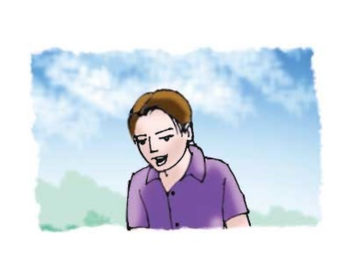
Look at the picture. Who is this?
We are going to know about Andy.

Slide 7
Look at your book

Slide 8
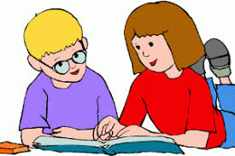
Make pair and find out the answer of the questions.
One pair come in front and give your answer please
1 C
2 D
3 B
4 A

Slide 9
We are going to play a ball game.
We will follow a sentence structure.
My name is Rubina Akhter Mita. First name Rubina. Last name Akhter and nickname Mita.

Slide 10
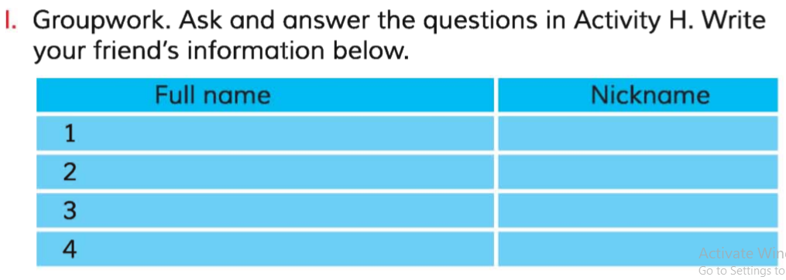
Every 4 person is now a group and fill up the form

Slide 11
After group work……
Group presentation……..

Slide 12
No more today
Stay home
Stay safe
Stay online…

