Slide 2
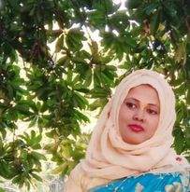
Teacher’s Introduction
Mst.Sharmin Akter
Assistant teacher
Matoin Govt. Primary School
Hajigonj, Chandpur
E-mail:
mstsharminakter1985@gmail.com

Slide 3
Lesson Identity
Class :Four
Subject : English
Lesson : 1-2(A)
Unit:21
Time : 40 min

Slide 4
Learning Outcomes
Student’s will be able to-
Reading:1.4.1-read words and phrases with the help of visual clause (about 30 new words) and simple sentences.
1.5.1:read words , phrases and sentences in the text with proper pronunciation , stress and intonation.
1.7.1: read short paragraphs , dialogues and simple letter.

Slide 5
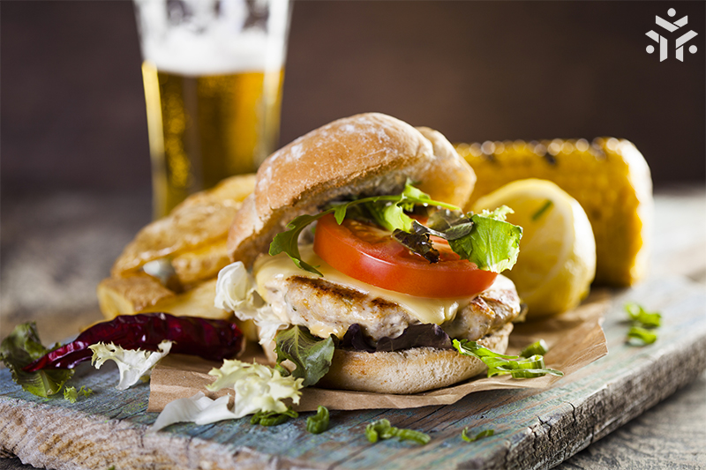
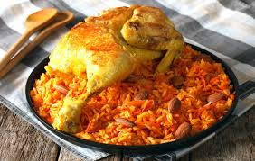
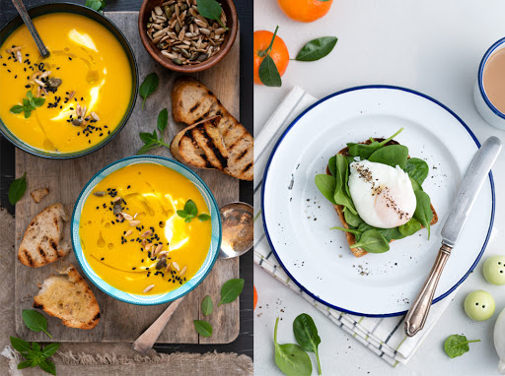
Look at the pictures and think alone

Slide 6
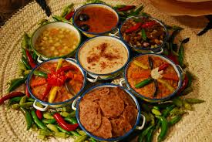
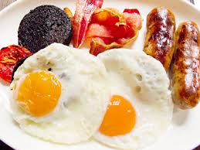
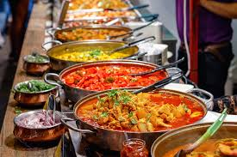

Slide 7
Todays lesson topic
Food around the world

Slide 8
Input

Slide 9
British
cheese
supermarket
favourite
cereal
bread
N
E
W
W
O
R
D
S

Slide 10
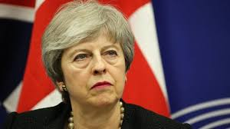
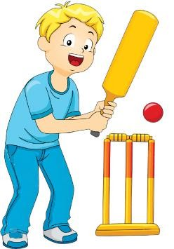
British
A native of England.
favourite
Fond of.

Slide 11
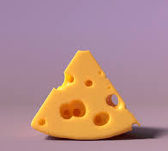
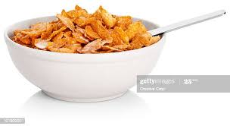
cheese
A food made from the processed curd of milk.
cereal
A grain used for food.

Slide 12
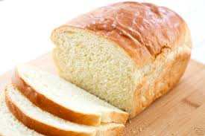
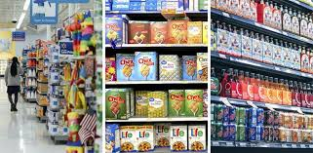
A type of food made from flour, water, sugar etc.
bread
A large shop which sells foods and other things.
supermarket

Slide 13
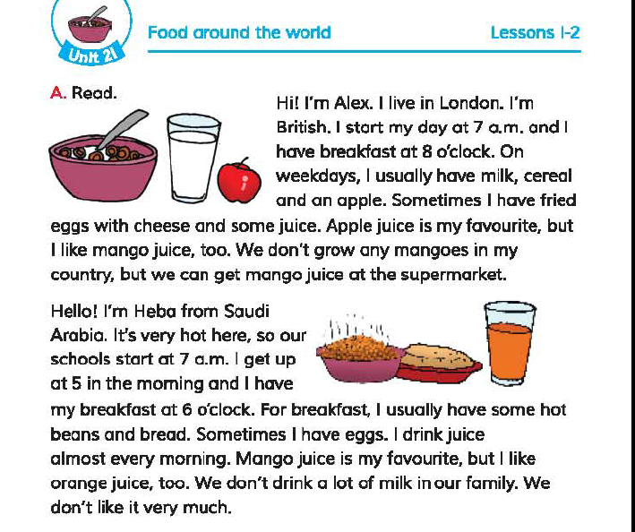
Open your book at page 42.

Slide 14
Teacher’s reading

Slide 15
Practice

Slide 16
Student`s reading

Slide 17
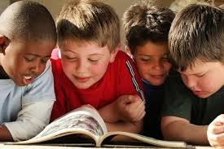
Group reading

Slide 18
Silent Reading
5 minutes

Slide 19
EVALUATION
Say the word that will sit in the space.
Alex
British
Country
Apple
Alex is.............
........has breakfast at eight o’clock.
3) Alex likes.............juice.

Slide 20
Now we will play “BINGO” game
cereal
cheese
bread
juice
milk
hot
breakfast
supermarket

Slide 21
task
Write five sentences about your food habits.

Slide 22
Thanks

