Slide 1
Welcome

Slide 2
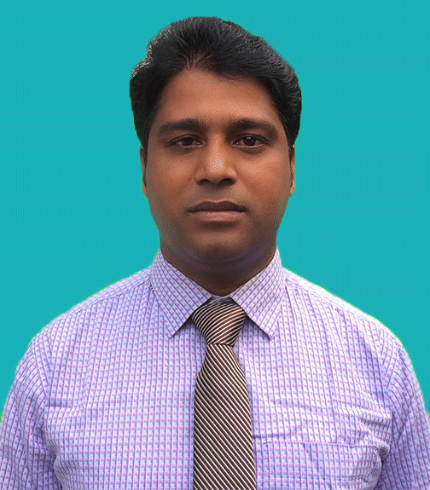
Teacher's Identity
Md. Showkat Ali
Assistant Teacher
Bishnupur Govt. Primary School
Taraganj, Rangpur

Slide 3
Subject Identity
Subject : English
Class : One
Title of the lessons : Alphabet
Part of the lesson : A . B. (C c)
Unit : 4
Lessons : 4-6
Time : 40 Minutes
Date : 07/11/2020

Slide 4
Learning outcomes
Students will be able to -
Listening :
1. 1. 1 become familiar with English sounds by listening to common English words.
Speaking :
1. 1. 1 repeat after the teacher simple words and phrases.
1. 1. 2 say simple words and phrases.
Reading :
1. 2. 1 recognize and read the alphabet both small and capital. (non-cursive).
Writing :
1. 1. 1 to practice letter shapes/ simple writing patterns, etc.
1. 2. 1 write non-cursive capital and small letters.

Slide 5
Let's watch a video

Slide 6
Today's lesson
Alphabet
C c

Slide 7
Let's see some pictures
cap

Slide 8
cat

Slide 9
cup

Slide 10
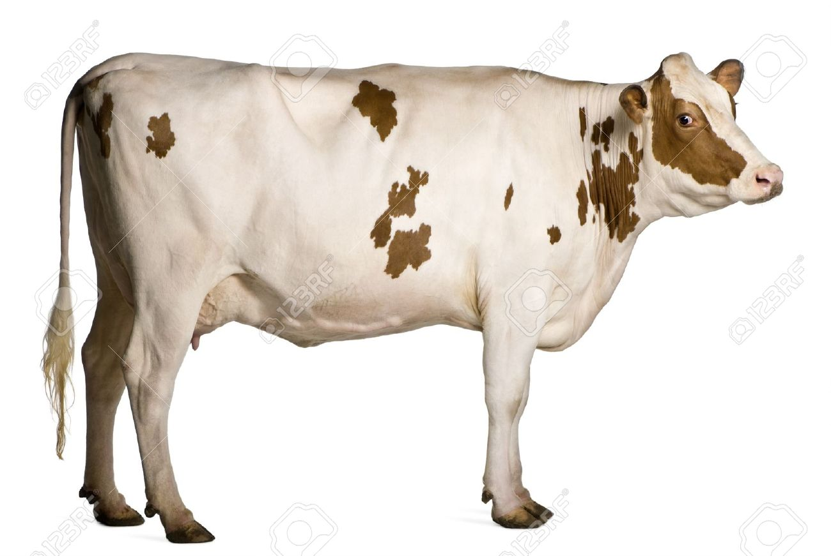
cow

Slide 11
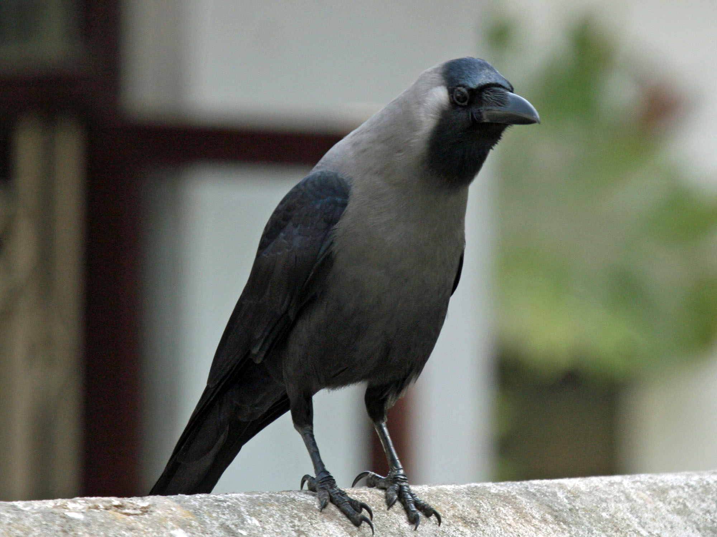
crow

Slide 12
Open the English book
Page no. 9

Slide 13
C for cap

Slide 14
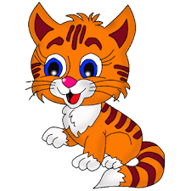
C for cat

Slide 15
C for cup

Slide 16
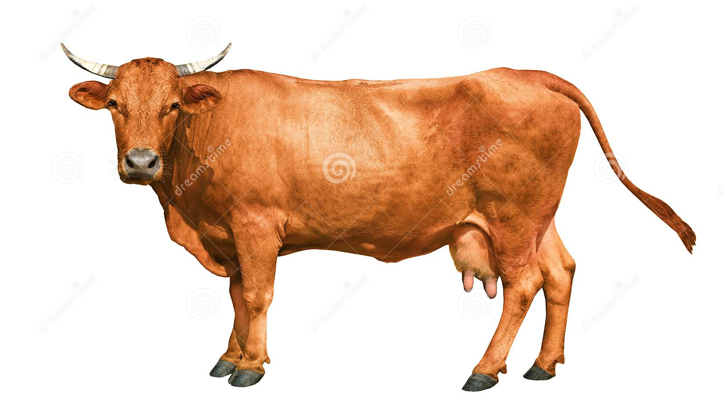
C for cow

Slide 17
C for crow

Slide 18
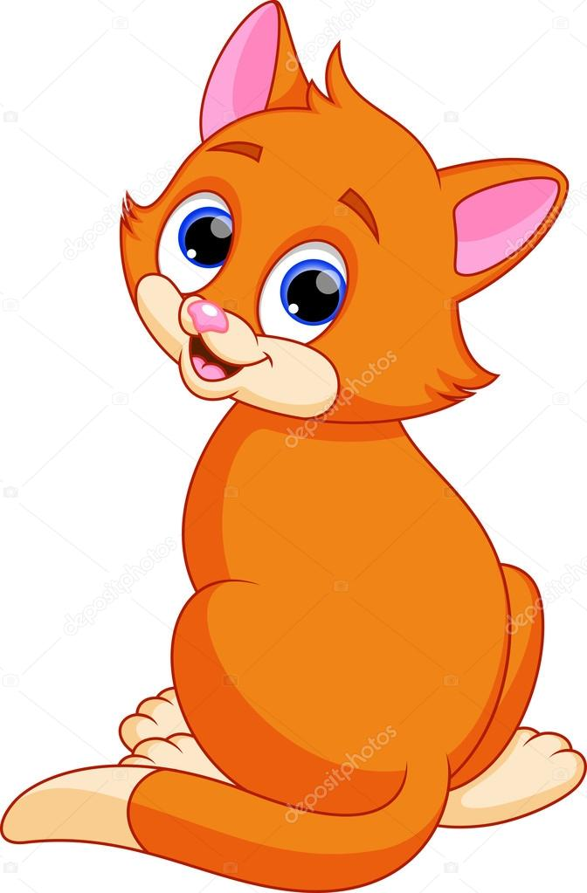
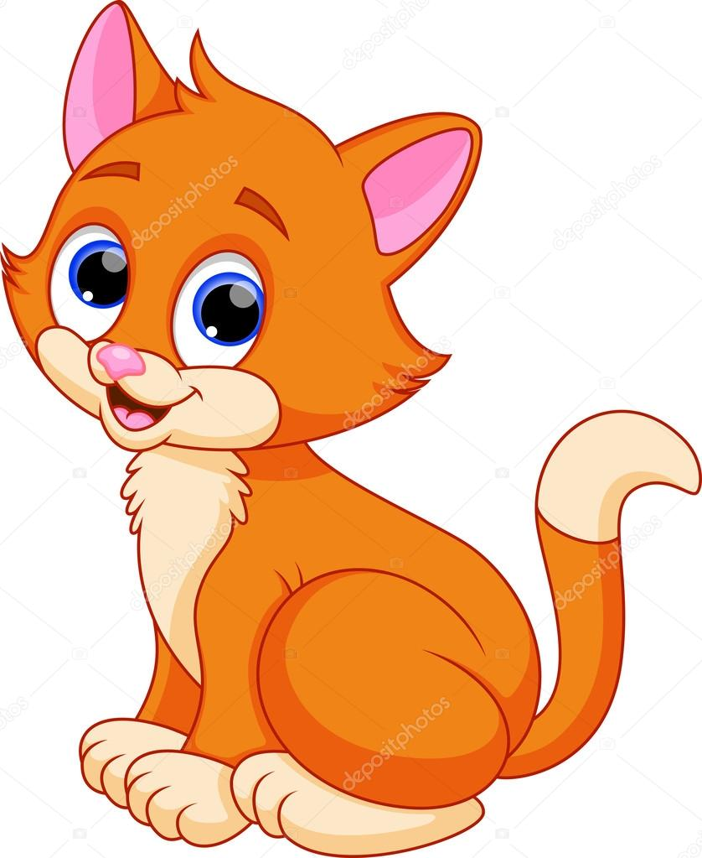
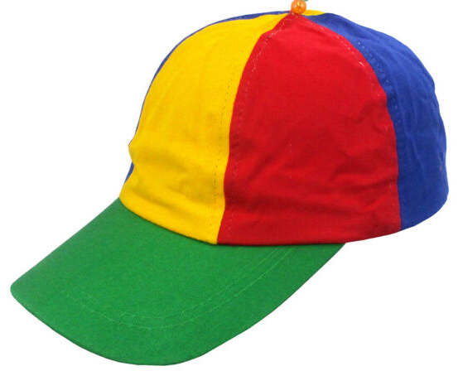
Alphabet
Lessons 4-6
Unit 4
A. Look, listen and say. Trace in the air.
C
c
cap
cat

Slide 19
B. Say and read. Trace and write.
C
C
C
c
c
c

Slide 20
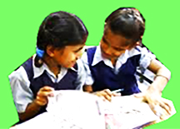
Pair work
Read the letter
C c

Slide 21
Evaluation
Find out the letter C , c :
A | C | B | D
a | b | d | c
B | A | C | D
c | d | a | b

Slide 22
Home work
C
Read and write the letter C , c :
c

Slide 23
Thanks Everybody

