Slide 1
WELCOME TO MAJHIRA MODEL ONLINE HIGH SCHOOL
DEAR STUDENTS. HOW ARE YOU?

Slide 2
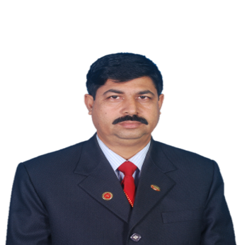
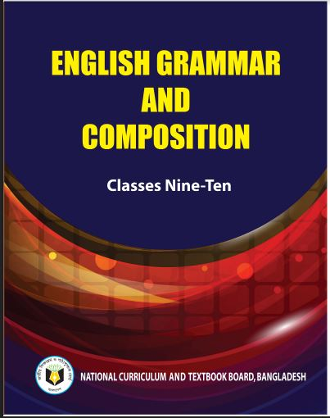
IDENTITY
Md. Afsar Ali
Assistant Teacher (English)
Majhira Model High School
Shajahanpur, Bogura
e-mail:afsar0903@gmail.com
Class: Eight
Subject: English 2nd Paper
Unit: 8
Lesson:1-5
Title: Voice

Slide 3
Today we will learn about…
Voice
Voice part-1

Slide 4
Learning outcomes
After finishing the lesson, The students will be able to….
define voice
tell the name of all kinds of voice.
define all kinds of voice.
change the voice according to direction.

Slide 5
What is voice?
Voice is the way of expressing verbs which describes whether the subject does the work or it has been done by the subject.
Active voice: The children play football.
Passive voice: Football is played by the children.
How many kinds of voice are there?
There are two kinds of voice.
Active voice
Passive voice

Slide 6
Active voice: The sentence in which the subject does the work by himself actively is called active voice.
Sentence Structure of active voice:
Subject + Verb + Object
Example:
I write an articles.
Passive voice: The sentence in which the subject does not do the work by himself actively rather the object’s work is done by the subject is called passive voice.
Sentence Structure:
Object + be verb+ verb’s past participle + by+ subject
Example:
An articles are written by me.

Slide 7
Rules to change the voice from active into passive
1. The object of the active voice will be the subject of the passive voice.
2. The subject of the active voice will be the object of the passive voice.
3. An auxiliary verb has to use after subject according to tense.
4. The verb of the active voice will be past participle form.
5. An accurate preposition like (by, to, of, with) has used after the past participle form of verb.

Slide 8
Structure of changing from active voice into passive voice
Subject
+
Verb
+
Object
Active voice:
Passive voice:
by
+
Object
+
+
+
A.V
Subject
V.P.P
Active Voice: He plays football.
Passive Voice: Football is played by him.

Slide 9
Use of auxiliary verb.
Active voice
Passive voice
Present Indefinite Tense
(base form of verb/verb+s/es/do/does)
am/is /are
Past Indefinite Tense
(Past form of verb)
was/were
Auxiliary verb+ing form
(am/is/are/was/were/shall be/will be+verb+ing)
am/is/are/was/were/shall be/will be+being
Have/has/had/shall have/will have
have/has/had/shall have/will have+been
Modal auxiliary
(Shall/will/should/would/may/can /might/could etc)
Shall/will/should/would/may/can /might/could+be

Slide 10
Present Indefinite Tense
Subject+ base form of verb+ object
Object’s subject+ am/is/are+ V.P.P+ by+ subject’s object
Example:
Active: She writes a letter.
Passive: A letter is written by her.
Active: We play football.
Passive: Foot ball is played by us.

Slide 11
Present Continuous Tense
subject+ am /is /are + verb+ing + by+ object
Object’s subject+ am /is /are+ being+ v.p.p+ by+ subject’s object
Example:
Active: She is writing a letter.
Passive: A letter is being written by her.
Active: We are playing football.
Passive: Foot ball is being played by us.

Slide 12
Present Perfect Tense
subject+ has / have+ v.p.p+ object
Object’s subject+ has been/ have been+ Verb’s past participle+ by+ subject’s object
Example:
Active: She has written a letter.
Passive: A letter has been written by her.
Active: We have played football.
Passive: Foot ball has been played by us.

Slide 13
Past Indefinite Tense
subject+ past form of verb+ object
Object’s subject+ was/were+ Verb’s past participle+ by+ subject’s object
Example:
Active: She wrote a letter.
Passive: A letter was written by her.
Active: We played football.
Passive: Foot ball was played by us.

Slide 14
Past Continuous Tense
subject+ was / were +verb+ing+object
Object’s subject+ was being/ were being+ Verb’s past participle+ by+ subject’s object
Example:
Active: She was writing a letter.
Passive: A letter is being written by her.
Active: We were playing football.
Passive: Foot ball were being played by us.

Slide 15
Past Perfect Tense
subject+ had + verb’s past participle+ object
Object’s subject+ had been+ Verb’s past participle+ by+ subject’s object
Example:
Active: She had written a letter.
Passive: A letter had been written by her.
Active: We had played football.
Passive: Foot ball had been played by us.

Slide 16
Future Indefinite Tense
subject+ shall /will be+ base from of verb+ object
Object’s subject+ shall be/will be+ Verb’s past participle+ by+ subject’s object
Example:
Active: She shall write a letter.
Passive: A letter will be written by her.
Active: We shall play football.
Passive: Foot ball will be played by us.

Slide 17
Future Continuous Tense
subject+ shall be /will be +v+ing+ object
Object’s subject+ shall be being/will be being+ Verb’s past participle+ by+ subject’s object
Example:
Active: She will be writing a letter.
Passive: A letter will be being written by her.
Active: We shall be playing football.
Passive: Foot ball will be being played by us.

Slide 18
Future Perfect Tense
subject+ shall have / will have + v.p.p+ object
Object’s subject+ shall have been/ will have been+ Verb’s past participle+ by+ subject’s object
Example:
Active: She will have written a letter.
Passive: A letter will have been written by her.
Active: We shall have played football.
Passive: Football will have been played by us.

Slide 19
Home work
Write ten sentences using various kinds of verbs
and describe them what kinds of verbs are they.
When your school open, you must submit the same to your subject teacher for evaluation because it will be considered for your continuous evaluation and contribute to your final performance.

Slide 20
No more today
Stay home with your family and be safe and sound.
Thank you for joining me
Allah Hafez

