Slide 1
WELCOME

Slide 2
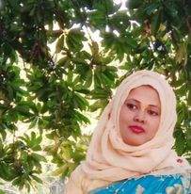
Teacher’s Introduction
Mst.Sharmin Akter
Assistant teacher
Matoin Govt. Primary School
Hajigonj, Chandpur
E-mail:
mstsharminakter1985@gmail.com

Slide 3
Lesson Identity
Class :Four
Subject : English
Lesson : 1-2(A)
Unit:40
Time : 40 min

Slide 4
Learning Outcomes
Student’s will be able to-
Listening:1.1.1-become familiar with English sounds by listening to common English word.
Speaking:1.1.2-say simple words and phrases with proper sounds and stress.
Reading:1.4.1-read words and phrases with the help of visual clause (about 30 new words) and simple sentences.

Slide 5
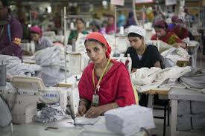
Discuss about the picture and tell me what will be our todays topic ?

Slide 6
Todays lesson topic
A garment’s workers day

Slide 7
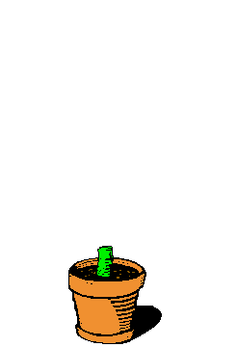
Input

Slide 8
Garment worker
accident
factory
River erosion
younger
money
N
E
W
W
O
R
D
S

Slide 9
Who work in a garment.
Garment worker

Slide 10
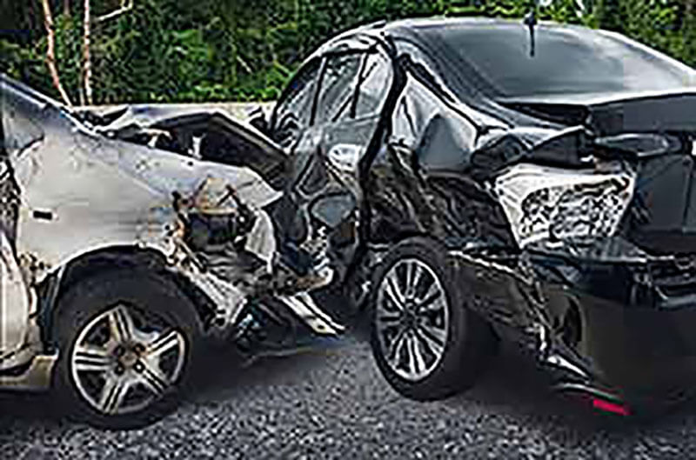
An unfotunate incident by which be damage or injury.
accident

Slide 11
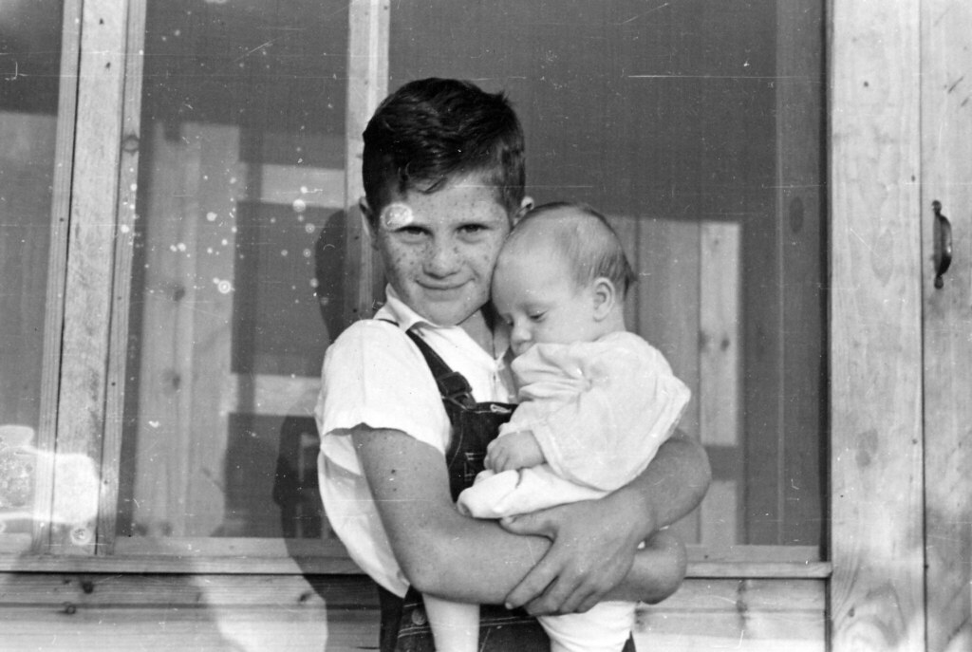
junior
younger

Slide 12
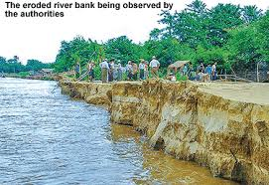
The process eroding by wind, water etc.
River erosion

Slide 13
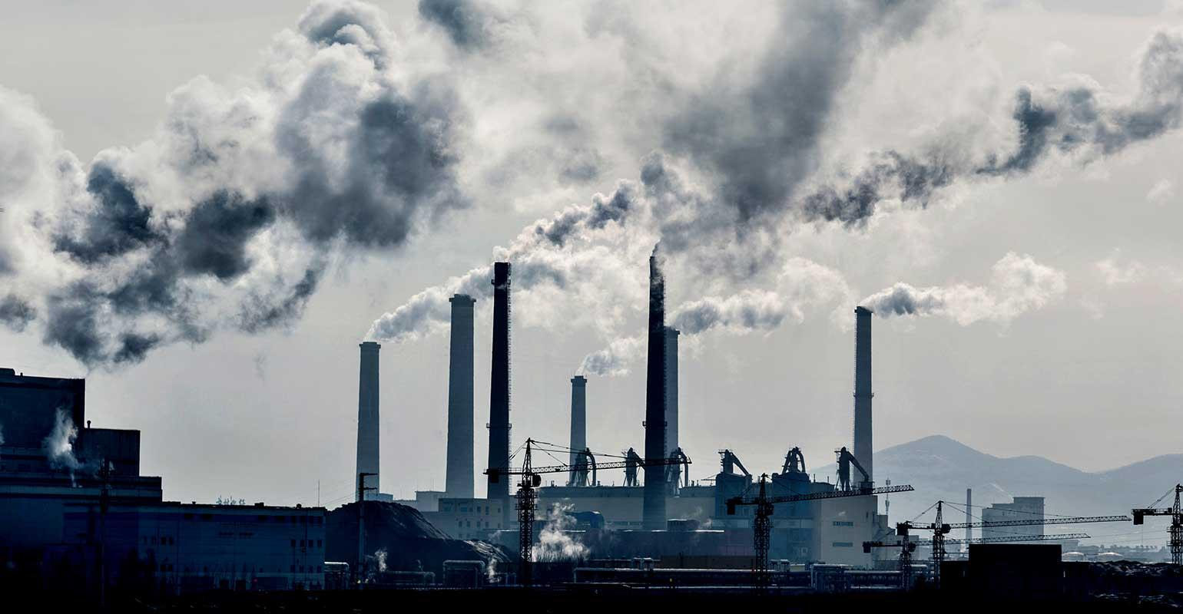
mill
factory

Slide 14
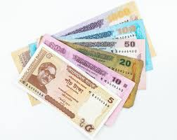
A current medium of exchange in the form of coin and banknotes.
money

Slide 15
Open your book at page 80.

Slide 16
Teacher’s reading

Slide 17
Practice

Slide 18
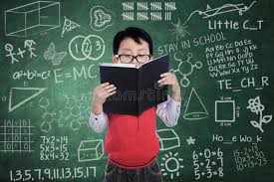
Student`s reading

Slide 19
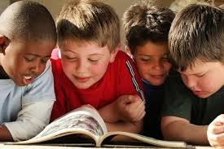
Group reading

Slide 20
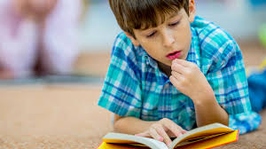
Silent Reading
5 minutes

Slide 21
Questions
1 What is Reshma ?
2.Who did help her ?
3.Who stich Nakshi Katha?
4.How far the factory ?

Slide 22
Answer `s
Reshma is a garment worker.
Her uncle Ratan helped her.
Reshma’s mother stiches Nakshi Katha.
The factory is 2 kilometres from Reshma’s house.

Slide 23
Now we will play “BINGO” game
garment
stich
Work
accident
factory
cinema
erosion
extra

Slide 24
task
Write five sentences about your father’s occupation.

Slide 25
thanks

