Slide 2
Md.Zuel Hossain
Assistant Teacher ( English) Itbaria UCK High School Pukurjana ,Patuakhali.
Email:mdzuelhossain248@gmail.com
Mobile:01728591706

Slide 3
English Second Paper
Unit-9, Lesson-1
Class: Nine /Ten
Time: 50 Minutes
Date:00/00/00

Slide 4
Let’s see some image and texts to guess something.
Notes:
Advance to suspension.

Slide 5
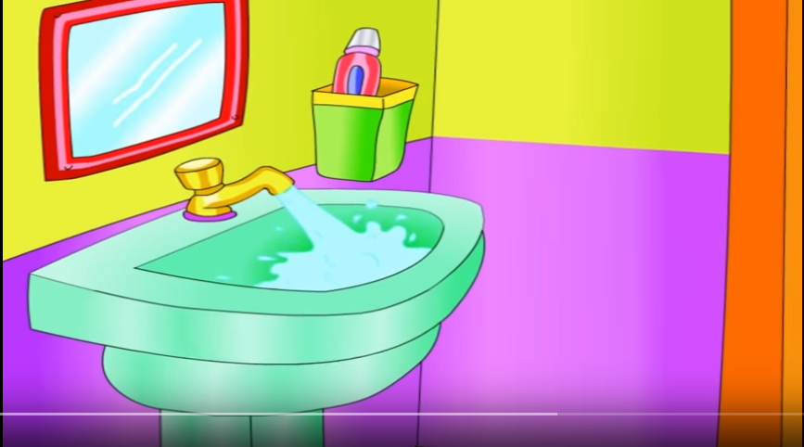
running.
is
The tap
The tap is running.

Slide 6
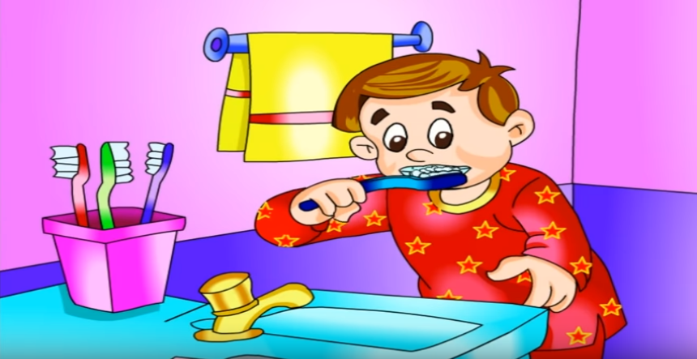
your
teeth .
Brush
Brush your teeth .

Slide 7
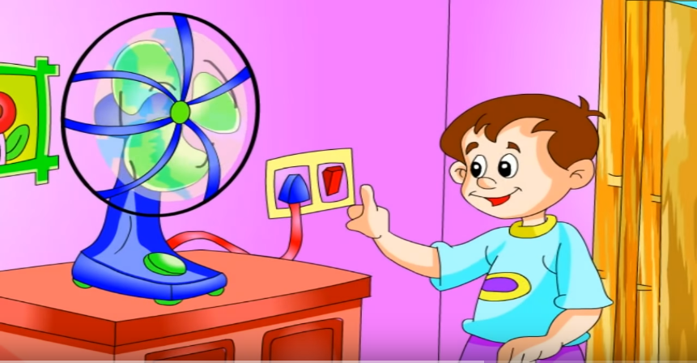
fan.
the
off
Switch
Switch off the fan.

Slide 8
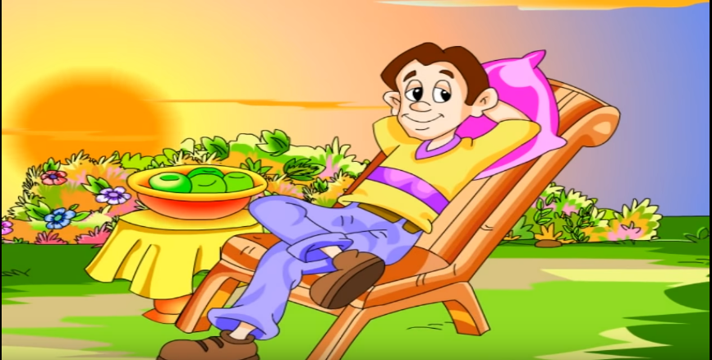
He
rest .
is
taking
He is taking rest .

Slide 9
Can you guess what are we going to discuss today?

Slide 10
Our Today’s lesson is-
Brush your teeth .
He is taking rest .
Switch off the fan.
Sentence
The tap is running.

Slide 11
LEARNING OUTCOMES
By the end of the lesson the students will be able to
Learn the defination of Sentence .
Classify the sentence .
identify the Sentences

Slide 12
What is Sentence ?
A sentence is a word or group of words that must expresses a complete idea or sense or meaning and that may consists of a subject and a verb.
Example: - We practice English everyday. (Here we is subject, practice is verb, English is object and everyday is adverb)

Slide 13
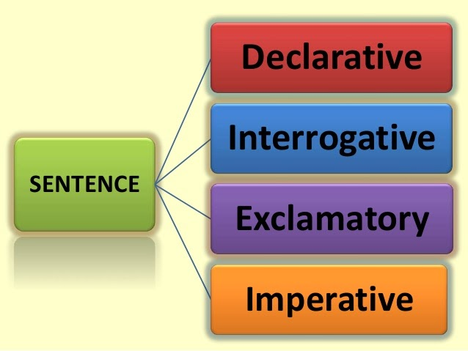
(According to meaning)
Optative

Slide 14
Simple
According to structure
Sentence
Complex
Compound

Slide 15
Open Questions
How many kinds of sentence according to meaning ?
How many kinds of sentence according to structure ?
b) What are they?

Slide 16
The Simple Sentence
A simple sentence has one independent clause and no subordinate clauses.
Look at the examples of simple sentences below. Notice that a simple sentence may have a compound subject (sentence 2) or a compound predicate (sentence 3) or both (sentence 4).
A compound subject consists of two or more connected subjects that have the same verb.
A compound predicate consists of two or more connected verbs that have the same subject.

Slide 17
Look at the examples of simple sentences below.
1.Bangladesh has some beautiful tourist spots.
2 The tea gardens in Sylhet and the forests of the Sundarbans are favourite tourist attractions. (The two parts of the compound subject have the same verb, are.)
3 We planned to go to Syhet but then went to the Sundarbans instead.
4 Paban and Sara brought some bananas and fed the monkeys.

Slide 18
The Complex Sentence
A complex sentence consists of one independent clause and one or more subordinate clauses.
a)We had lunch at the student cafeteria when we visited the college.
b) He gave her a pair of bangles which belonged to his mother.
c)While we walked along the beach, it started raining.

Slide 19
The Compound Sentence
A compound sentence has two or more independent clauses but no subordinate clauses.
The independent clauses are usually joined by some connecting or linking words such as, and, but, or, nor, for, yet, however, therefore, etc. We can also join the independent clauses by using a semicolon.

Slide 20
Some examples of compound sentences:
I like jogging, but I like swimming better.
Razzak graduated last year, and now he works in a private bank.
I wanted to go to the concert, but I didn't get the ticket.
The giraffe has a long neck and long legs, but it is a very graceful animal.
It was a good day for outing; I went cycling in the countryside.

Slide 21
Group work
Group –A
Group-B
a)What is sentence ?
b)How many kinds of
sentences ?
c) What is complex sentence ?Give some example .
a)What is sentence ?
b)What is simple sentence?
c) What is compound sentence ?

Slide 22
Home work
Identify simple, complex and compound sentences from the following text:(a) Once there lived an old king. (b}) He had much wealth and he was happy. (c) At the same time he had much curiosity to acquire knowledge and information. (d) He wanted to acquire knowledge on different subjects so that he could apply them in his personal life. (e) He asked his chief minister to invite the scholars of his country. (f) When all the scholars came to his court, he told them to provide him books on all sources of knowledge. (g) The scholars were happy and they went to collect. (h) Ten years later the scholars came back with 5000 books. (i) When the king saw all these books, he was overwhelmed. (i) He told them to get the books return and reduce the numbers

