Slide 1
Welcome to the learners

Slide 2
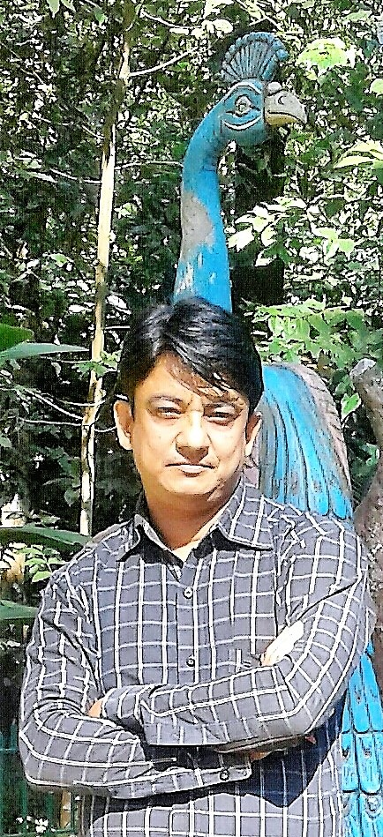
Teacher’s identity
Md. Safiqur Rahman
Asst. Head teacher
Raipura Pilot Girls High School

Slide 3
Which one is the oldest
The national memorial
The shatgambuj Mosque
A museum
Power station

Slide 4
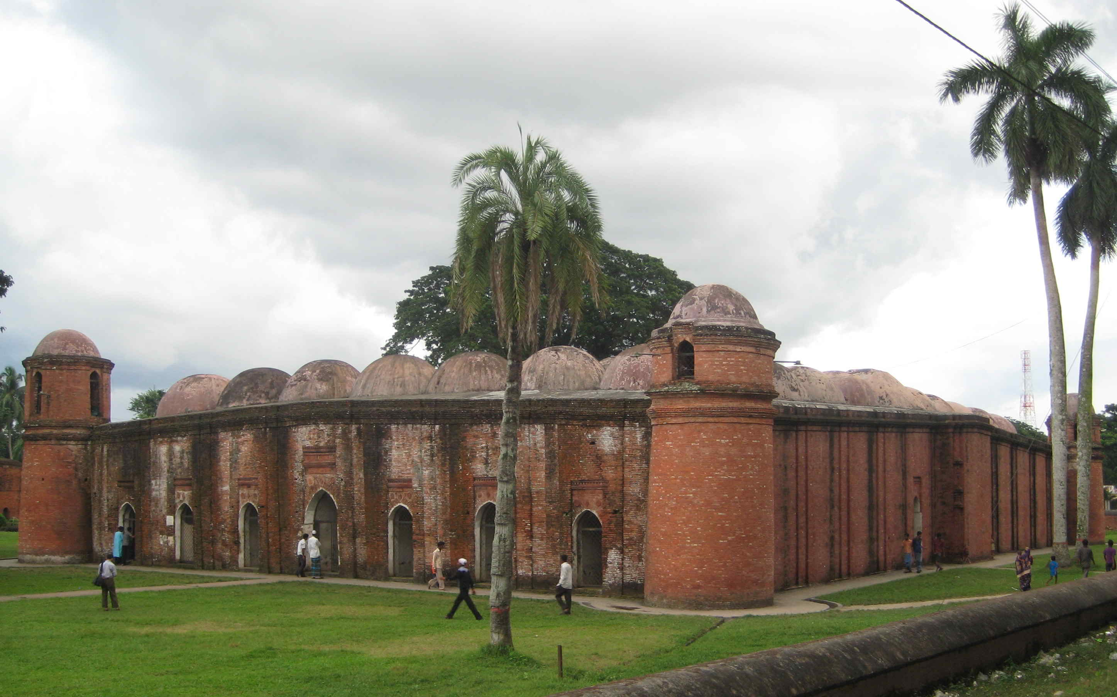
Today’s Lesson is-------------

Slide 5
Learning outcomes
Introducing new words
Asking question
Getting ideas about “Shat Gombuj Mosque”
Reading skill
Writing skill

Slide 6
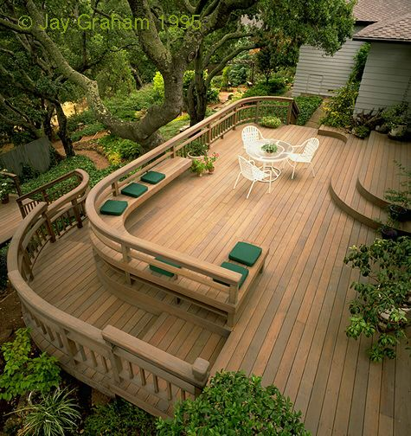
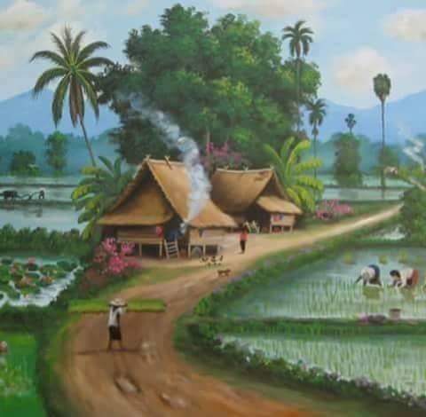
Let us go with some new words
Internal
Interior
Corridor
Path

Slide 7
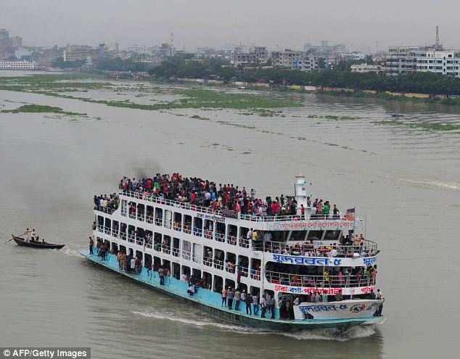
Outskirts
The outer parts of a town or city.
Meaning
The Buriganga river is at the outskirts of Dhaka city.

Slide 8
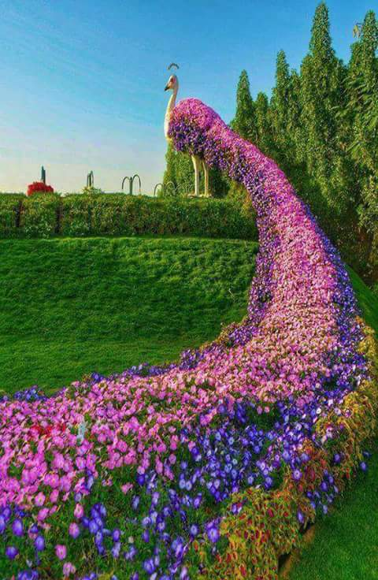
Remarkable
Meaning
Worthy of attention
The garden is very remarkable for its various colourful flowers.

Slide 9
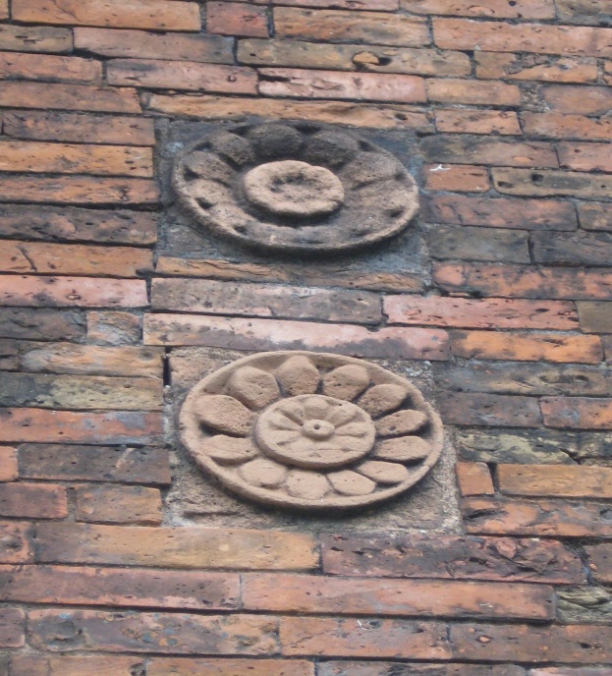
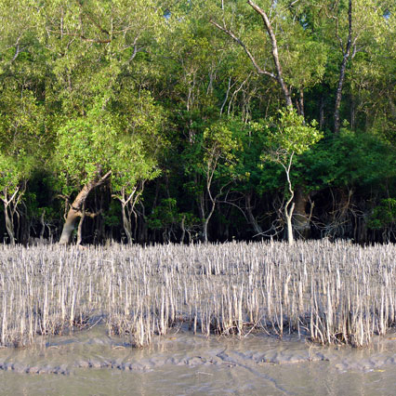
TERRACOTTA
Poramati
Mangrove
A tree or shrub that grows in wet mud at the edge of river

Slide 10
INDIVIDUAL WORK
1.Who founded the Shat Gombuj Mosque and when?
How many domes have Shat Gombuj Mosque?
How many mosque had in the city?
In what purpose the mosque was used?
What was the past name of Bagerhat?

Slide 11
Read the text again and fill the table . [pair work]
Who/What | Event/Activities | When/Why
The Shat Gombuj Mosque | a) …………….. | in 1985
It | was founded | b) ………………
Khan Jahan Ali | c) ……………... | to fit the city to live in.
The mosque | is unique | d) ….………….
It | e) ……………… | for its architectural beauties.
a) became a UNESCO World Heritage Site
b) in the 15th century.
c) built a networks of roads, bridges, public buildings and reservoirs
d) for its 60 pillars that supports the roof with 77 low height domes.
e) attracts the tourists

Slide 12
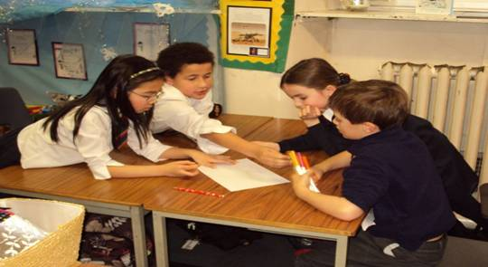
Read the text again and fill the table given in the textbook.
Group work
Shat Gambuj Mosque | Information
Founded by | ----------------
When | -----------------
Number of domes | --------------------
Number of pillars | ---------------------------
Arches | --------------------
Thickness of the arches | --------------------------
Mihrabs | -----------------------------

Slide 13
Evaluation
Q 1. Why is the Shat Gombuj Mosque a world heritage?
Q 2. How are the decorations of the mosque?
Q 3. Why were there many doorways in the mosque?
Q 4. For what purpose was the mosque used?

Slide 14
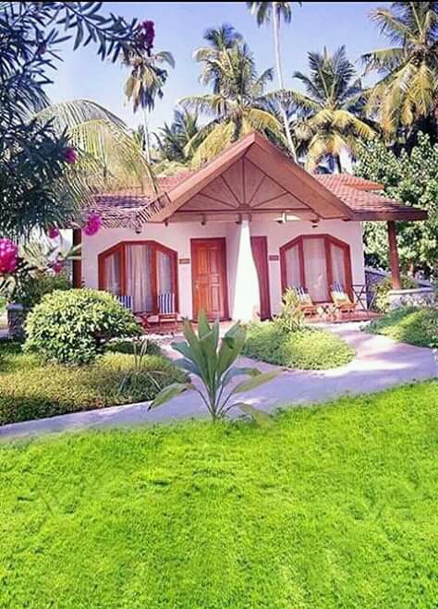
Homework
Write a paragraph on “Shat Gombuj Mosque”

Slide 15
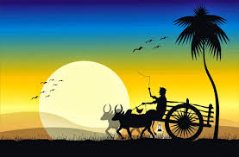
Thanks all

