Slide 1

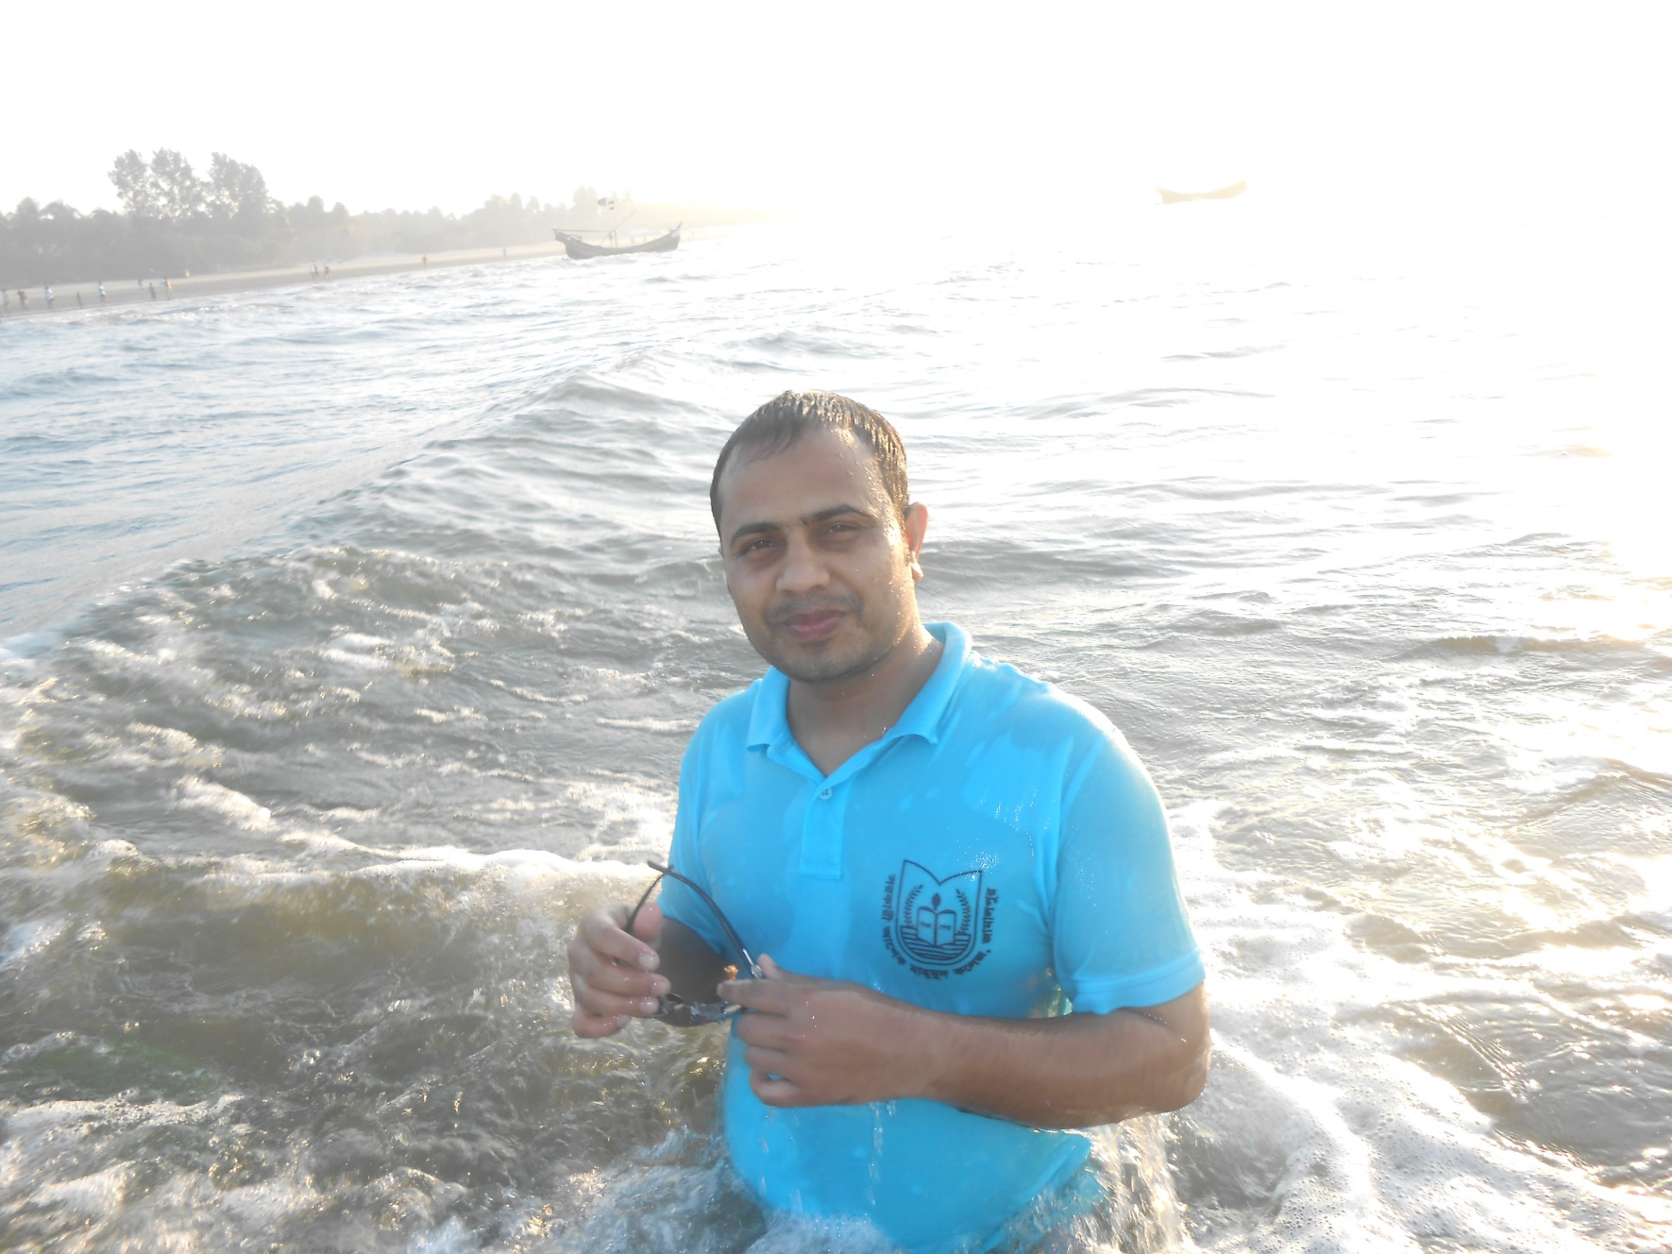
Welcome To Online Class
Presented by Ahsan Uddin
Sub: English Second Paper
Topic: Voice Part-2

Slide 2

Learning Outcome
By the end of the lesson the SS will be able to
Know the structures of Active & Passive Voice.
illustrate examples of Assertive Voice.
practise Voice of Indefinite, Continuous & Perfect tenses.

Slide 3

Voice (Assertive Sentence)
1. Present Indefinite
Structure: Active voice: Sub + V1 + Obj.
Passive voice: Obj+ am /is/are +V3 +..................... + by +Sub.
Ex: The principal teaches us English.
P.V: We are taught English by the principal.

Slide 4

Voice (Assertive)
2. Past Indefinite:
Structure: Active voice: Sub+V2+Obj
Passive voice: Obj+was/were+V3 +............. + by+Sub.
Ex- A.V: I called him a fool.
P.V: He was called a fool by me.

Slide 5

Voice(Assertive)
3. Future Indefinite:
Structure: Active voice: Sub+ shall/will+V1+Obj.
Passive voice: Obj+shall/will+be+V3 +............. + by+Sub.
Ex- A.V: Father will sign a deed.
P.V: A deed will be signed by father.

Slide 6

Voice (Assertive)
4. Present Continuous:
Structure: Active voice: Sub + am /is/ are +V1 +ing +obj.
Passive voice: Obj+ am /is /are + being +V3 +.................. + by +sub.
Ex: A.V: We are digging a cannel.
P.V: A cannel is being dug by us.

Slide 7

Voice (Assertive)
5. Past Continuous:
Structure: Active voice: Sub+ was/were+V1+ing+Obj.
Passive voice: Obj+was/were+being+V3 +............. + by+Sub.
Ex- A.V: We were doing the work.
P.V: The work was being done by us.

Slide 8

Voice(Assertive)
6. Future Continuous:
Structure: Active voice: Sub+ shall/will+be+V1+ing+Obj.
Passive voice: Obj+shall/will+be+being+V3 +............. + by+Sub.
Ex- A.V: Father will be signing a deed.
P.V: A deed will be being signed by father.

Slide 9

Voice (Assertive)
7. Present Perfect:
Structure: Active voice: Sub+ have/ has +V3+ Obj.
Passive voice: Obj+have / has+been+V3 +............. + by+Sub.
Ex: He has done the work.
P.V: The work has been done by him.

Slide 10

Voice (Assertive)
8. Past Perfect:
Structure: Active voice: Sub+ had+V3+Obj.
Passive voice: Obj+had+been+V3 +............. + by+Sub.
Ex- A.V: They had done the hard work.
P.V: The hard work had been done by them.

Slide 11

Voice (Assertive)
9. Future Perfect:
Structure: Active voice: Sub+ shall/will+have+V3+Obj.
Passive voice: Obj+shall/will+have+been+V3 +............. + by+Sub.
Ex- A.V: Father will have signed a deed.
P.V: A deed will have been signed by father.

Slide 12

Bye, See you next week
Work hard and be able to touch your dream.

