Slide 1
Welcome to the Class

Slide 2
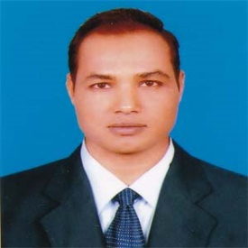
Introduction
Md. Mizanur Rahman
B.A. (Hons.), M.A. English, B. Ed.
Assistant Teacher
Police Lines School and College, Pabna.
Mobile no: 01737979719
Email:mizanplsc@gmail.com
Class : Six
Subject : English 1st paper
Lesson: Twenty One
Lesson Title : Hason Raja: The mystic bard of Bangladesh
Time : 40 Minutes
Date : 19/11 /2020

Slide 3
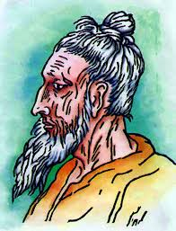
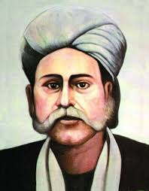
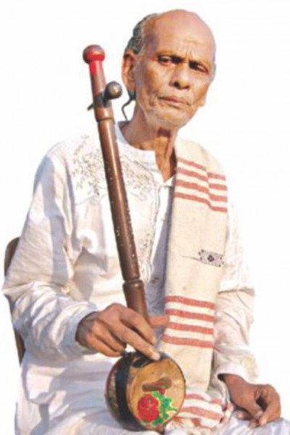
A. Look at the picture
What do you see in the pictures?

Slide 4
Today’s Lesson
Hason Raja: The mystic bard of Bangladesh

Slide 5
Learning Outcomes
At the end of the lesson, the students will be able to:
read and understand text .
write the answer of the questions
Practise reading the passage loudly giving proper attention to pronunciation, pause and intonation.

Slide 6
Key Words presentation
adjective
Word: mystic
Meaning: A person who believes in the spiritual apprehension of truths that are beyond the intellect.
Synonym: spiritual
Example: Hason Raja is one of the mystic birds of Bangladesh.

Slide 7
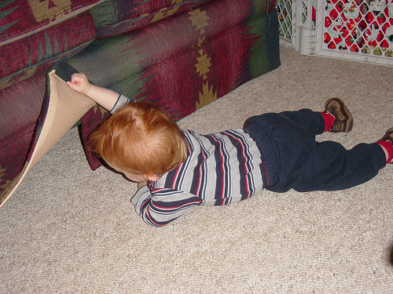
Word: Search
Verb
Synonym: seek
Meaning: try to find something by looking or otherwise seeking carefully and thoroughly
Example: The boy is searching something.

Slide 8
Word: meditation
Noun
Synonym: contemplation
Meaning: the action or practice of meditating.
Example: She is in deep meditation.

Slide 9
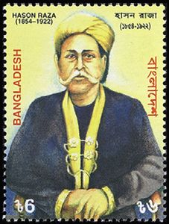
Word: Landlord
Noun
Synonym: landowner, overlord
Meaning: a person or organization that owns a building or an area of land and is paid by other people for the use of it.
Example: Hason Raja was born in a Land lord family.

Slide 10
B. Today you will read about the mystic poet Hason Raja. Read the text:
The above pictures are of the three well – known mystic bards of Bangladesh. They are famous in Bangladesh and in other countries too. They are Lalon Shah, Hason Raja and Sha Abdul Karim.
A bard is one who writes poems and songs. And a mystic is one who tries to search the Truth and become united with God through prayer and meditation . All there bards wrote poems and songs to express their deep thoughts and feelings about God, life and love for man.

Slide 11
Hason Raja was born in 1854 in a wealthy landlord’s family in Sylhet.
He did not receive much formal education. In his youth, he led a life of luxury.
He had everything- money , comfort and pleasure. At one time he understood that all these are meaningless. He gave away all of his properties. He started to think deeply about the Creator, about life, death and mankind. Hason Raja wrote a lot of songs, perhaps about a thousand in number

Slide 12
His book called ‘Hason Udash’ was published in 1906. The book had 206 songs in it. In his songs Hason called himself ‘Crazy Hason Raja’ or the ‘Pagla Hason Raja’. A volume called ‘Hason Raja Samargra’ (Complete Works of Hason Raja) was also published. The book contained 500 poems and songs. Some of the songs were written by the poet in Hindi.
Hason Raja’s songs were always popular in Sylhet. But very soon they spread all over Bangladesh and beyond. In India’s West Bengal, some eminent folk singers made Hason’s songs popular. When you grow older, you will learn more about this great mystic poet through reading and listening to his songs.

Slide 13
Individual work
B1: Practise reading the passage loudly giving proper attention to pronunciation, pause and intonation.
Individually the students will read the text fo;;owing all items.

Slide 14
B2: Pair works
Answer the following questions:
When was Hason Raja born?
Where did he come from?
c. What was his childhood like?
Ans: Hason Raja was born in 1854.
Ans: He came from Sylhet.
Ans: He led a life of luxury in his childhood. He did not lack anything- money, comfort and pleasure.

Slide 15
Group Work
B3: Learn the meanings of the words:
Comfort:
Luxury:
Pleasure:
Volume:
Contain:
Eminent:

Slide 16
Evaluation
Choose the correct answer to each question from the alternatives given and write the corresponding number of the answers in your answer script.
a. Hason Raja was born in in a wealthy landlord’s family in Sylhet. Here the word “wealthy” is similar to
Humble ii. modest iii. Poor iv. Well – off
b. He did not receive much formal education. Here ‘formal’ means
Institutional ii) unconventional
iii) Casual iv. Informal

Slide 17
c. Hasan Raja was born in
A poor family ii. An insolvent family
iii) An affluent family iv. A needy family
d. He did not have want of
Pleasure ii. Anything
iii. Money iv. Comfort
e. A time came when he understood that joy, pleasure and comfort were
Valuable ii. Precious
iii. Worthless iv. meaningful

Slide 18
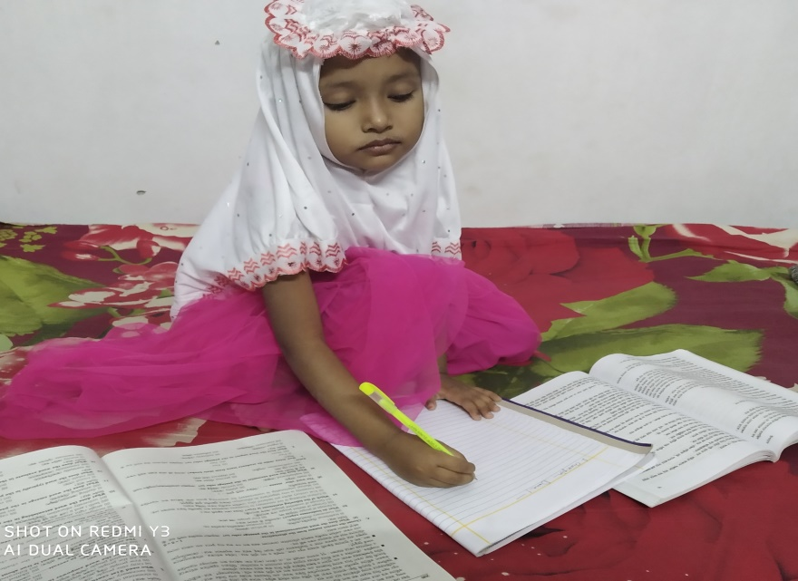
Home Work
Write ten sentence about Hason Raj on your own words

Slide 19
Thanks to all
See you again in the next class.

