Slide 1
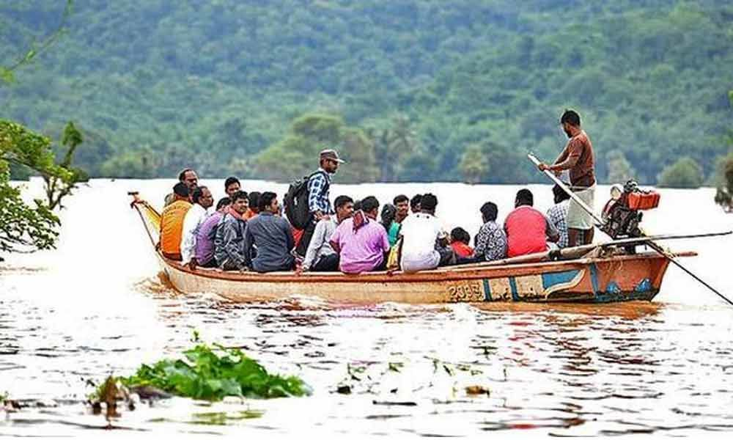
Welcome

Slide 2
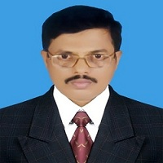
Md. Saiful Islam Chowdhury
Senior Teacher
C. J. M High School,
Mohara , Chandgaon , Chattogram.
saifulcjm@gmail.com Mob: 01991945882
ENGLISH FOR TODAY
Class : Nine-Ten
Unit-Four, Lesson-1
Time: 40 minute

Slide 3
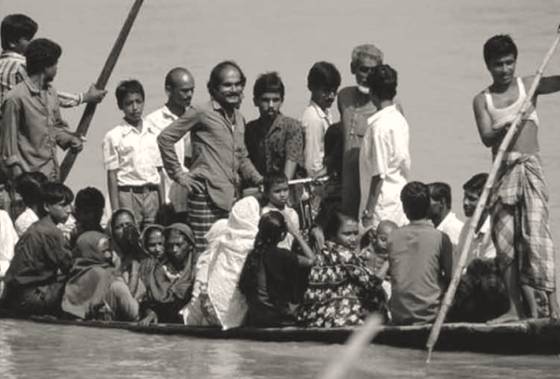
Look at the picture
Where can you find this kind of boat ?
Whey does the boatman carry passengers across the river ?
Why do people use country boats ?

Slide 4
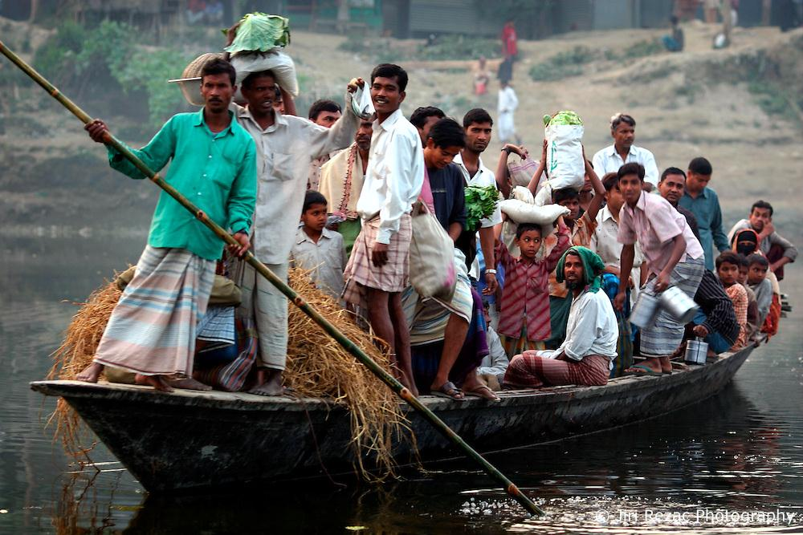
Today our Lesson is
The ferry boat
Unit-Four, Lesson – One

Slide 5
Learning outcomes
After completing the Lesson students will be able to –
1. Read and understand texts through silent reading;
2. Ask and tell about problem;
3. Seek and give suggestions;
4. Listen for specific information;
5. Narrate something in writing .

Slide 6
Listen the text attentively.
Teacher’s Model reading.
“Is there anybody here who has ever crossed a river by a country boat?’
“I have, teacher,” said Jamil. “And I clearly remember what happened in that journey.”
“Would you please tell us what happened?” the teacher asked.
“Okay, teacher. It happened when I was in class 6. On a weekly bazar day, people were coming back with their shopping bags and baskets in hands, on shoulders and heads. They had to cross the river. It was not a big river. There was a ferry boat plying on the river. The boat could cross it in 8-10 minutes. It was just after sunset. The weather was getting bad. The wind started blowing from the north-west. Black clouds were moving fast in the sky . Everybody was trying to get into the boat. ‘No more, no more, please wait.’ shouted the boatman. But nobody listened to him.”
“What happened then, Jamil?” asked Rumi. “With too many people on board, the boat sank in the middle of the river,” replied Jamil. “Oh no! What happened then?” asked the teacher. “Thank God. There were no casualties. All the passengers swam to the other side. But some of them lost the stuff they were carrying such as oil, salt and milk,” said Jamil.“Were you on you boat?” asked the teacher. “No, teacher. Seeing the boat overcrowded, I waited for the next trip,” replied Jamil. “You did the right thing, Jamil.”

Slide 7
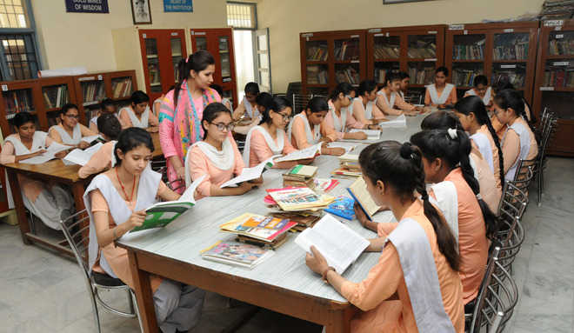
Student’s Model reading.
Go to the section “B” and start silent reading.

Slide 8
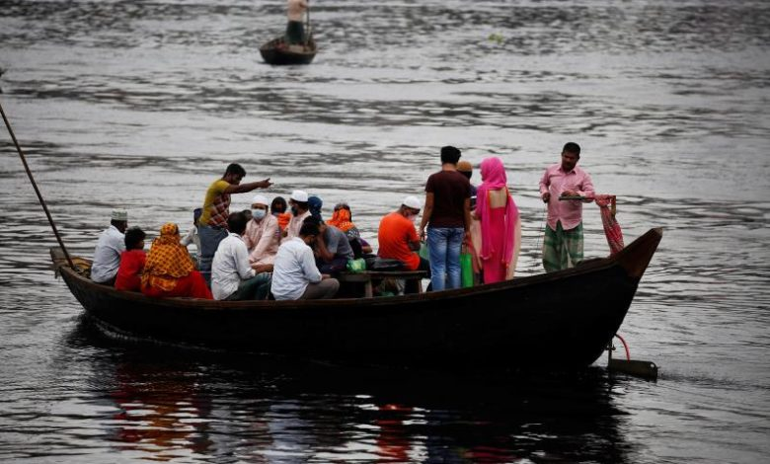
Vocabulary
Key word
Clearly
Meaning:
Undoubtedly
I clearly remember what happened in that journey.

Slide 9
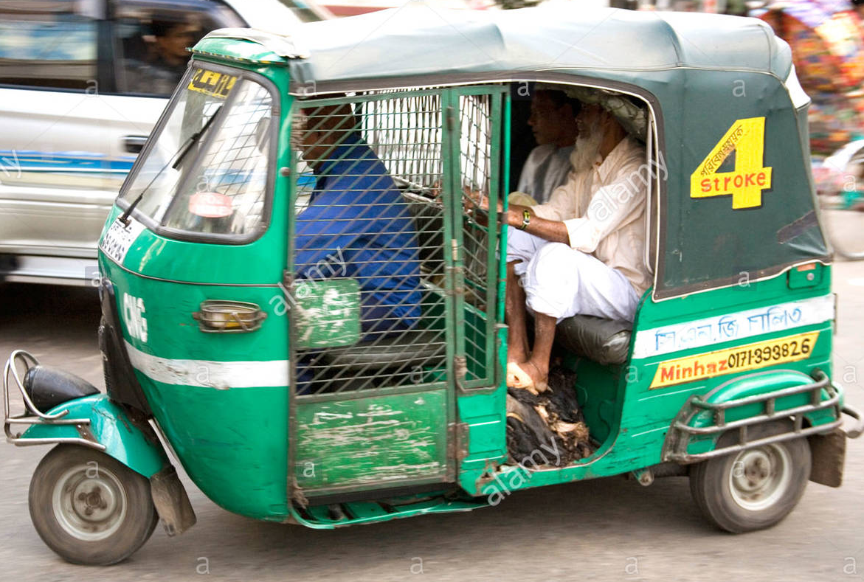
Vocabulary
Key word
Passenger
Meaning:
Traveller
There are two passengers in the taxi.

Slide 10
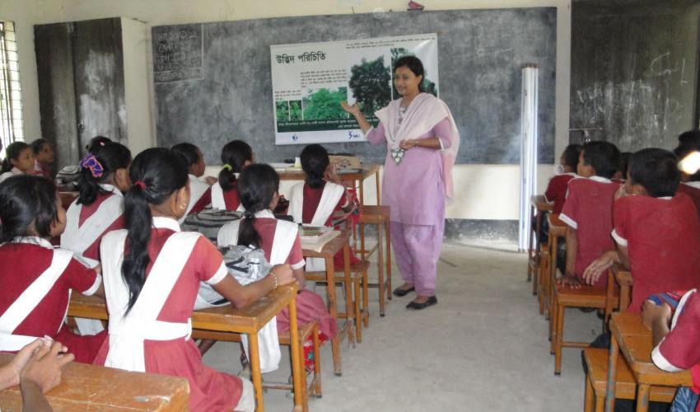
Vocabulary
Key word
Listen
Meaning:
Pay attention
Students are listening to their teacher’s speech.

Slide 11
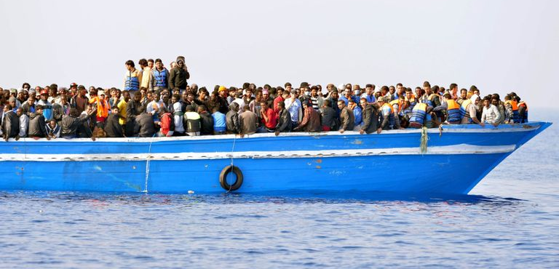
Vocabulary
Key word
Overcrowded
Meaning:
Populous
Being overcrowded the boat sank in the middle of the river.

Slide 12
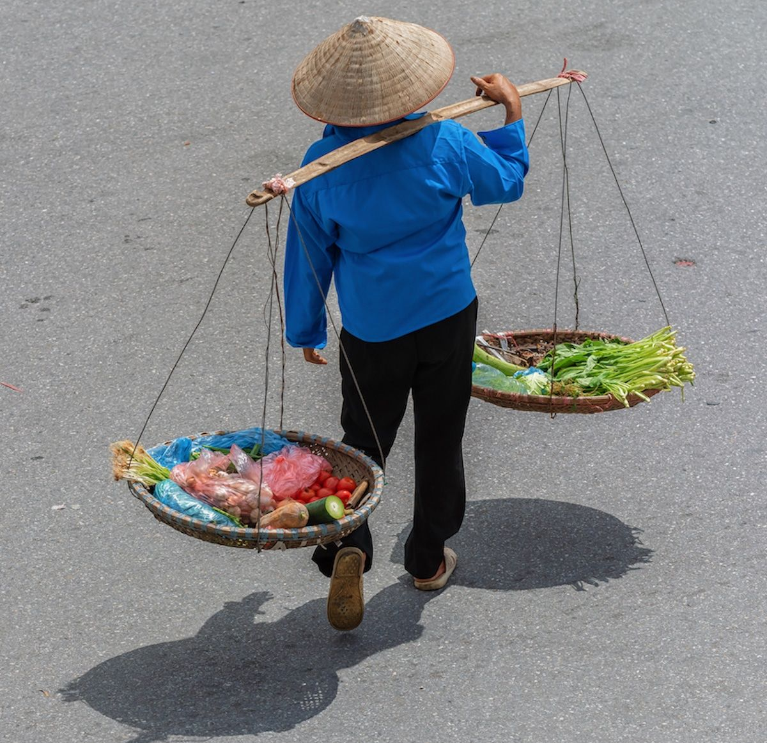
Vocabulary
Key word
Shoulder
Meaning:
A organ of human body
Street hawkers often carry their bags on shoulder.

Slide 13
Choose the correct answer from the alternative.
Individual work
1.A ferry boat was playing on the river . Here plying means-
Playing with other boats.
Sinking in the river.
Travelling along a route.
Waiting for passengers.
2.Why was everybody trying to get into the boat ?
It was weekly bazar day.
After sunset no ferry would ply on the river.
Everybody had shopping bags with them.
It was going to be a dark and stormy evening.

Slide 14
Choose the correct answer from the alternative.
3.The boatman requested the people to wait, because….
His boat was very small.
The boat had already too many people.
There were other boats they could take.
He would not ferry people with bags and baskets.
4.”With too many people on board , the boat sank ….”
On the boat.
On the wooden board.
Outside the boat.
On the notice board.

Slide 15
Choose the correct answer from the alternative.
5. There were no casualties. The statement tells us that-
Nobody died.
Nobody was rescued.
Nobody accepted their fate.
Nobody lost anything.
6. The boat was overcrowded. Here ‘overcrowded’ means -
People were quarrelling on the boat.
The boat was unable to carry any more people.
The boatman did not like a crowd.
People were sitting on the boat`s bamboo hood.

Slide 16
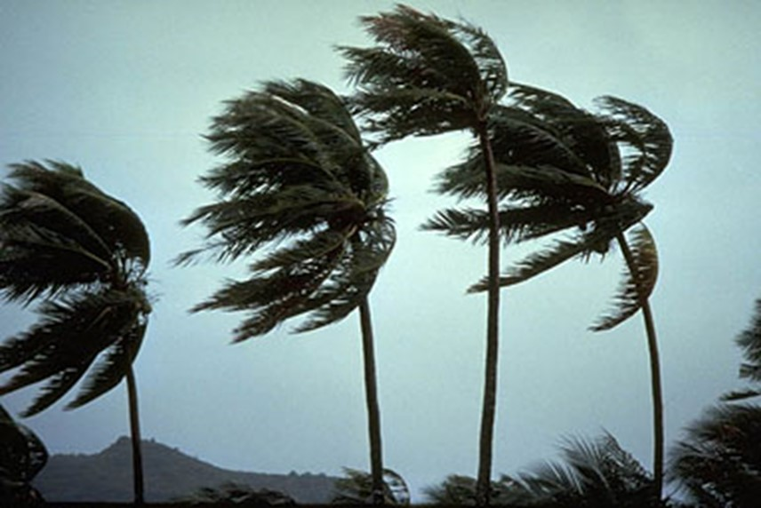
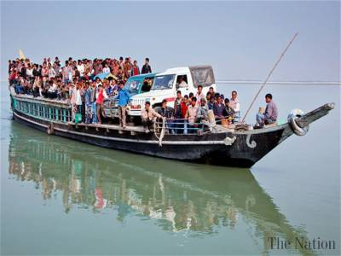
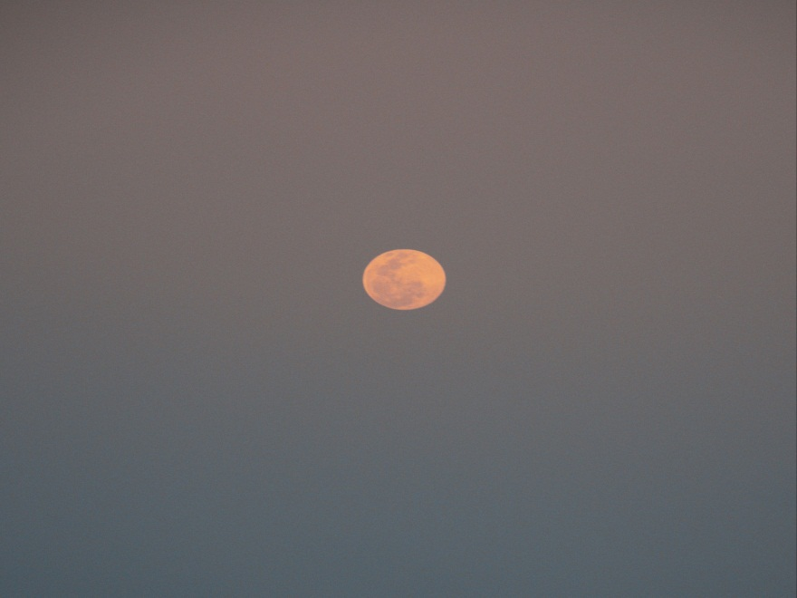
Look at the pictures
Individual/pair work
a) Why did many people have little or no patience when the ferry boat was in danger of sinking ?
b) ‘ No more , No more , please wait ‘ Who said this? Explain in 2/3 sentence.
b) Ans. When all the people tried to get into the boat, the boatman shouted‘ No more , No more , please wait ‘. He shouted because his boat could not hold all the passengers at a time.Moreover, the wind was blowing roughly . Actually , he was afraid that the boat might sink.
a)Ans. It may be that they were in hurry or may be they became afraid of such critical situation .

Slide 17
Read the passage carefully and answer the following questions.
1. Why were the people making hurry to cross the river?
2.What happened to the passengers in the ferry boat ?
Group Work.
3. Do you think that Jamil’s decision was right ? Why?
4. In what way does the text render us a message?
5. How can we say that Jamil is a wise boy?

Slide 18
Compare with your answer
1. As the weather was getting bad, the people were making a hurry to cross the river.
2.The boat was overcrowded it sank in the middle of the river .But no passenger died. They swam to the other side of the river.
3. Yes. I think that Jamil’s decision was right .He saw that the boat was over crowded . He thought that life is more valuable than time. So he didn’t get into the boat.
4. The text renders us a message in the way that Jamil could escape the boat-capsize only because he did not get into the over crowded boat and waited for the next trip. In case, a vehicle is overcrowded ,it is likely to cause a massive accident.
5. We can say that Jamil is a wise boy because he decided to wait for the next trip instead of getting into the boat , which had already been overcrowded. He did not take any risk. He set an example of wisdom.

Slide 19
Fill in the blanks with the correct words
trip
survive
overcrowded
lost
fatal
Many of us have a tendency to get into a boat (a) ………………with passengers. This result in (b) ………… consequences. Such is the story of Jamil. In this story, the victims of the boat sinking manage to (c)…………….. However some of them (d) ………… possessions as well. Jamil witnessed the disastrous event from the bank of the river while waiting for the following (e) ……….

Slide 20
Evaluation
1. If we have too many buyers of fish in the market ,what will likely happen ?
If there are too many buyers in the fish market ,the sellers may raise the price of the fishes . The rich people will compete with each other , whereas, the poor will get nothing.
2.If we have too many passengers at a bus or train station, what may happen ?
If we have too many passengers at a bus or train station, it will become crowded and noisy. Again, accident may occur there.
3. If we have too many people in a village/town what will happen ?
If we have too many people in a village/town ,housing problem will arise. The cultivable lands will be occupied for housing . The environment will become uncomfortable.

Slide 21
Home Work
Write a paragraph with in ten sentences about The ferry accident.

Slide 22
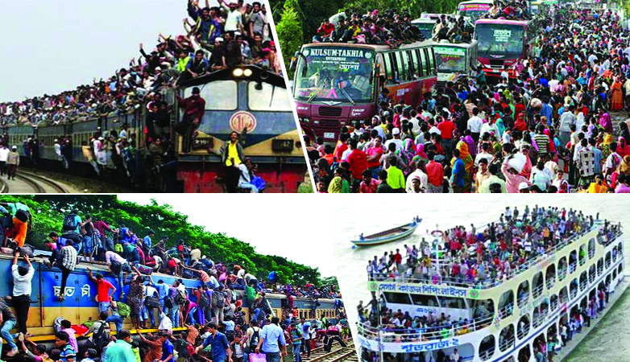
Life is more valuable than time ..
Thank you all

