Slide 1
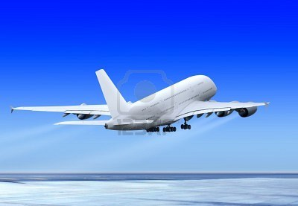
Wel come

Slide 2
Introduction
Md. Abdur Rokib
Assistant Teacher
Chatrajitpur Govt. primary school
Shibganj, Chapainawabganj

Slide 3
Class: One
Subject: English
Lesson unit:2
Todays lesson : READ A…H.

Slide 4
Learling out comes
Students will be able to
Read A………….H.

Slide 5
A

Slide 6
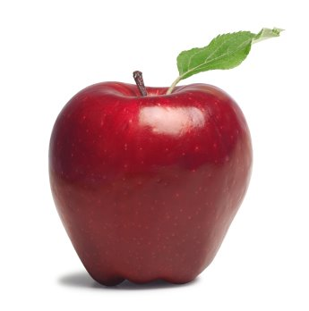
APPLE

Slide 7
a

Slide 8
apple

Slide 9
B

Slide 10
BALL

Slide 11
b

Slide 12
ball

Slide 13
C

Slide 14
CAP

Slide 15
c

Slide 16
cap

Slide 17
D

Slide 18
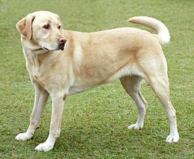
DOG

Slide 19
d

Slide 20
dog

Slide 21
E

Slide 22
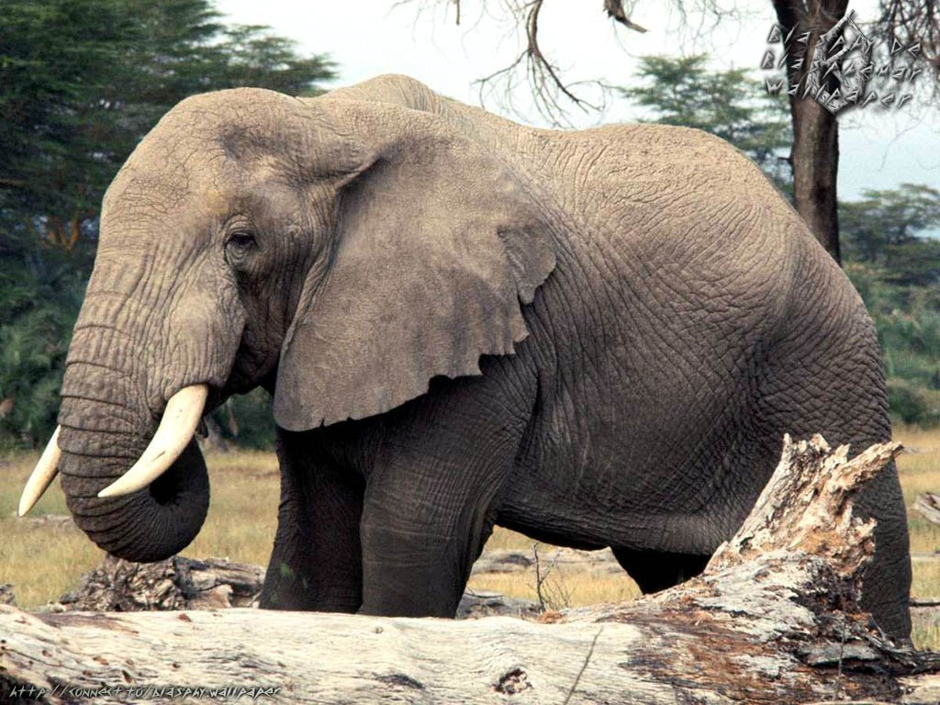
ELEPHANT

Slide 23
e

Slide 24
elephant

Slide 25
F

Slide 26
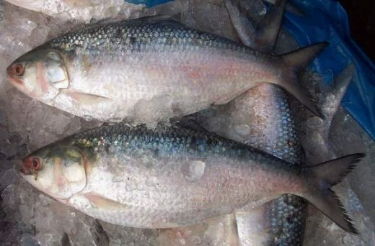
FISH

Slide 27
f

Slide 28
fish

Slide 29
G

Slide 30
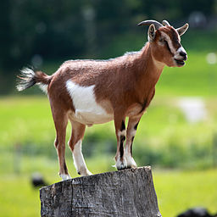
GOAT

Slide 31
g

Slide 32
goat

Slide 33
H

Slide 34
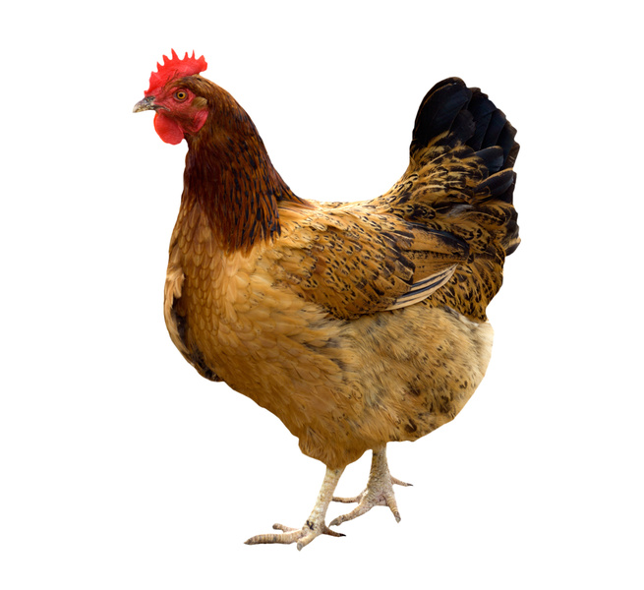
HEN

Slide 35
h

Slide 36
hen

Slide 37
match
a
b
c
d
e
f
g
h

Slide 38
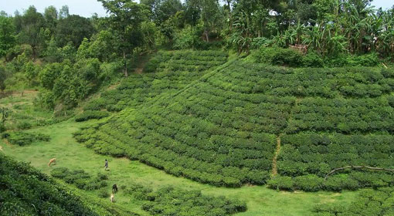
Evaluation
Oral and write

Slide 39
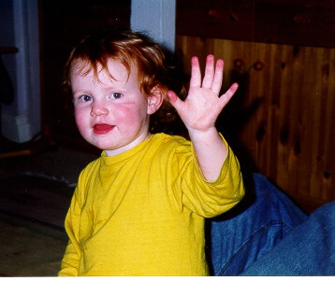
Good bye

