Slide 1
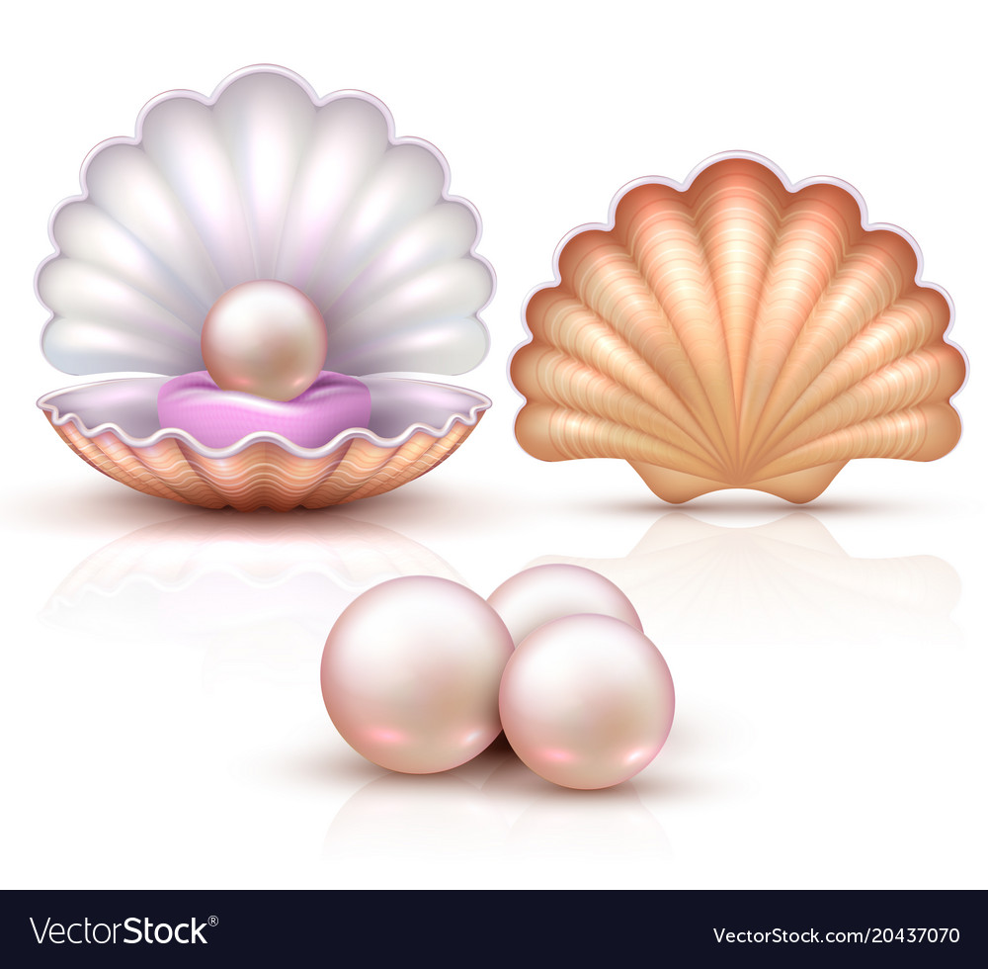
Welcome

Slide 2
LAUDOBE BADAMTALA HIGH SCHOOL

Slide 3
Learning Outcomes
After this lesson the students will be able to-
1. read and enjoy text through silent reading.
2. infer meaning from the text.
3. mention some information.
4. ask and answer questions.

Slide 4
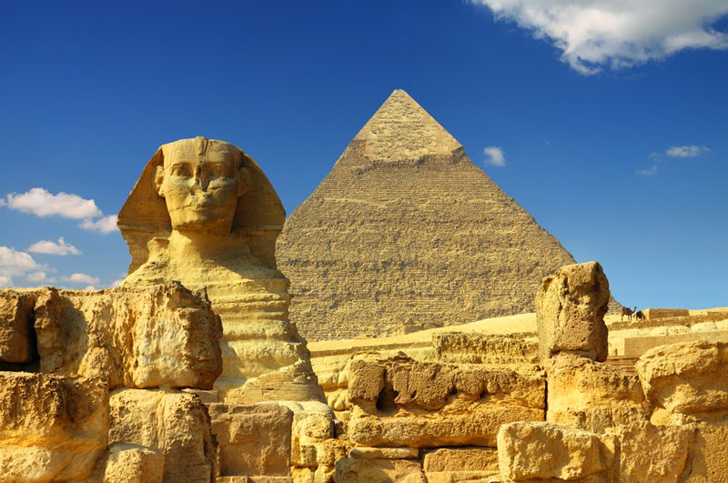
Ancient
Meaning: Olden, Primeval, Age-old, Earliest

Slide 5
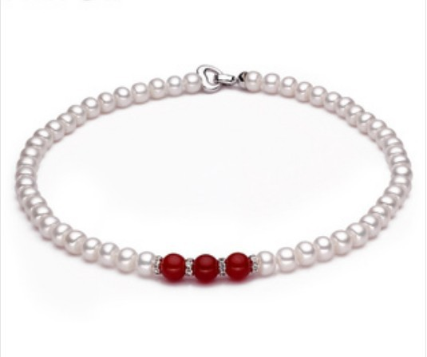
Unparalleled
Meaning: Supreme, Unmatched, Incomparable

Slide 6
Let’s read the text.

Slide 7
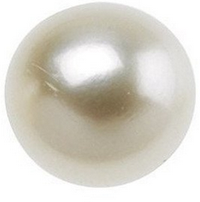
Thousands of years ago, the first pearl was probably discovered while human beings were searching for food at the sea shore. Throughout history, the pearl with its shine has been one of the most highly valued gems.

Slide 8
Pearls have been mentioned many times in religious texts and mythologies from the earliest times.

Slide 9
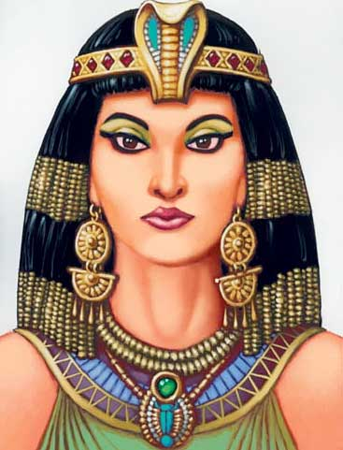
The ancient Egyptians valued pearls so much that they were buried with them. It is said that, the famous queen of Egypt Cleopatra would dissolve a pearl in a glass and drink it as a sign of love and respect for the entire nation.

Slide 10
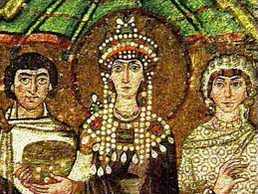
The Greeks thought the pearls as a sign of wealth and social position. The beauty of pearls was associated with love and marriage.

Slide 11
In ancient Rome, pearls were considered the greatest sign of wealth and social status. At that time the young women of noble families loved to wear beautiful pearl necklaces.

Slide 12
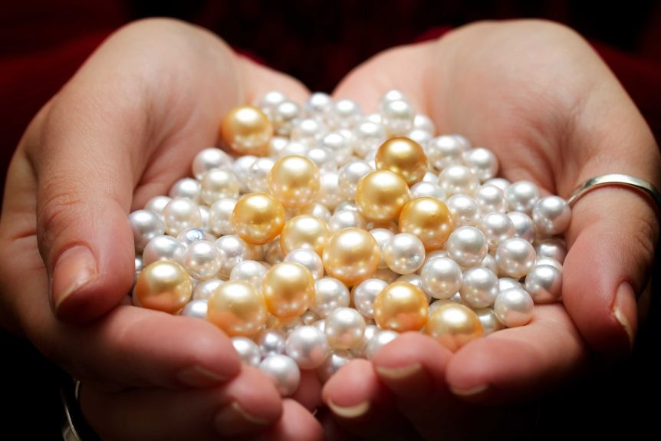
Thank You

