Slide 1
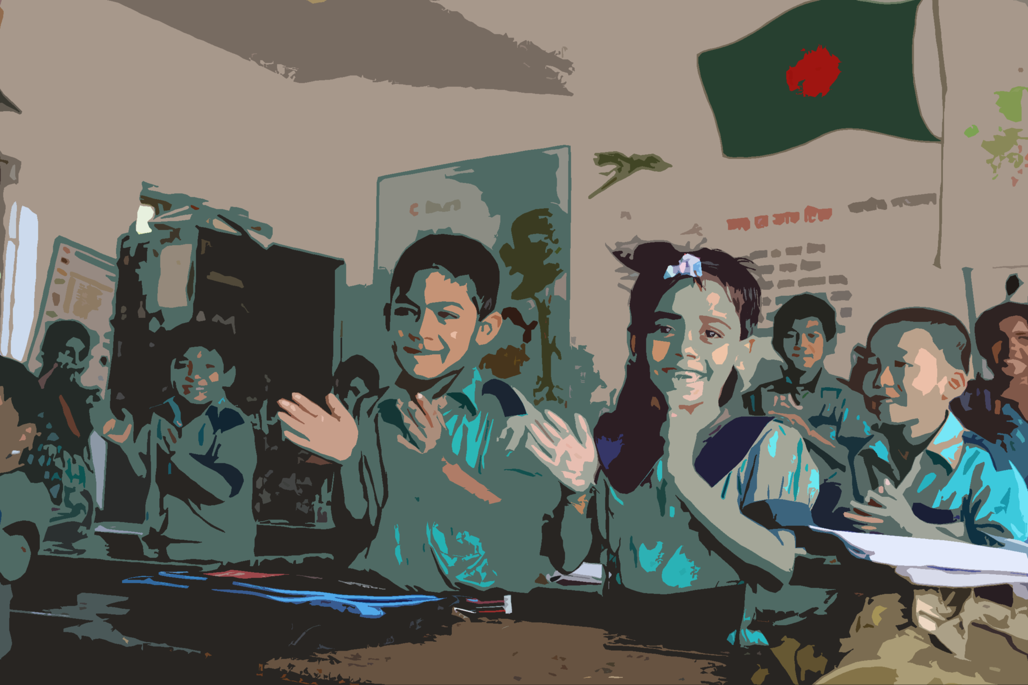
Welcome
to my dear students

Slide 2
Class: Two
Subject: English
Time: 40 Min.
Muhammad Abdul Muhaimin
Assistant Teacher
Chhakapan Govt. Primary School
Kulaura,Moulvibazar.

Slide 3
Unit-24
Lesson-1

Slide 4
students will be able to-
Listening 1.1.1- become familiar with English sounds listening to common English words..
Speaking1.1.1-repeat after the teacher simple words a phrase with proper sounds and stress.

Slide 5
Let’s watch a picture.

Slide 6
Animals

Slide 7
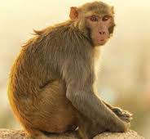
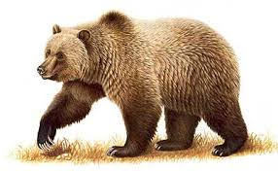
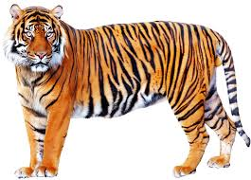
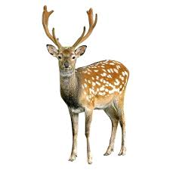
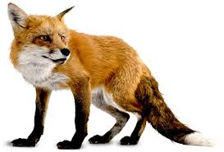
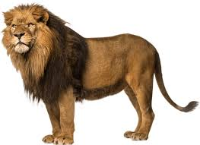
Look and listen
bear
monkey
tiger
deer
fox
lion

Slide 8
Matching
deer
bear
monkey
fox
lion
tiger

Slide 9
Checking learning

Slide 10
bear
tiger
fox
lion
monkey
deer

