Slide 1
Welcome

Slide 2
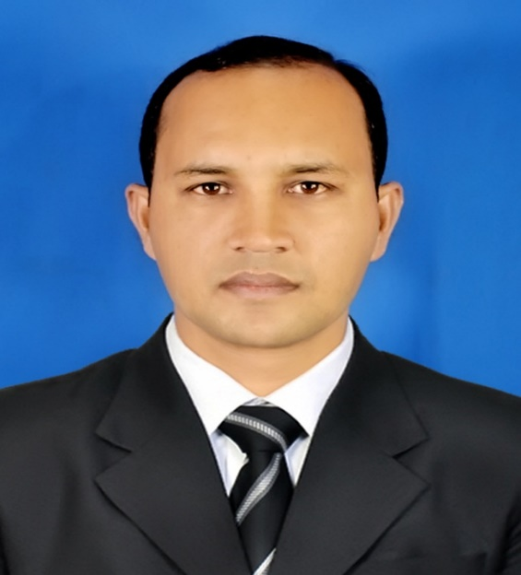
Teacher Identity
Mofiz Uddin Ahamed
Assistant Teacher
Dakhin Rajer Hawla Govt. Primary school
Hatiya, Noakhali
01718779962

Slide 3
Class-Two
Subject-English
COLOURS
Lesson 4-6
Unit 16 .A

Slide 4
LEARNING OUTCOMES:
1.1.1They will be recognize the colours

Slide 5
Lets go & see a video

Slide 6
PRESENTATION:
Look at the picture?

Slide 7
Do you see any Colours in the picture?

Slide 8
Green
Red
Blue
Orange
Yellow
Violet

Slide 9
Missing game:

Slide 10
Red
Green
Orange
Yellow
Violet
Blue

Slide 11
Evaluation
What colour is it?
Yellow
What colour is it?
Red
What colour is it?
Blue

Slide 12
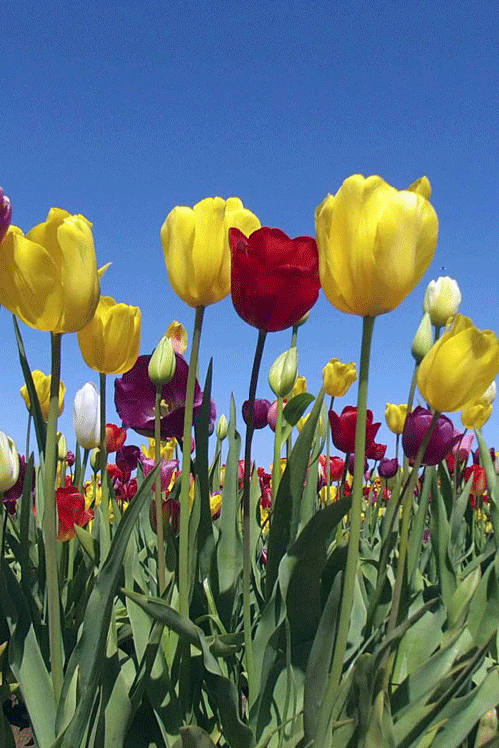
Thank You

