Slide 1
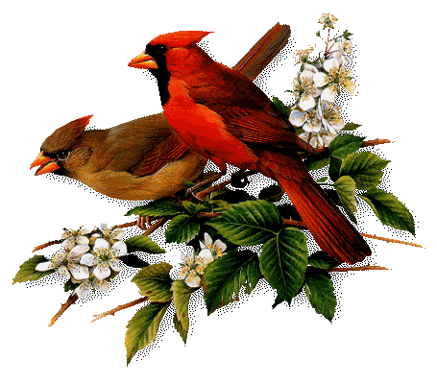

Slide 2
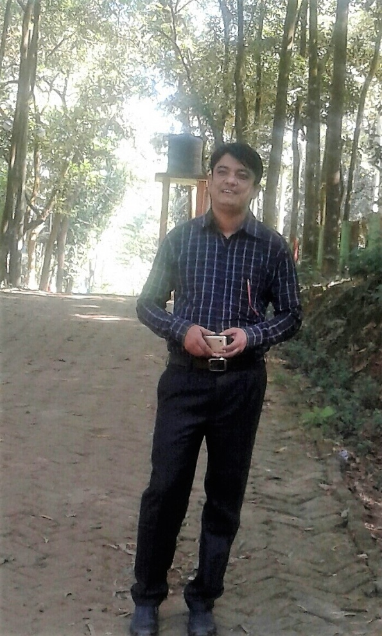
Presented by
Md. Safiqur Rahman Asst.Headteacher Raipura pilot Girls High School

Slide 3
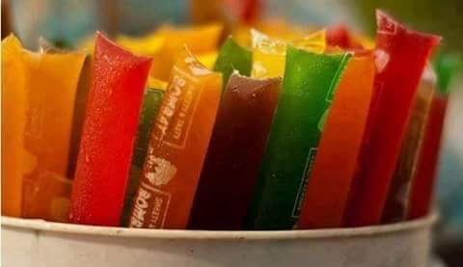
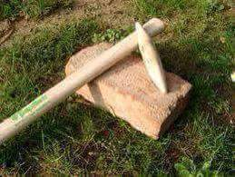
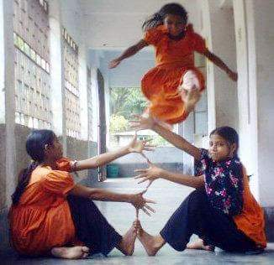
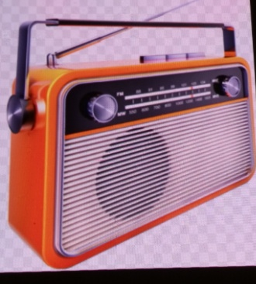
Let’s enjoy some picture

Slide 4
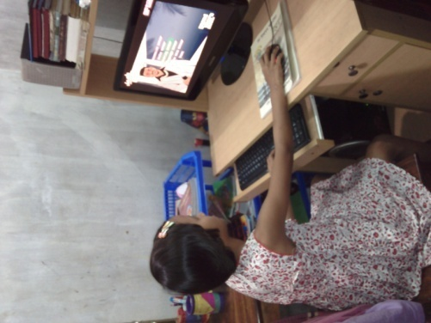
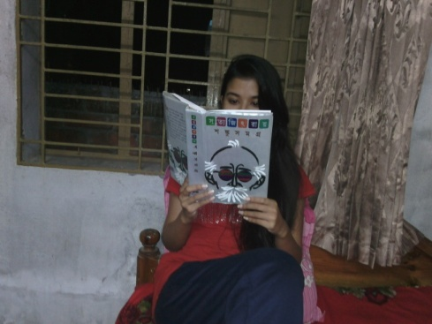

Slide 5
Lesson Identity
Subject : English 1st Paper
Class : Nine & Ten
Content Name: Changing Past time
Time: 50 Minute

Slide 6
Learning outcomes
Ideas of past time
Improving reading skill .
Understand Yoga.
Knowing the health benefit of Yoga .
Will able to make in conversation and discussion.

Slide 7
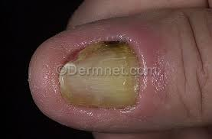
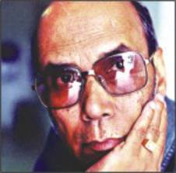
Vocabulary
Cronic
Severe
Depression
Dumps
Decline
Decrease

Slide 8
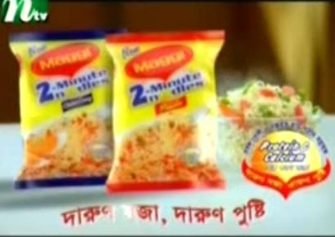
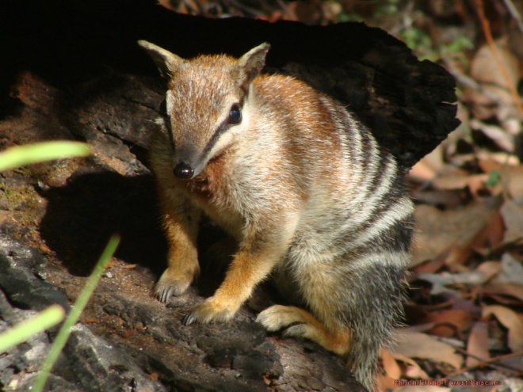
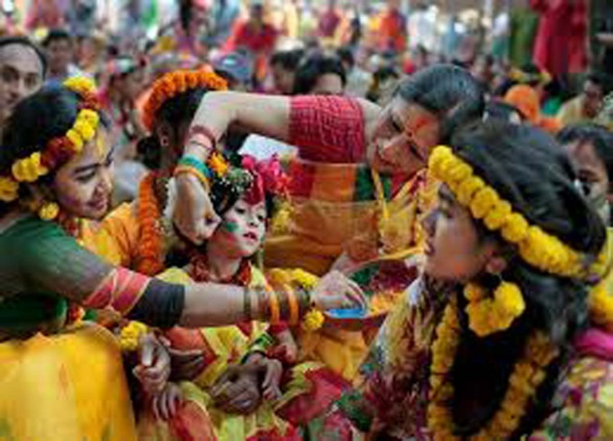
Posture(Noun)
Gesture/
pose
Dens
Hole
Tradition
Customs

Slide 9
Individual works
Past time
Online
Programme
35%
Game /sports
35%
Others 5%
Watching
TV 30%
Make a list of your own pastimes. Following the charts

Slide 10
Discuss these questions with your partner and write down your ideas of Past time.
1.What is pastimes activities?
2. Do you think the pastime activities in Bangladesh are changing?
3.What kind of pastime activities are useful for the students in Bangladesh?

Slide 11
Home work
Write a paragraph on Past time

Slide 12
Thanks to all

