Slide 2
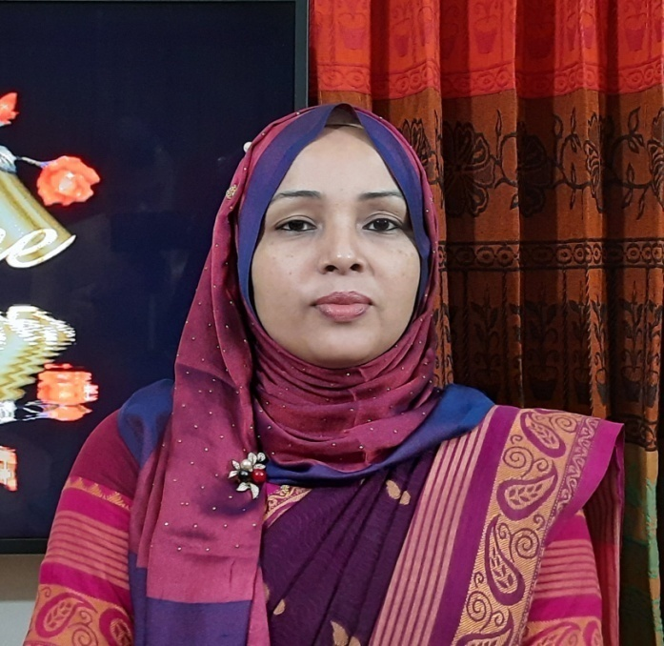
Achia Begum
Head Teacher
Uttarsur k.c Govt’ Primary School
Sreemangal,Moulvibazar.

Slide 3
English For Today
Class:5

Slide 5
Good morning. Let’s sing a greeting song.

Slide 6
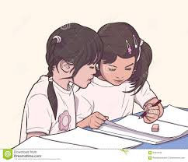
Pair work
What are the names of your friend?
Tell us something about them.
Today we are going to learn about two friends by reading a paragraph from the book.

Slide 7
Today’s topic is-
Completing forms
Unit:22
Lessons 1-2
pg:86

Slide 8
0pen your book and put your finger under the line. Listen to the audio carefully…

Slide 9
What do you understand from the text. Let’s see…
Individual work
What is the relationship between Laila and Bithi?
What does Laila like?
What type of person is Laila?
What type of person is Bithi?
What does Bithi enjoy doing?
What is the difference between Laila and Bithi?

Slide 10
Vocabulary
different-not the same
active-not idle
talkative-a person who talks very much
quite-not at all talkative
especially-in a charming way.

Slide 11
Pair work
Students will read loudly. And they will put their finger under the line. Teacher will try to see the reading of each student and give them feedback.

Slide 12
Look at the picture carefully.
What do you think of these pictures?
What is the first girl doing in the the pictures?
What is the second girl doing in the pictures?

Slide 13
Individual work
Bithi
Laila
Which picture shows Laila and which picture shows Bithi? Write the correct name under each picture.

Slide 14
Look at the activity C very carefully.
active
clever
funny
kind
quite
talkative
Students will read the adjective loudly.

Slide 15
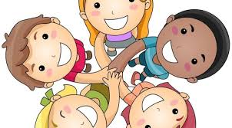
Teacher will ask and students will give examples of each adjective.
1.What can a very clever person do?
2.What do kind people do?
3.What do quiet people not like doing?
4.What do talkative /funny/active people do?

Slide 16
Individual work
Use the adjectives to make sentences about people you know.
active,clever,funny,kind,quiet,talkative

Slide 17
Some student will write a sentence on the board using an adjective. The other students in the class will give feedback.

Slide 18
Write 5 sentences about your friend.

