Slide 2
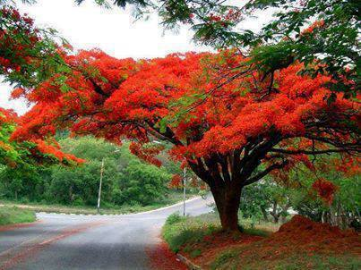
Welcome
to
all
in
my
Class.

Slide 3
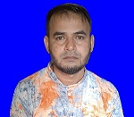
i
Teacher Introducing
Md Shamsunnoor
Head Teacher
Murergaon Govt. Primary school
Companiganj, Sylhet
Mobile : 01712-307039
Email : shadmanheya@gmail.com

Slide 4
Lesson Identity
Class : Five
Subject : English
Time : 40 minute

Slide 5
Learning outcomes
By the end of the lesson students will be able to-
Listening
3.4.1 Understand statements made by the teacher and students.
4.2.1 Undestand and enjoy simple stories.
Speaking
1.1.1 say words, phrases and sentences with proper sound and stress.
6.2.1 talk about people, objects, events etc.
Reading
1.5.1 read words, phrases and sentences in the text with proper
pronunciation, stress and intonation.
1.7.1 read paragraphs, dialogues, stories, letters and other texts .

Slide 6
Let’s we sing a song.

Slide 7
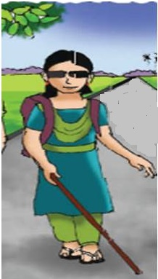
Justifying previous knowledge
What is the girl doing in the picture ?
What do you see in this picture ?
A girl walking in the picture.
How did Maria know about the day ?
What could she smell ?
She is Maria.

Slide 8
Today’s lesson
Life is Beautiful!
Lessons : 1-2 (second pera)
Maria is a lot like any other…….she was born.
Unit : 20
Page : 78

Slide 9
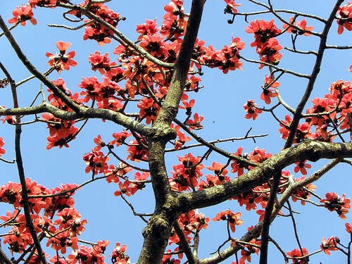
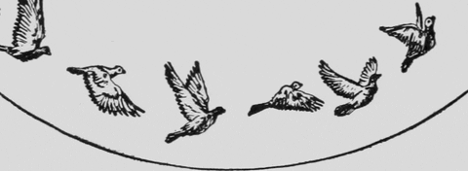
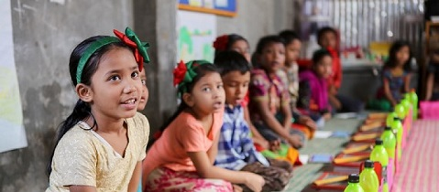
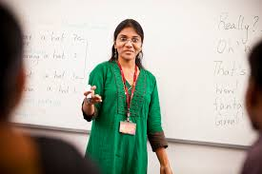
Lesson presentation :
She goes to school and likes to be with her friends.
Maria is a lot like any other students in her neighbourhood.
সে বিদ্যালয়ে যায় এবং সেখানে গিয়ে তার বন্ধুদের সাথে সময় কাটাতে পছন্দ করে ।
মারিয়া তার এলাকার অন্য যেকোন ছাত্র-ছাত্রীর মতোই একজন ছাত্রী ।

Slide 10
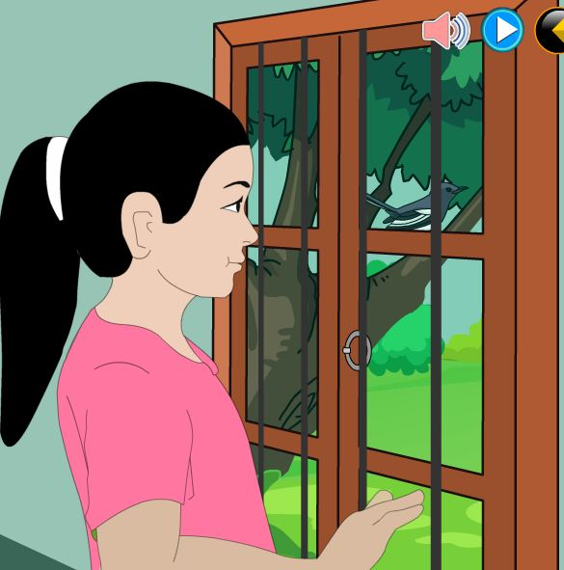
But Maria cannot see the beautiful spring day.
Listen and read-
কিন্তু মারিয়া বসন্তের সেই মনোরম/সুন্দর দৃশ্য দেখতে পারেনা ।

Slide 11
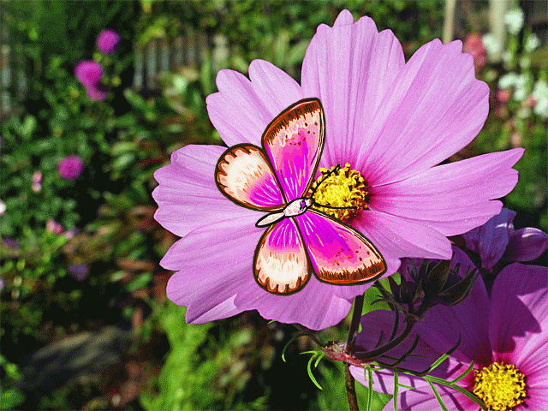
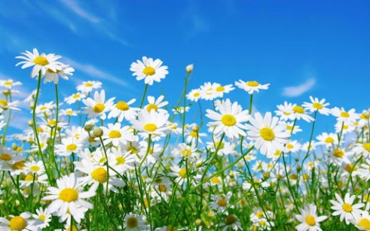
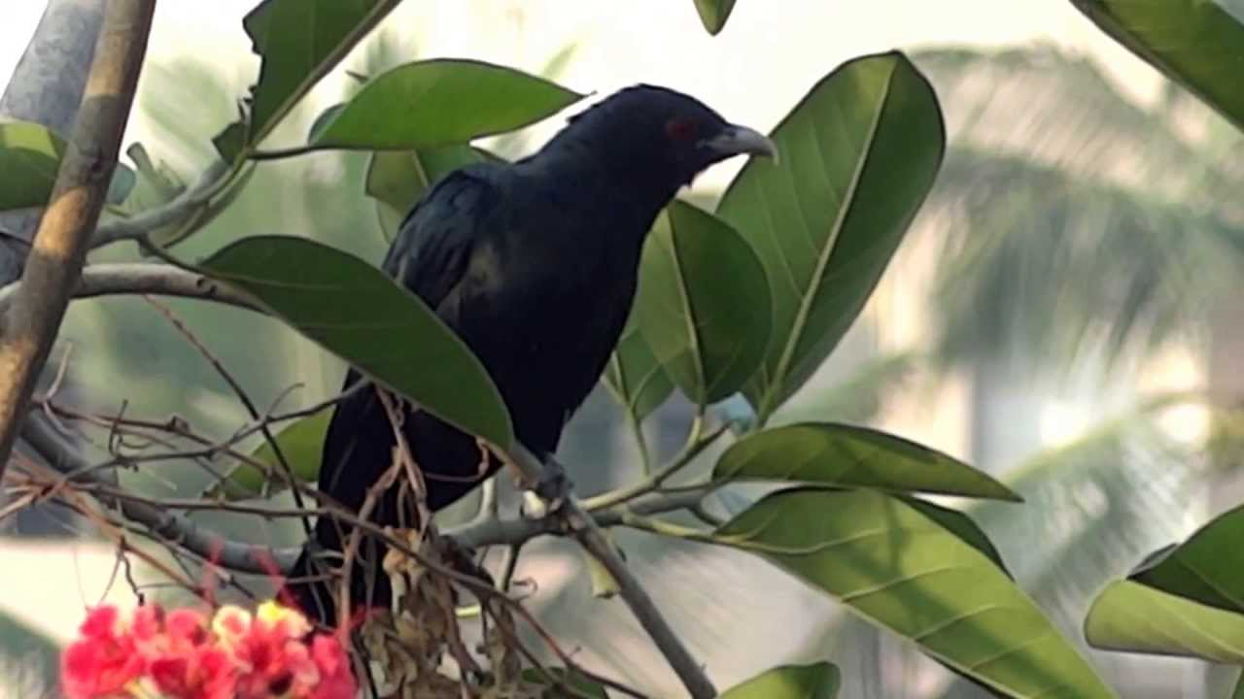
She cannot see the flowers, the blue sky, or the singing birds.
Listen and read-
সে পুষ্পরাজি, নীল আকাশ কিংবা পাখিদের গান শুনতে পায় না ।

Slide 12
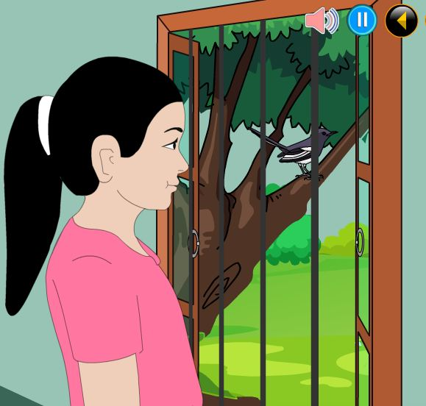
Listen and read-
She cannot see the new green leaves on the tress.
সে দেখতে পায় না বৃক্ষরাজির নতুন সবিজ পাতা ।

Slide 13
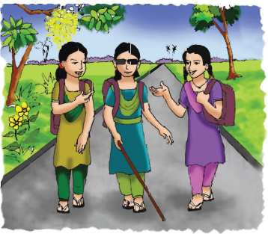
She cannot see these because she is visually impaired.
She has been unable to see since she was born.
সে এগুলো দেখতে পায়না কারণ সে দৃষ্টি প্রতিবন্ধী ।
জন্মলগ্ন থেকেই সে দেখতে পায় না ।

Slide 14
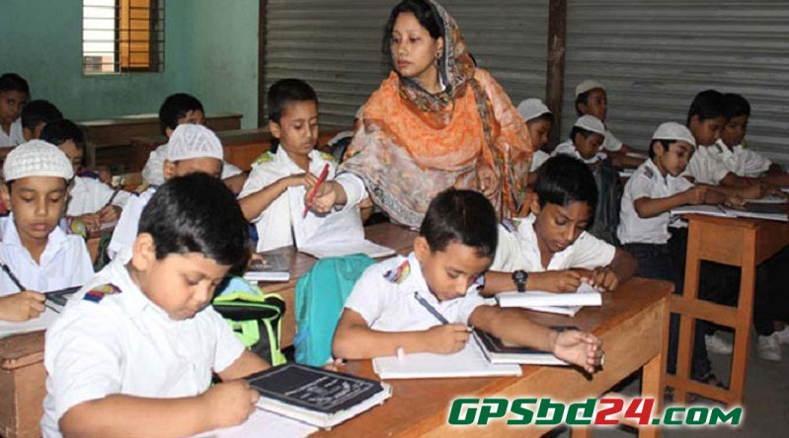
Loud reading & Learning new words

Slide 15
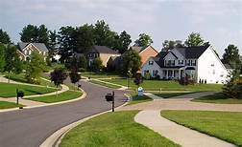
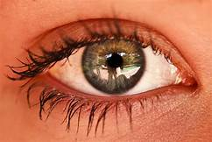
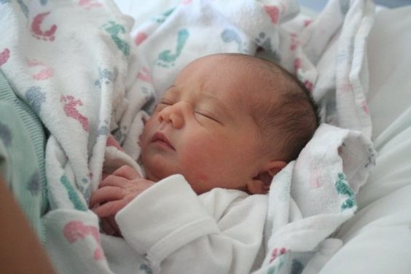
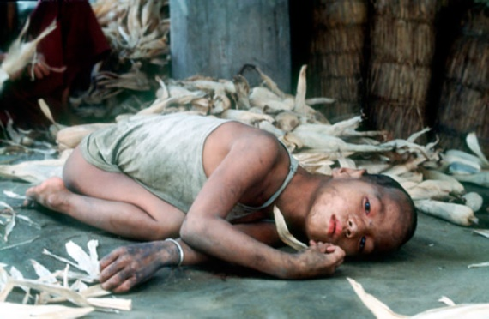
New Words
Meaning in English & Bengali
a district or community within a town or city.
পাড়া, আশপাশ
Neighbourhood
Visually
চাক্ষুষভাবে
able to seen.
চাক্ষুষভাবে
Impaired
having a disability of a specified kind.
প্রতিবন্ধী
to come out of a mother’s baby and start to exist.
Born
প্রতিবন্ধী
জন্মগত
জন্মগত
অক্ষম
not be able to do something.
Unable
অক্ষম

Slide 16
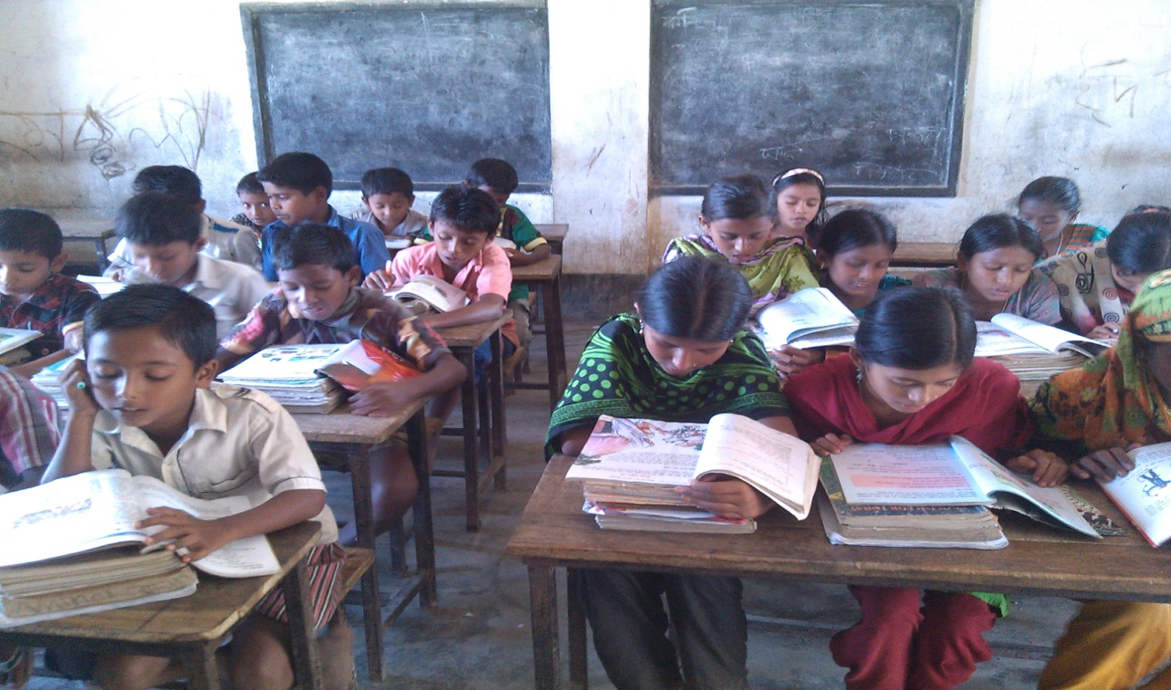
Silent reading

Slide 17
Match the words in column A with their meanings in column B. Two extra meanings are gives in column B.
Column A
Column B
(i) Beautiful
(i) To feel love or fondness for anything.
(ii) Happy
(ii) To become an adult.
(iii) Like
(iii) Very pleasant and impressive to look at.
(iv) Breakfast
(iv) To feel or take sense with the nose.
(v) Smell
(v) an emotional state of reaction.
(vi) Feeling or showing pleasure or joy.
(vii) The meal taken in the morning.

Slide 18
Fill in the gaps with the best word from the box. Find the information in the text . There are extra words which you need not use.
black
see
looks
singing
green
smell
Happy
after
(a) The birds are …………………. outside the room.
(b) Maria cannot ……………anything
(c) Maria is ……………..in her life.
(d) Usually the color of new leaves is ……….....
(e) Maria gets ready for school ……………….having breakfast.

Slide 19
Answer the following questions in a sentences.
(a) When does Maria get up ?
(e) Why cann’t Maria see all the beautiful things ?
(b) What fills maria’s room ?
(c) How are the spring days ?
(d) How does she feel ?
Answer : Maria cannot see all the beautiful things
as she is visually impaired.
Answer : She feels happy.
Answe : The spring days are beautiful.
Answe : The singing of the birds fills Maria’s room.
Answe : Maria gets up early.

Slide 20
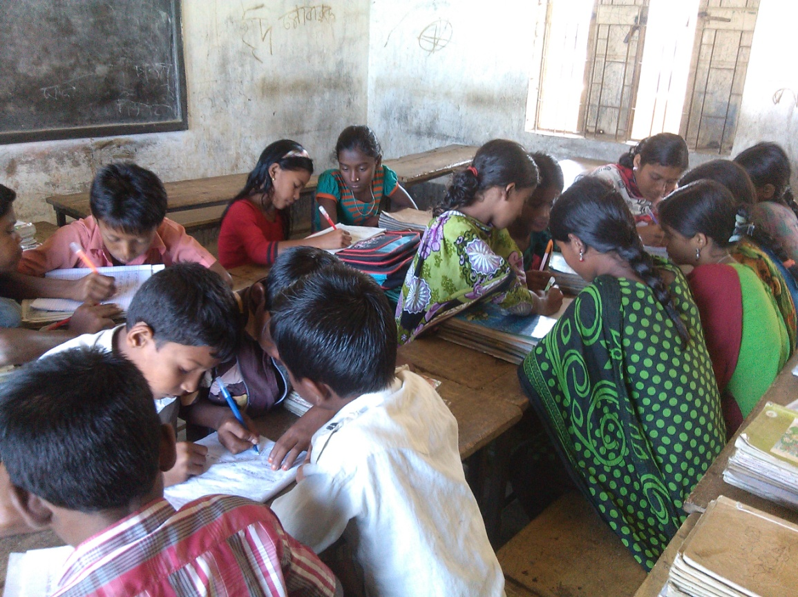
Write “T” for true or “F” for False.
Group work
1. Maria goes to school with her sister.
2. The flower garden is the source of the sweet smell.
3. Maria gets-up late in the morning.
4. We take our breakfast at noon.
5. Green new leaves are seen in the spring.
6. Flowers are the symble of ugliness.
F
T
F
F
T
F
F

Slide 21
Evalution
Choose the best answer and write your notebook.
1. Maria cannot see because-
(a) It is dark
(b) She is visually impaired.
(c) She doesn’t feel well .
2. Maria knows it is a warm day because-
(a) The birds are singing
(b) her friends tell her.
(c) She feels the glass of the window .

Slide 22
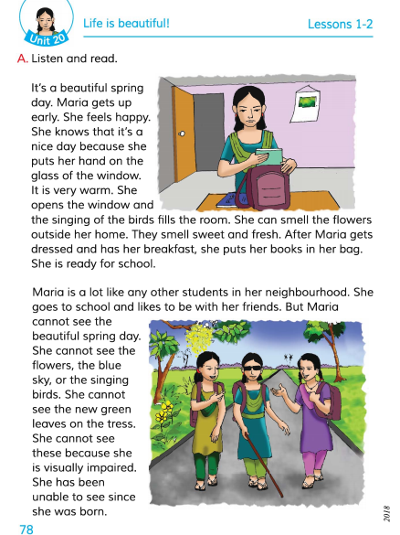
Connection with EFT Book.

Slide 23
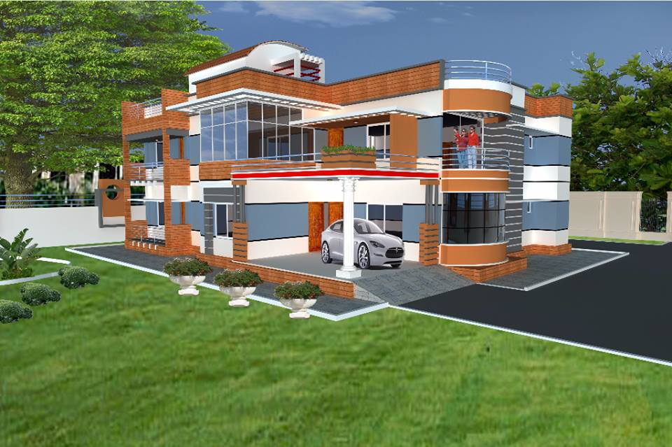
Home work
Write five sentences
about Maria’s daily life.

Slide 24
Thanks everybody.
See you again.
Bye Bye

Slide 25
END
OF
THE
LESSON

