Slide 1
Welcome to my English class

Slide 2
How are you doing today ?

Slide 3
Teacher’identy
Kamrunnaher
Assistant teacher
Sreerampor purbopara govt.prymary school.
Raipura-Narsingdi

Slide 4
Class: Tow
Subject : English
Unit : 13 Days of the week
Lesson 1-3 (A)

Slide 5
Learning outcomes-
Listening
1.1.1become familiar with English sounds by listing to English words.
Speaking
1.1.1 Repeat after the teacher simple words and phrases with proper sounds and stress .
1.2.1 Say simple words and phrases with proper sounds and stress ..
5.1.1 Say the name of the days of the week
Reading
3.1.1 recognize and read the days of the week

Slide 6
Now we will sing the greeting song hello hello…

Slide 7
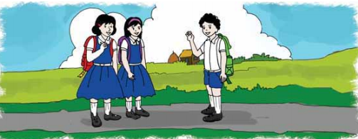
Do you know what day is it today ?
Today is sunday.

Slide 8
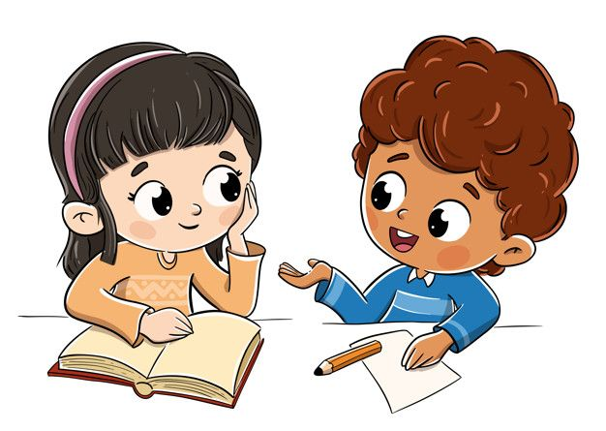
Do you know ,how to talk with anyone ?
Come here Mitu and Ritu do the activity.

Slide 9
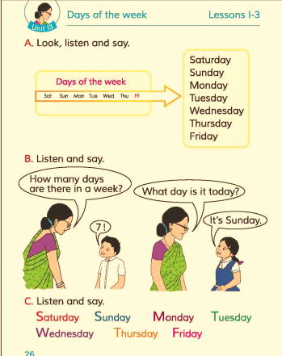
Now open your book at page 26.
Look activity A.

Slide 10
Individual work
Find out new word.
Nice
সুন্দর
Meet
দেখা
Dialouge
কথোপকথন

Slide 11
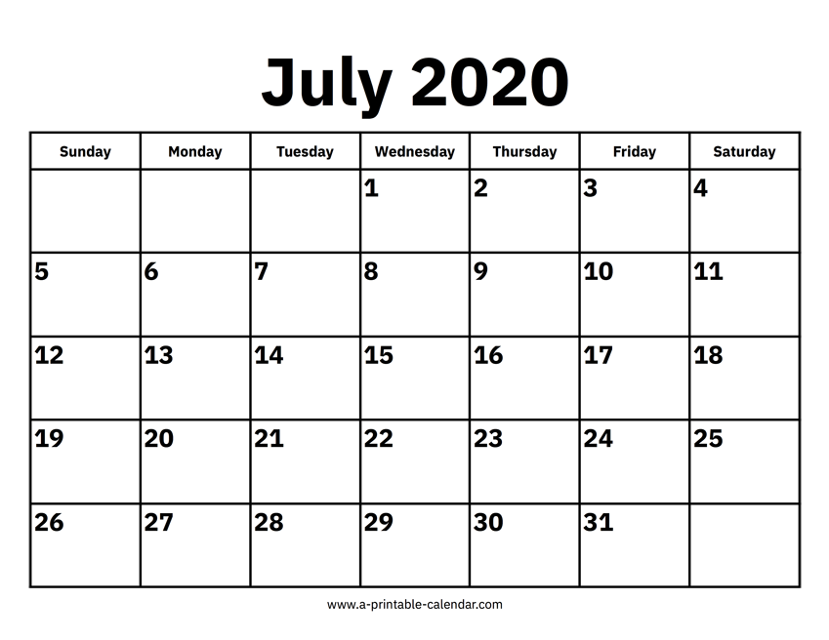
Do you know what is it ?
It is a calendar.
What can you see in this calendar ?
There are 7 days in a week.

Slide 12
Group work
Now you will practice do the activity between 3 students as like Mita,Ayesha,Salam.

Slide 13
What we say after getting to know each other ?
Nice too meet you
Now the 3 student will com forword and practice the dialouge as Mita,Ayesha,Salam.

Slide 14
One day one word
Meet–
দেখা
Nice to meet you.

Slide 15
Home work
You will read the dialouge properlly .

Slide 16
Thank you, that’s all for today
See you tomorrow.

