Slide 1
Good morning

Slide 2
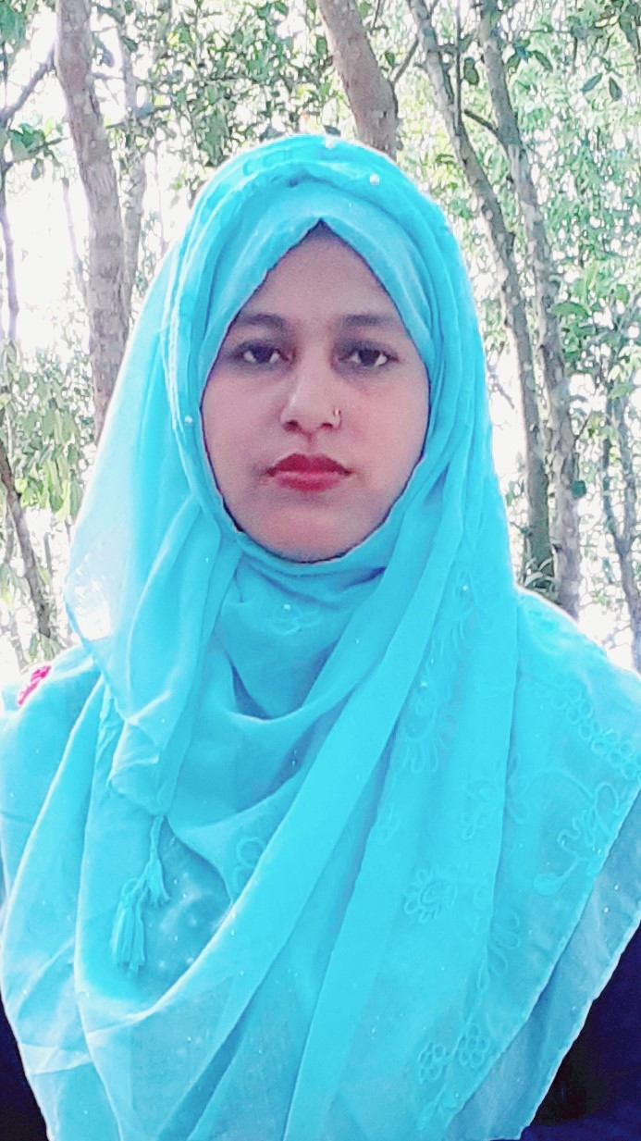
Introduction
Days Of the Week
Subject: English
Class:4
Lesson:9
Lesson Title:
Days Of the Week
Time : 40 Mins
Rajia Akter Koli
Assistant Teacher
Aralia GPS
Kapasia,Gazipur

Slide 3
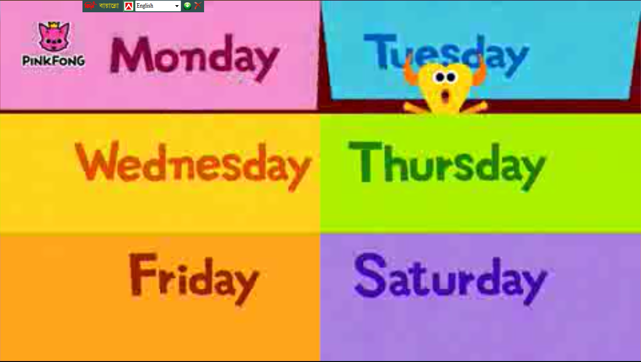
To create emotion
reciting the rhymes

Slide 4
Look and discuss in pairs.
Then try to find the missing words.
Yesterday was ..........
Today is ................ .
Tomorrow will be.......

Slide 5
To day’s topic
Days of the Week

Slide 6
Learning outcomes:
After this lesson the students will be able to-
7.1.1 write names of the days of the week with proper spelling.

Slide 7
PRESENTATION
Lets watch the Movie clip

Slide 8
7 Days of the Week
Days of the Week
Sunday
Monday
Tuesday
Wednesday
Thursday
Friday
Saturday

Slide 9
Spelling of the names of the days
Saturday
Friday
Thursday
Wednesday
Tuesday
Monday
Sunday

Slide 10
Lets Try to spell properly.
the students will try to spell loudly with teacher’s.
Sunday
Wednesday
Monday
Thursday
Tuesday
Friday
Saturday

Slide 11
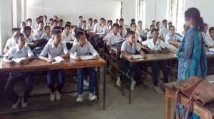
Teacher’s reading
Teacher will read loudly and the students will also read loudly with teacher.

Slide 12
Weekdays
Or Working days
First day of the week.
Sunday
Second day of the week.
Monday
Third day of the week.
Thursday
Fourth day of the week.
Wednesday
Fifth day of the week.
Tuesday
Weekend

Slide 13
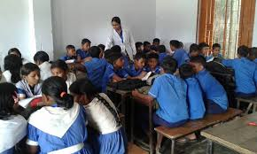
Group work
the students will try to read the names of the days and spell loudly in group.

Slide 14
Evaluation
Fill in the gaps with given letter:
Su...day.
Tue...day
We...nesday
Fr...day
M...nday
Sat...rday
Thu...sday
i
n
s
o
d
r
u

Slide 15
Ask and answer in pairs
1. How many days are there in a week ?
Ans. There are ........................
seven days.
2. What is the first day of the week ?
Ans. It is ........................
Sunday.
3. What day is it today ?
Ans. It is ........................
Saturday.
4. What day was it yesterday ?
Ans. It was ........................
Friday.
5. What day will it be tomorrow ?
Ans. It will be ........................
Sunday.

Slide 16
Ask and answer in pairs
1. What is the last day of the week ?
Ans.Saturday.
2. What is the second day of the week ?
Ans.Monday

Slide 17
Good bye

