Slide 1
Good morning

Slide 2
Teachers Identity:
Ayasha siddiqua
Assitant teacher
Dakkhin Balur Cor Government Primary School
Ramgoti,Lakshmipur
ayashasiddiqua231@gmail.com

Slide 3
Learning Outcomes
By the end of the lesson students will be able to
1.1.1:become familiar with English sounds by listening to common words.
1.1.2:say simple words and phrase with proper sound and stress.

Slide 4
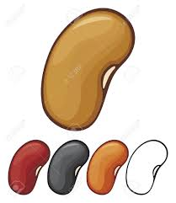
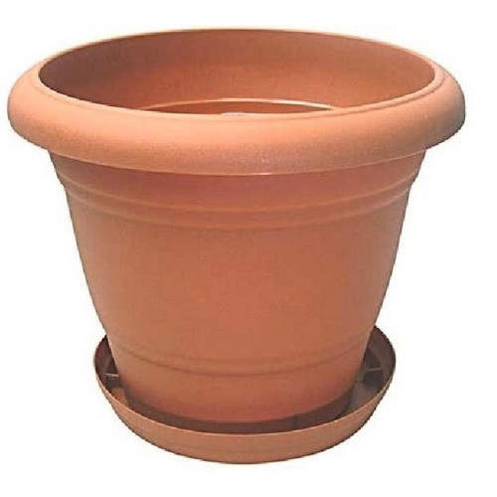
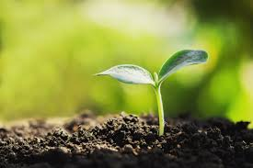
Seed
Tub
Lets see some pictures…
Sun
Plant

Slide 5
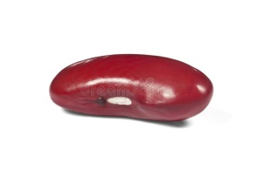
Sun
Plant
Lets match them
Tub
Seed

Slide 6
Evalution
Re arrange them..
nsu
sun
utb
tub

Slide 7
Thank you

