Slide 1
WELCOME
TO
Online Class
Zia High School Khulna

Slide 2
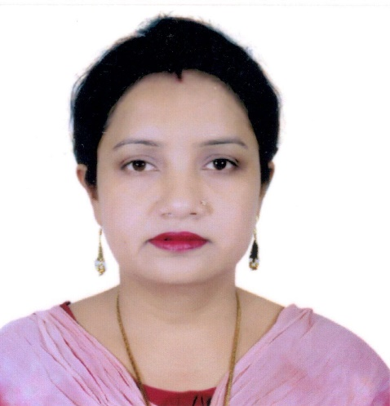
Teachers Identity
Anamika Gain
Assist: Teacher (English)
Zia High School
Khalishpur, Khulna.

Slide 3
Subject
ENGLISH FOR TODAY
CLASS : Nine & Ten
UNIT - 3
Lesson : 4

Slide 4
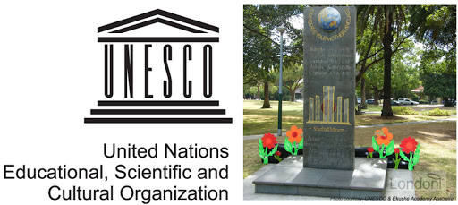
Talk about these questions.
When does the International Mother Language
Day celebration begin?
17 November in 1999, UNESCO Declared 21 February is the International Mother Language Day.

Slide 5
2. What does the abbreviation UNESCO stand for?
UNESCO (United Nations Educational, Scientific and Cultural Organization)
3. What is the other name of 21 February?
The other name of February 21 is International Mother Language Day.

Slide 6
Describe the picture at next
slide and talk about it.

Slide 7
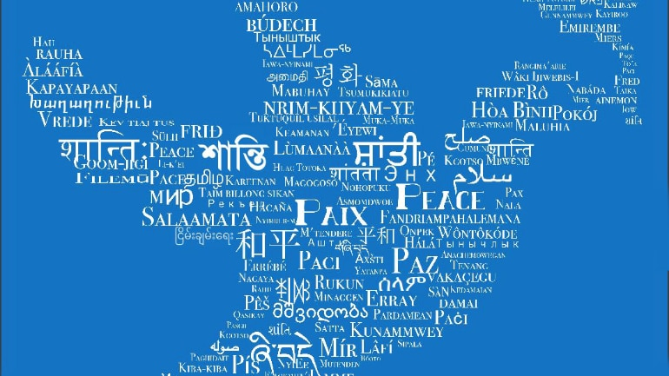

Slide 8
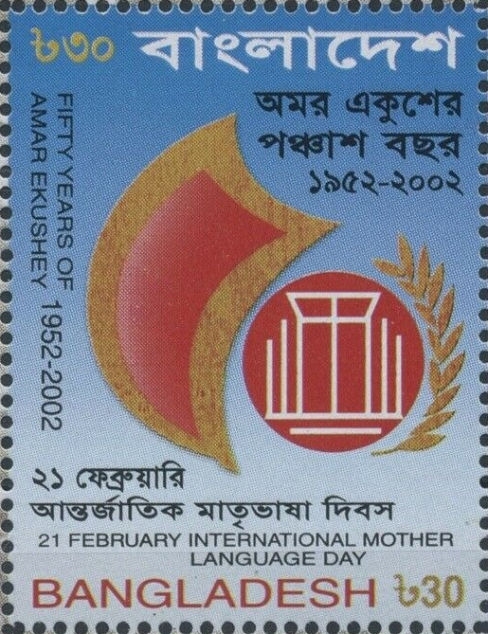
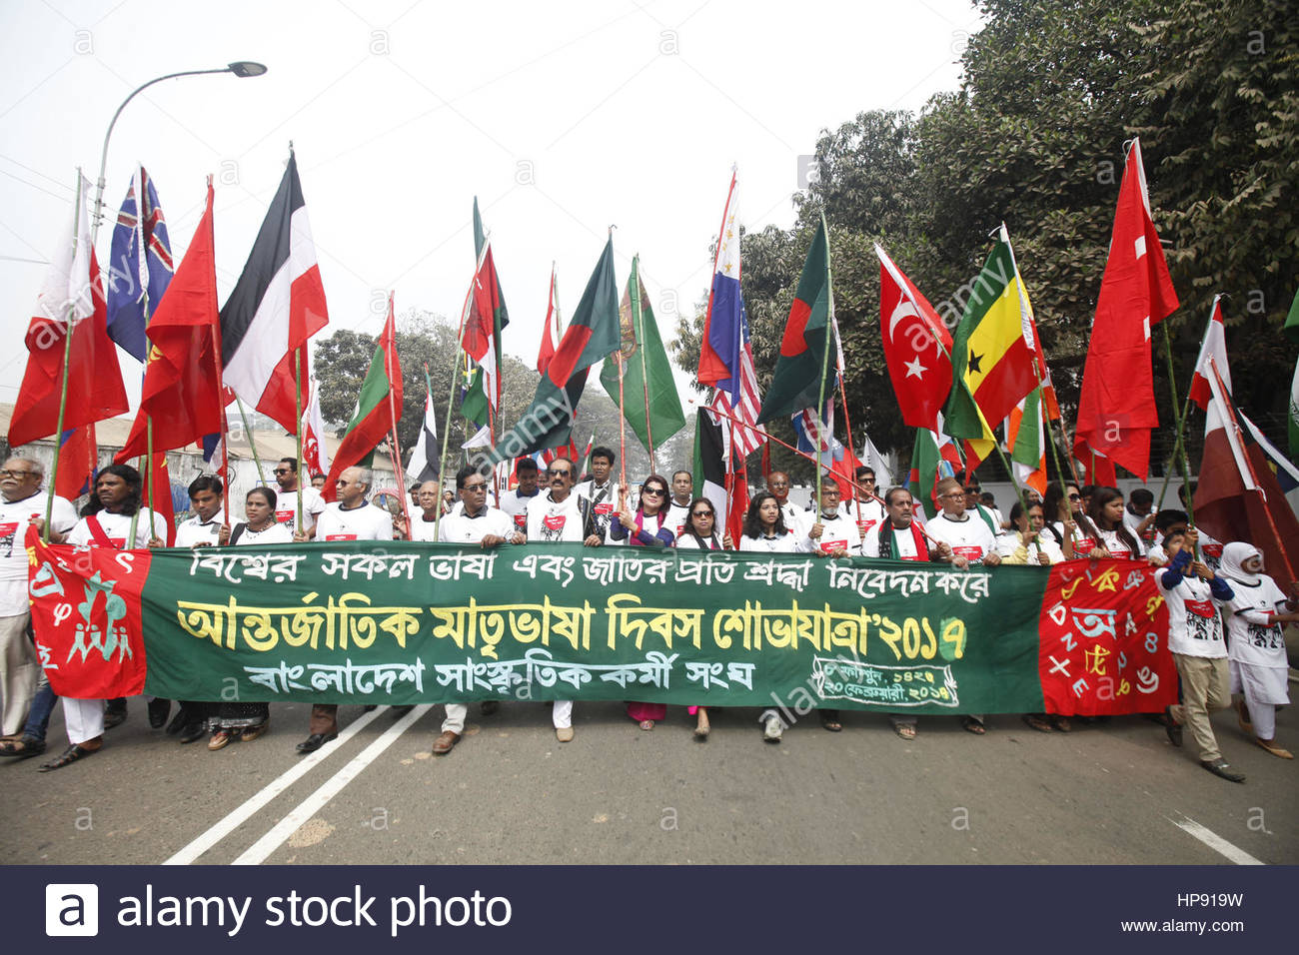
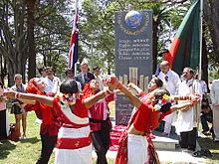
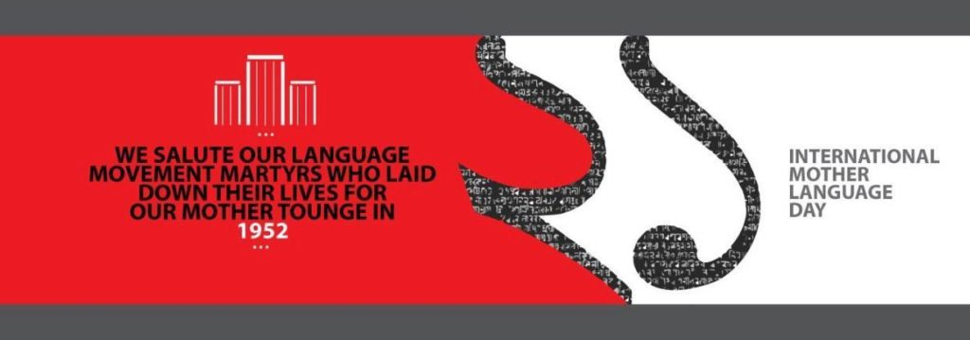

Slide 9
So our today’s lesson is…
International Mother Language Day-2

Slide 10
Open your Text Book,
Unit-3, Lesson-4, Page #34

Slide 11
21 February has been observed as Shaheed Dibosh every year throughout the country in remembrance of the martyrs of language movement of 1952. The occasion begins at the early hours of the day with mourning songs that recall the supreme sacrifices of our language martyrs. People wear black badges and go to the Shaheed Minar barefoot in procession, singing mourning songs. They place wreaths at the Minar. Many of them visit the graves of the martyrs at Azimpur graveyard and pray for them. They also attend various programmes organized in remembrance of the language martyrs.

Slide 12
The UNESCO (United Nations Educational, Scientific and Cultural Organization) on 17 November in 1999 proclaimed February 21 as the International Mother Language Day in recognition of the sacrifices of the martyrs for the rightful place of Bangla. The day is now annually observed worldwide to promote awareness of linguistic and cultural diversity and multilingualism.

Slide 13
INDIVIDUAL WORK

Slide 14
Match the words/phrases in the table with their meanings.
Words | Meanings
wreath | encourage
in remembrance of | in appreciation of
proclaim | practice of using several languages
promote | an arrangement of flowers in the shape of a circle
diversity | declare
multilingualism | in memory of
in recognition of | variety

Slide 15
Complete the passage with suitable words.
Blood
On 21 February 1952 _______ was shed at a place between Dhaka Medical College and Dhaka University _______ to establish Bangla as a state ______ of Pakistan. All subsequent movements _______ the struggles for independence had their origin from the historic language _________. Shaheed Minar is the ______ of the supreme sacrifice _______ the mother tongue.
Premises
Language
Demanding
Movement
Symbol
For

Slide 16
Answer these questions
1. Why is 21 February called Shaheed Dibosh?
2. Why do people go to the Shaheed Minar?
How do they go there?
3. Why is 21 February now observed throughout
the world every year?

