Slide 2
Md.Zuel Hossain
Assistant Teacher ( English) Itbaria UCK High School Pukurjana ,Patuakhali.
Email:mdzuelhossain248@gmail.com
Mobile:01728591706

Slide 3
English Second Paper
Unit-6, Lesson-1
Class: Nine /Ten
Time: 50 Minutes
Date:00/00/00

Slide 4
Let’s see some image and texts to guess something.
Notes:
Advance to suspension.

Slide 8
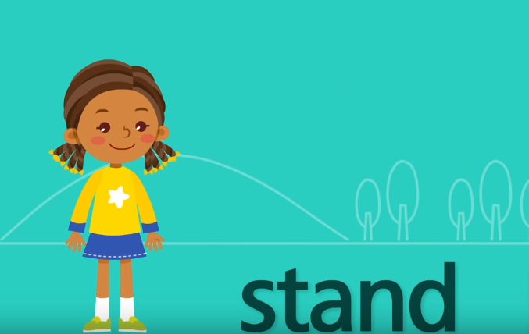

Slide 9
Can you guess what are we going to discuss today?

Slide 10
Our Today’s lesson is-
Verb

Slide 11
LEARNING OUTCOMES
By the end of the lesson the students will be able to..
Learn the defination of different types of verb ..
Differ the verbs .
identify the verbs from the Sentences

Slide 12
What is Verb ?
Verbs are "doing" words.
Verbs can express:
A physical action("to swim," "to write," "to climb").
A mental action("to think," "to guess," ).
A state of being ("to be," "to exist," "to appear").

Slide 13
Open Questions
What is verb ?
What are the characteristics of verb ?

Slide 14
Transitive Verbs
Verbs
Intransitive Verbs
Linking Verbs

Slide 15
Transitive Verb
A transitive verb is a verb that can take a direct object.
In other words, the action of a transitive verb is done to someone or something.
Most verbs are transitive.
Examples: (i) Who has broken the cup?
(ii) He reads a lot of story books.
(iii) Ishall take a cup of tea now.

Slide 17
Intransitive Verb
An intransitive verb is the opposite of a transitive verb: it does not require an object to act upon.
Example :i)They jumped.
ii)The dog ran.
iii)She sang.
iv)A light was shining.

Slide 21
What’s the Difference?

Slide 23
Group work
Group –A
Group-B
a)What is transitive verb ?
b) What is intransitive verb?
c)What is the difference between transitive and intransitive verb ?
a)What is transitive verb ?
b) What is linking verb?
c)What is the difference between transitive and intransitive verb ?

Slide 24
Home work
B .ldentify the transitive, intransitive and linking verbs in the following passage.
Nasima is a student. She is a student of class VIl. She attends classes regularly. Today she has worn a new dress. She looks very smart in this dress. The teacher praised her in the class.
C .Look at some more linking verbs in the following
sentences:
i) She got nervous in the class. (i) The man has gone mad. (ii) The food tastes delicious

