Slide 2
Introduction
Salma begum
Assistant teacher
Gokulnagar GPS
Raipura, Narsingdi
Class: 1
Subj: English
Unit: 17
Lesson: (1-3)

Slide 3
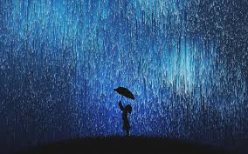
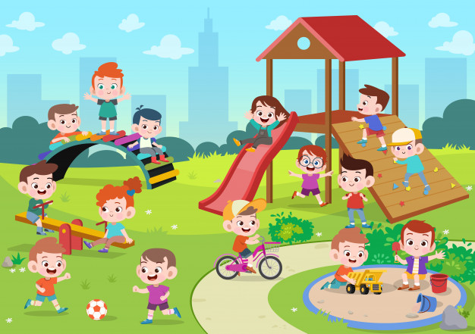
Look at the pictures.
Dear student’s
Look and think about the pictures. What are they doing ?
There is a relation between two pictures . Let’s we discuss about the pictures .

Slide 4
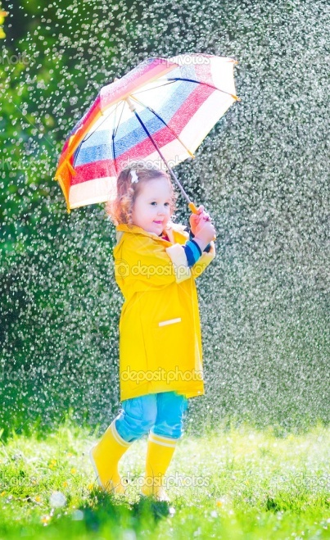
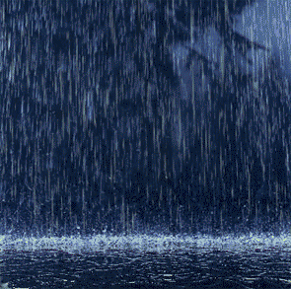
Today’s lesson is-
Rain Rain Go away

Slide 5
Learning Outcomes-
L- 1.1.1- become familiar with English sounds by listening to common English words.
4.1.1- enjoy the rhythm and music of simple rhymes.
S-1.1.1- repeat after the teacher simple words and phrases.
1.1.2- say simple words and phrases.
4.1.1- repeat rhymes after the teacher.
4.1.2- recite rhymes individually.

Slide 6
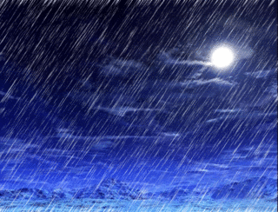
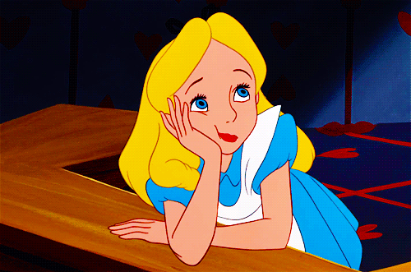
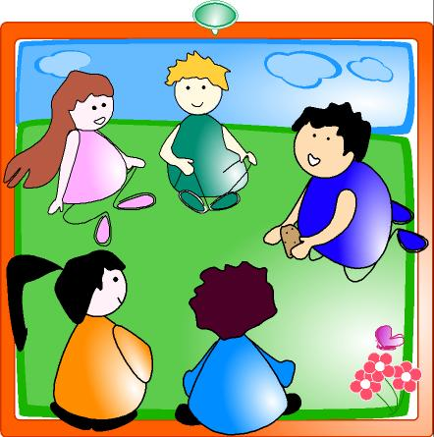
Look ,listen and say
Rain
Go away
Play

Slide 7
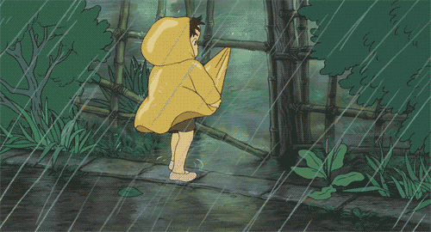
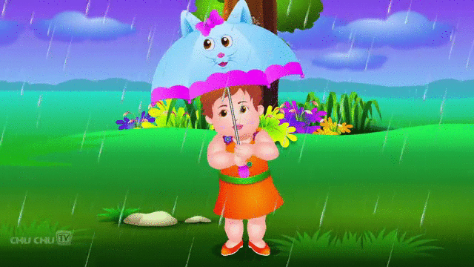
Rain rain go away

Slide 8
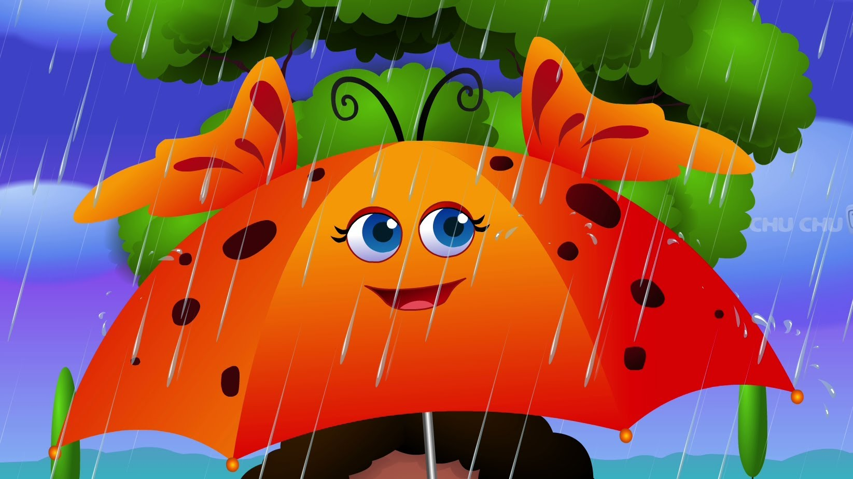
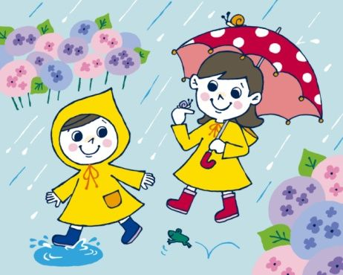
Come again another day

Slide 9
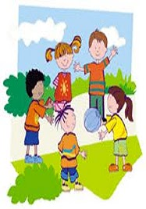
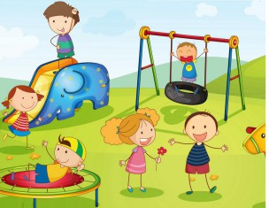
Little children want to play

Slide 10
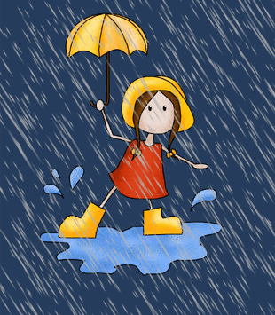
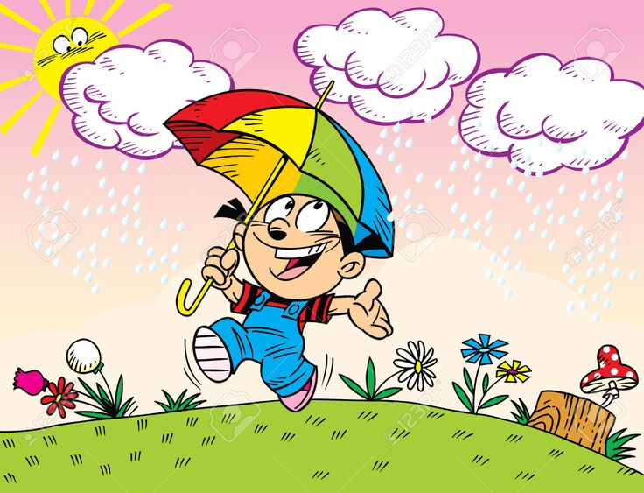
Rain rain go away

Slide 11
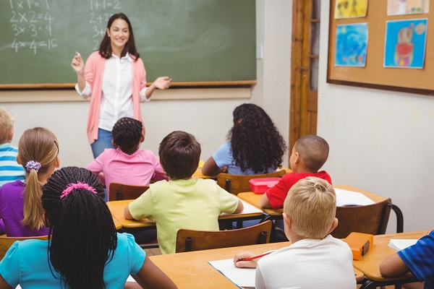
Listen and say with me.
Look ,listen and say
Rain,rain,go away.
Come again another day.
Little children want to play.
Rain,rain,go away.

Slide 12
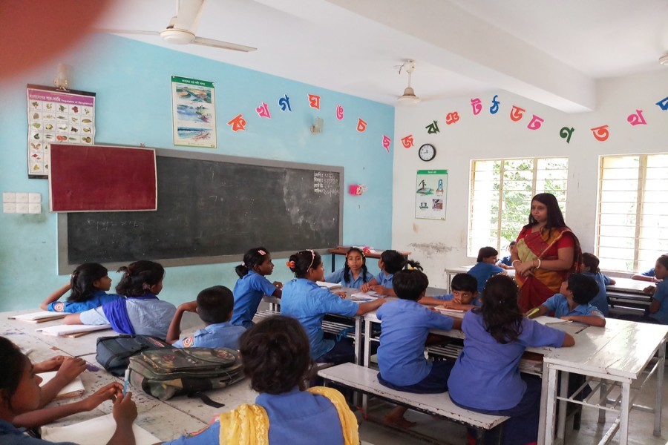
Dear students , say the rhyme indivisualy
Rain,rain,go away.
Come again another day.
Little children want to play.
Rain,rain,go away.

Slide 13
Let’s practice it in group
Rain, rain ,go away.
Come again another day.
Little children want to play.
Rain, rain, go away.

Slide 14
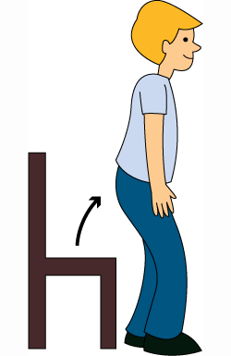
Stand up and come
Who want to recite the rhyme.
Rain,rain,go away.
Come again another day.
Little children want to play.
Rain,rain,go away.

Slide 15
HOMEWORK
Recite the Rhyme again and again.

Slide 16
Goodbye everyone ,
Stay well.

