Slide 1
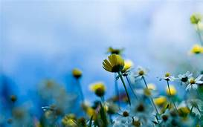
WELCOME

Slide 2
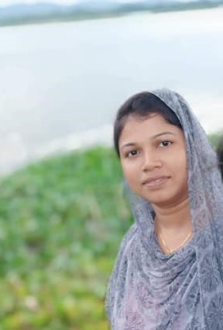
Rupa Mollik Rupu
Assistant Teacher
T and T gate Government Primary School, Khagrachari.

Slide 3
Today we are going to Completing forms
Unit:22
Lesson: 5-6
Page no: 88

Slide 5
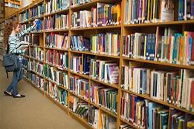
Let’s see a picture

Slide 6
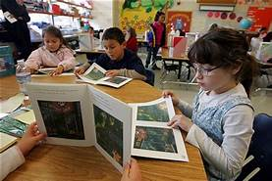
Have you ever heard the name of English Language club?
I hope you heard.

Slide 7
Introducing with some words
Ntionality-nationlism– জাতীয়তা
Date of birth– which date someone was born—জন্ম তারিখ
Hobbies--- fantasy— শখ

Slide 9
9 August,2010
mother’s
father’s
Bangladeshi
211,h:r: S:N:
five
N P S
running
swimming
taking with hriends
21 October,2020

Slide 10
Home Task
Make a form by using your information's to open a language club.

Slide 11
THANK YOU

