Slide 1
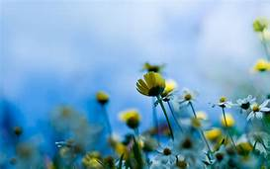
WELCOME

Slide 2
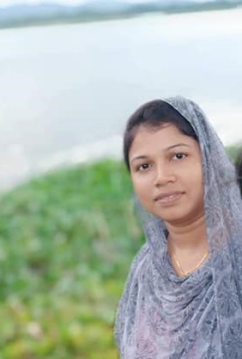
Rupa Mollik Rupu
Assistant Teacher
T and T gate Government Primary School, Khagrachari.

Slide 3
Unit:20
Life is beautiful
Lesson: 7-8
Page no: 82

Slide 5
Let’s see a picture

Slide 6
Introducing with some words
Business person– ব্যাবসায়ী
Computer engineer–কম্পিউটার প্রকৌশলী
Doctor– চিকিতসক
Farmer– কৃষক
Pilot – বিমানচালক
Teacher-- শিক্ষক

Slide 8
A1: I would like to be a business person. I would like to buy and sell things.
B1: I would like to be a computer engineer. I would like to study computer science and learn to fix computers.

Slide 9
Business person: I would like to have my own boutique house. I would like to buy and sell garment products.

Slide 10
Home Task
Write activity H about Farmer, Pilot and Teacher.

Slide 11
THANK YOU

