Slide 1
Hello Dear…

Slide 2
Ayasha Siddiqua
Assistant Teacher
Dakkhin Balur Cor Government Primary School.
Ramgoti,Lakshmipur
ayashasiddiqua231@gmail.com
Teacher’s introduction

Slide 3
Lesson Introduction:
Class :One
Sub:English For Today .
Unit:19
Lesson:1
Where do they live ?

Slide 4
Learning Outcomes:
Listening:
1.1.1 Become familiar with English sounds by listening to common English words .
Speaking:
1.1.1 Repeat after the teacher simple words and
Phrases with proper sounds and stress.

Slide 5
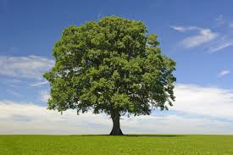
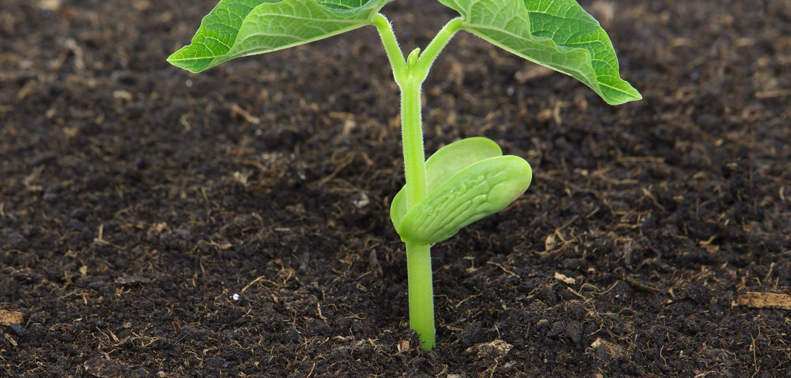
Let’s see the pictures
Tree
Plants

Slide 6
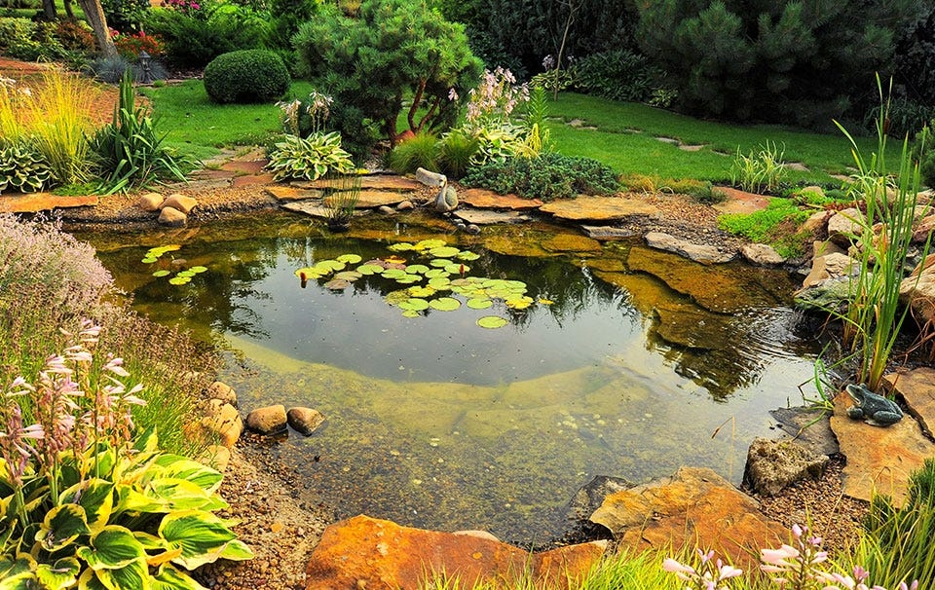
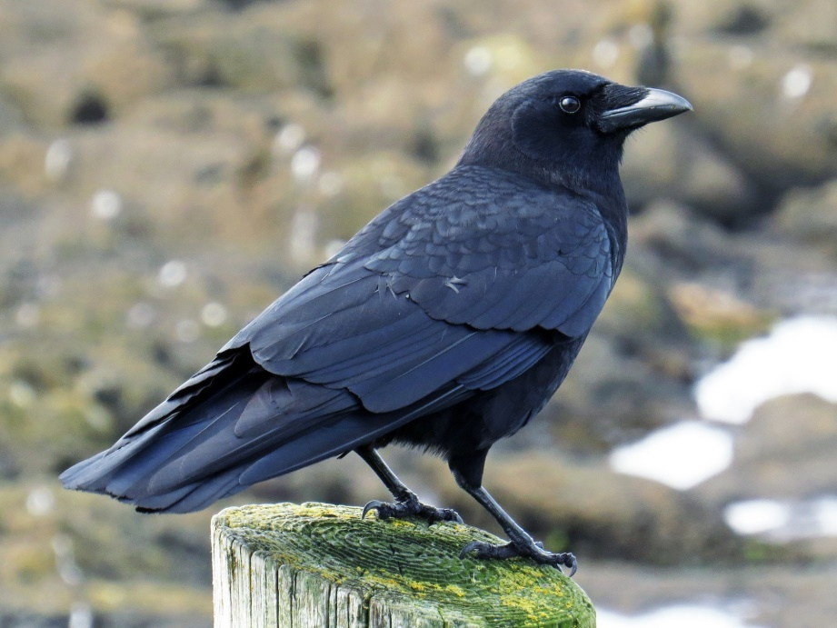
Crow
Pond

Slide 7
NEW WORDS
POND
Where contain a lot of water
CROW
A familiar bird in Bangladesh
TREE
Which has many branches and leaves
PLANT
A new-born tree

Slide 8
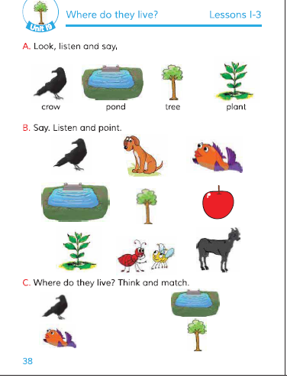
Open your book Page number 38

Slide 9
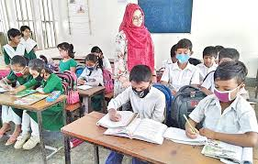
Whole class work.

Slide 10
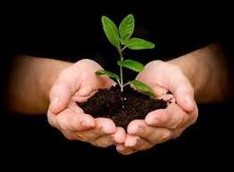
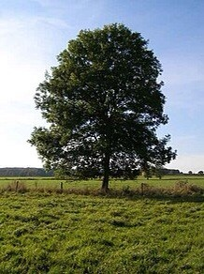
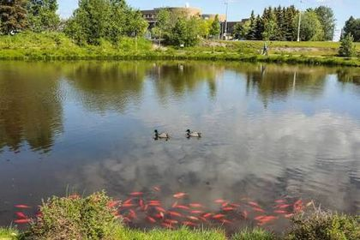
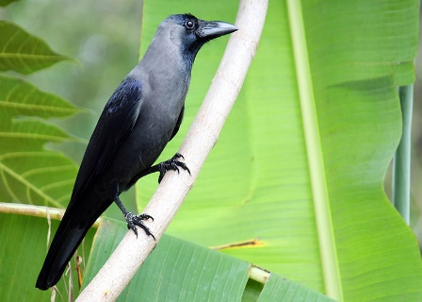
Match the words with pictures
POND
CROW
PLANT
TREE

Slide 11
See you again
Thank you

