Slide 1
Good Morning

Slide 2
Teachers Identity.
Ayasha siddiqua
Assitant teacher
Dakkhin Balur Cor Government Primary School
Ramgoti,Lakshmipur
ayashasiddiqua231@gmail.com

Slide 3
Lesson’s Introduction:
Class : two
Subject:English
Unit: 26
Lessons 4-6

Slide 4
By the end of the lesson students will be able to
1.1.1:become familiar with English sounds by listening to common words.
1.1.2:say simple words and phrase with proper sound and stress.

Slide 5
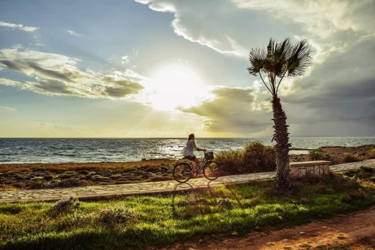
morning
Afternoon
evening
night

Slide 6
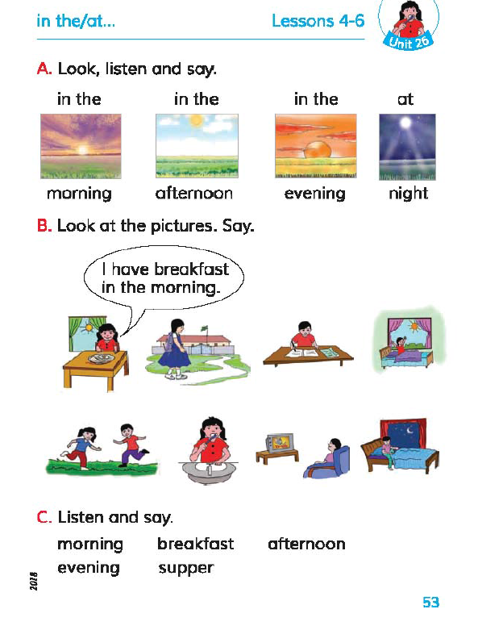
Open at page no 53

Slide 7
Whole class work.

Slide 8
Lets say
In the morning
In the afternoon
In the evening
At night

Slide 9
Now tell me one by one what is the picture about.
morning
Afternoon
evening
night

Slide 10
Thank You
See you again…

