Slide 1
Good Morning

Slide 2
Present By:
Ayasha Siddiqua
Assistant teacher.
Dakkhin Balur Cor Government Primary School.
Ramgoti Lakshmipur.
.

Slide 3
Introduction Of Lesson:
Class:Four-
Subject:English.
Unit:14.
Lesson: 1-2

Slide 4
Learning Outcomes:
Students will able to:
4.2.1 Enjoy and understand simple story.
2.1.2 Make simple self introduction.
5.1.1 Read silently with understanding paragraph,stories and other text.

Slide 5
Mita

Slide 6
Today’s Lesson
Mita’s day

Slide 7
Lets learn some new words..
Home-A dueling place where people live with his family.
School-A place where students went to learn.
Visit-To go to see someone or some things.

Slide 8
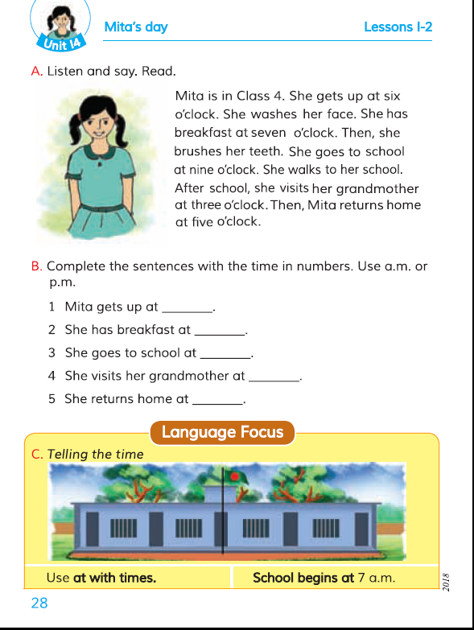
.
Open at page 28.

Slide 9
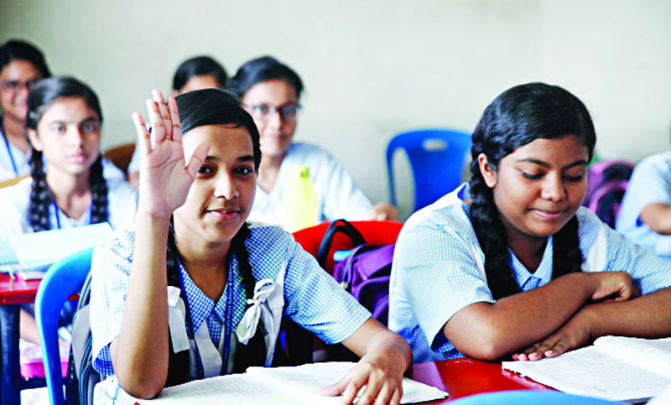
Pair reading..

Slide 10
Individual Work
Home- A dueling place where people live with his family.
School- A place where students went to learn.
Visit- To go to see someone or some things.

Slide 11
Complete the sentences with the time in numbers.
Mita gets up at-----------.
She has breakfast at------.
She goes to school at ----.
She returns home at------.

Slide 12
Thank you

