Slide 1
Hello Everyone….

Slide 2
Teacher’s Identity
Ayasha Siddiqua
Assistant Teacher
Dakkhin Balur cor Government Primary School
Ramgoti Lakshmipur.
ayashasiddiqua231@gmail.com

Slide 3
Lesson”s Instraction
Class: Three
Unit: 2
Lesson: 1-3

Slide 4
Learning Outcomes..
By the end of the lessons student will be able to
Listening:3.1.1: understand simple questions about students,family and friends
Speaking:3.1.1:ask and answer Wh questions.

Slide 5
Lets know some new words..
Teacher
The person who teaches students
Work
To do something

Slide 6
Today we should know about someone special…
The person is very important to us.
Can you guess….Who is the person..

Slide 7
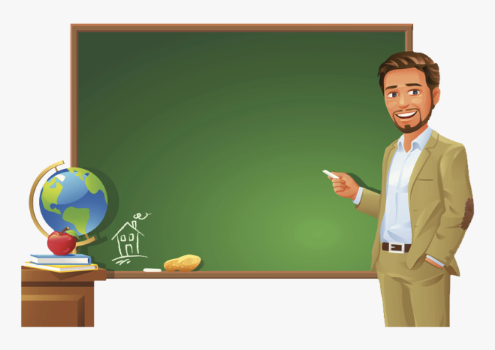
TEACHER

Slide 8
Now open your book at page 4

Slide 9
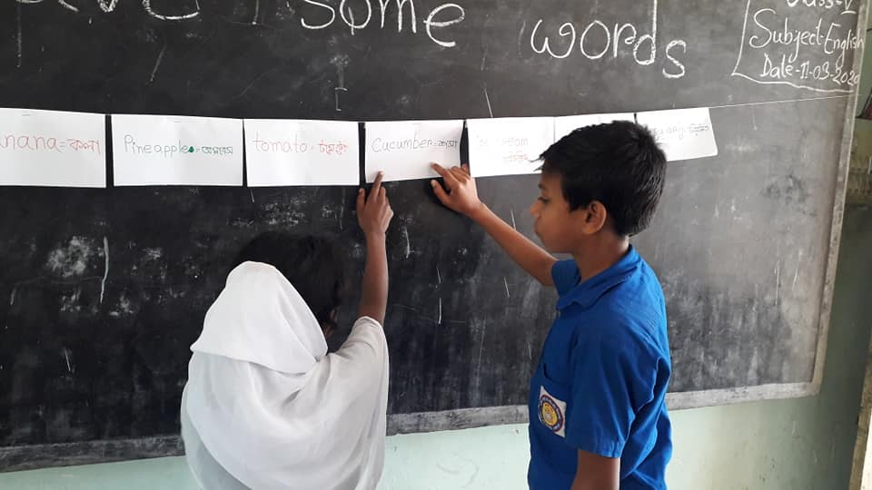
Lets practise and read the text in pair.

Slide 10
Now answer the following questions…
1.What is the man’s name?
Mahbub Alam
2.How old is he?
He is 30 years old.
3.What does he do?
He is a teacher

Slide 11
Thank You…

