Slide 1
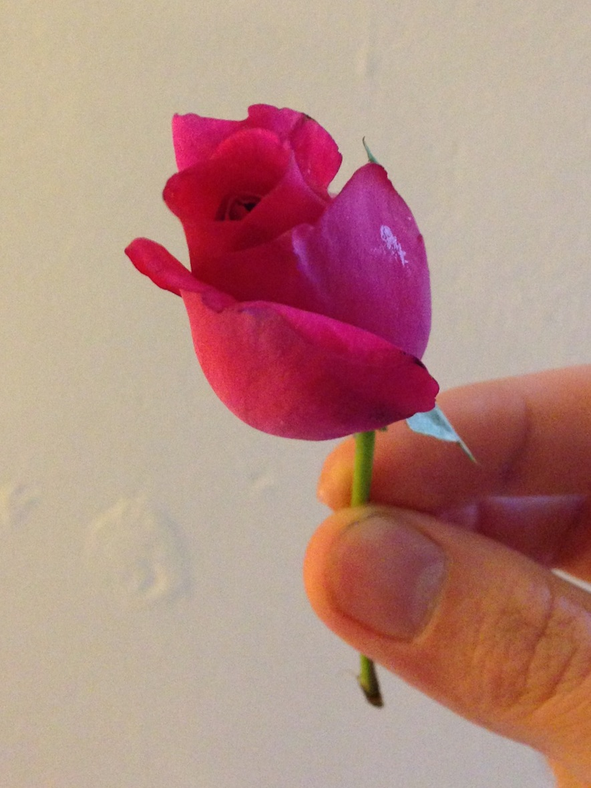
welcome

Slide 2
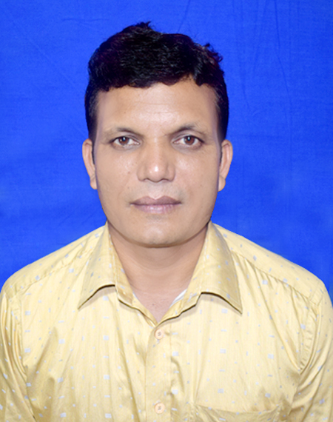
A F M Saiful islam
Head teacher
Musrat Madati Govt. Primary School
Kaligonj ,Lalmonirhat

Slide 3
Todays lesson
Class: Four
Unit: 14
Lesson: 1-3
Activity: A, B, C
Time: 35mn

Slide 4
Learning outcomes: student will able to-
Listening:
1.1.1. recognize sound differences in the text of word
1.2.1. recognize which syllable in a word is stressed
Speaking:
1.1.1 repeat after the teacher and say words, phrases, and sentences
with proper stress and intonation
5.1.1 tell the time ( hour only and mention a.m./ p.m.)
Reading:
1.4.1. read words, phrases and sentences in the text.
1.5.1. read words, phrases and sentences in the text with proper pronunciation,
stress and intonation .

Slide 5
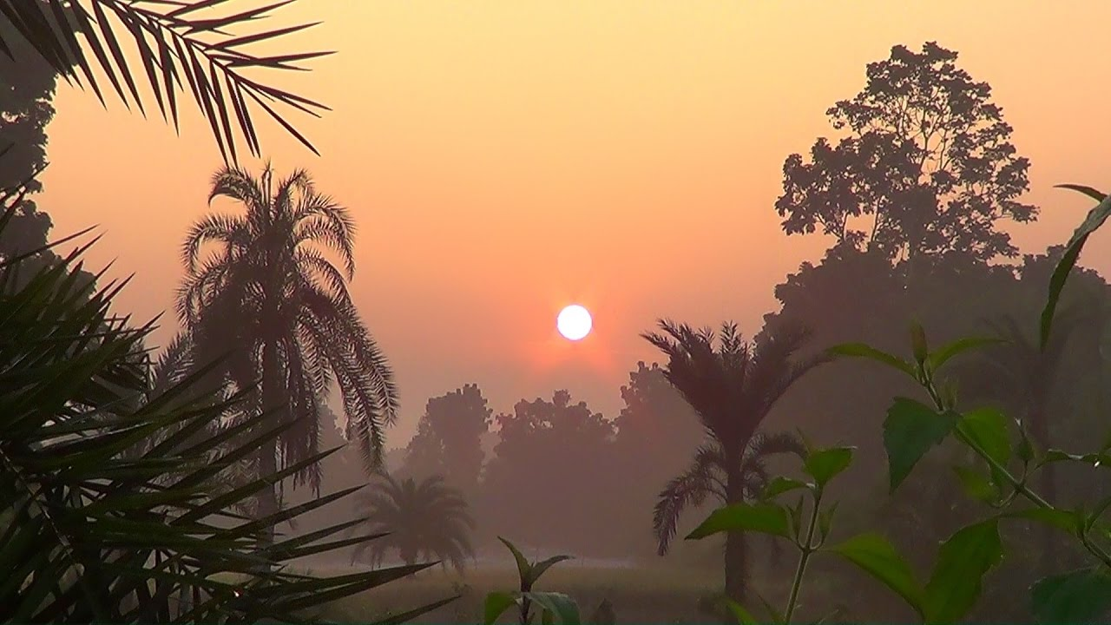
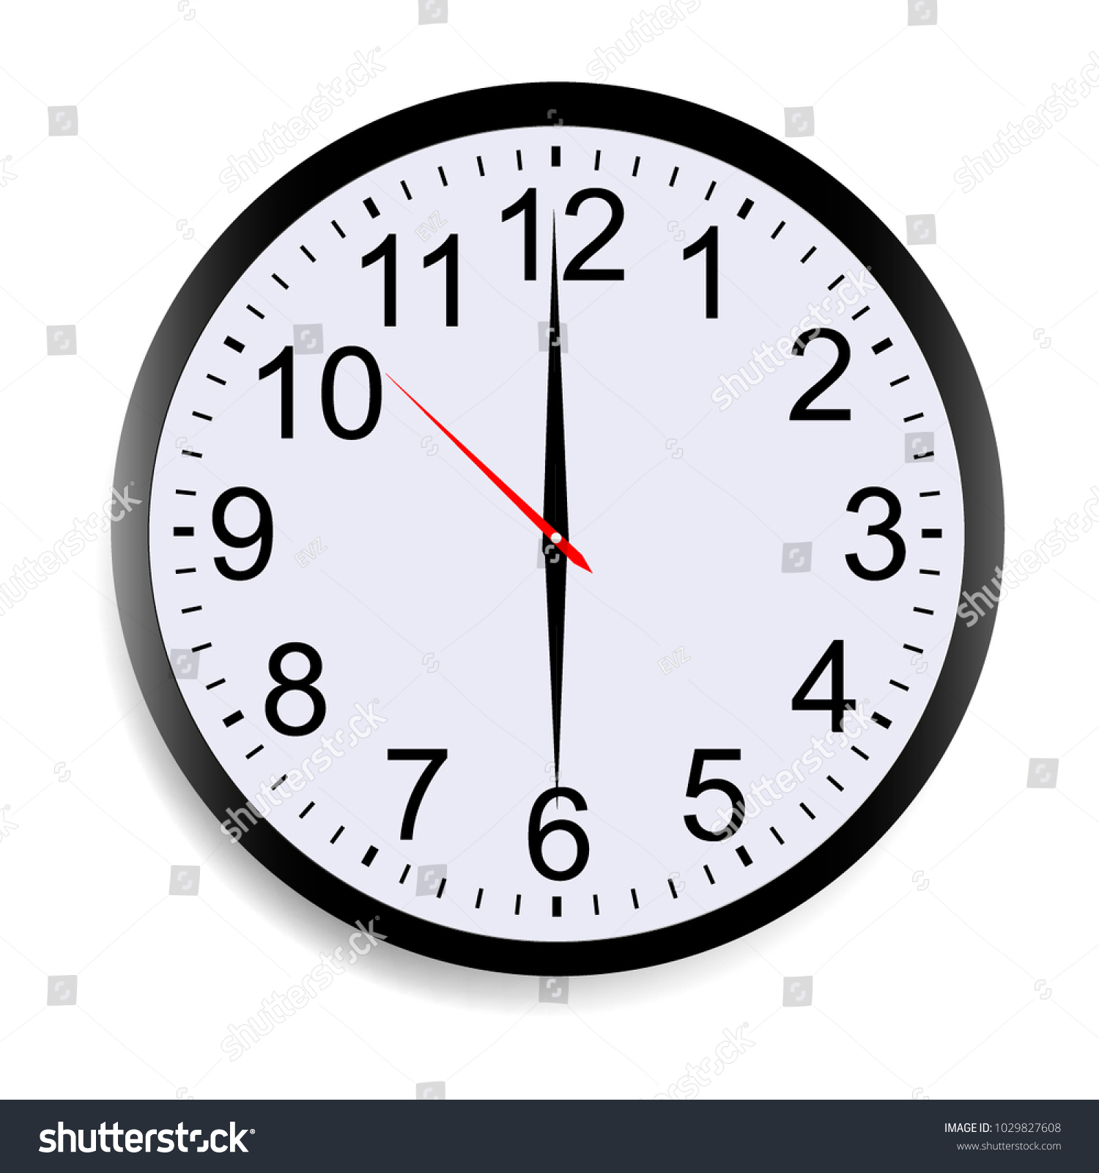
What can you see in the picture?
The sun rise, trees. It’s morning.
What time is it?
It’s 6 o’clock.

Slide 6
Do you know when we tell a.m. or p.m. ?
From midnight( 12:01) until midday (12:00), we use a.m.
From midday (12:01) until midnight(12:00), we use p.m.

Slide 7
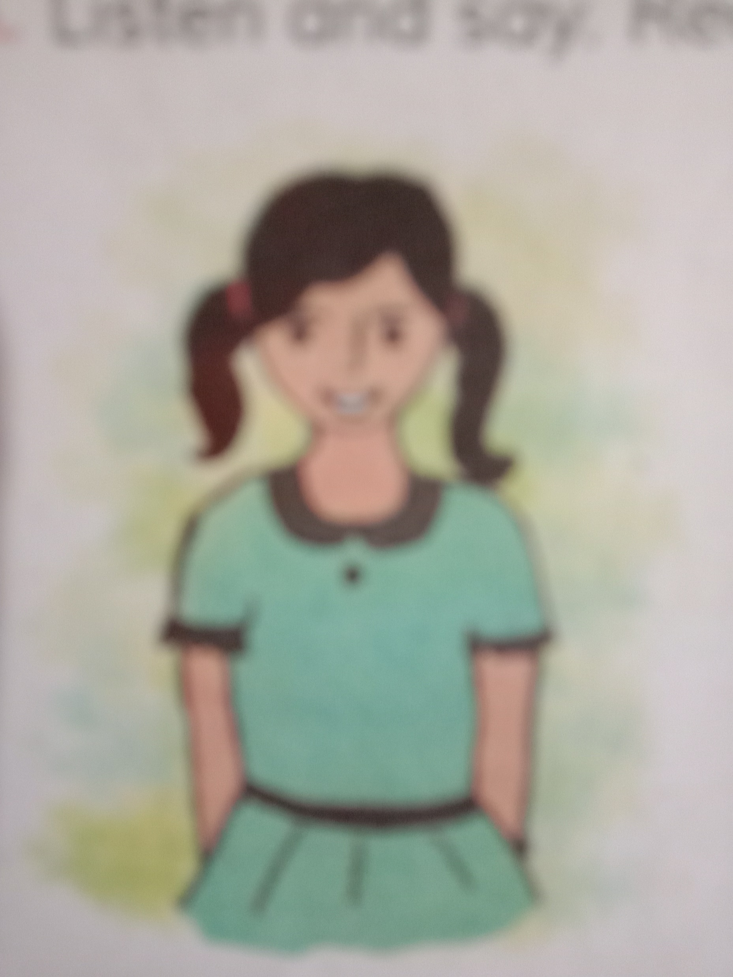
Today’s lesson
Mita’s day

Slide 8
Teaching words
visit
go to see and spend time with someone.
return
Come back
o’clock
To specify the hour in telling time

Slide 9
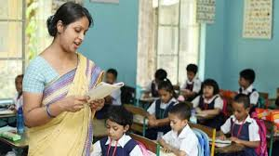
Teacher’s reading
Students open at 28
Please listen to me.

Slide 10
Students loud reading
Students put finger in first line. Listen and
repeat after me.

Slide 11
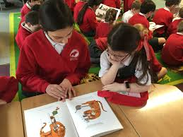
Students pair reading
Make pair next to you and read

Slide 12
Complete the sentences with the time in numbers. Use a.m. or p.m.
6 o’clock.
1. Mita get up at ---------------------
7 o’clock.
2. She has breakfast at --------------------
9 o’clock.
3. She goes to school at --------------------
3 o’clock.
4. She visit her grandmother at --------------
5 o’clock.
5. She returns home at -------------------

Slide 13
Activity c : Telling the time
When do we usually use at ?
We use at with times.
School begings at 7 o’clock.

Slide 14
Answer the questions . Use a.m. or p.m.after time.
1. When does Mita get up?
Mita gets up at 6 a.m.
2. When does she has breakfast ?
She has breakfast at 7 a.m.
3. When does she go to school ?
She goes to school at 9 a.m.
4. When does Mita return home ?
Mita returens home at 5 p.m.

Slide 15
Answer the questions
1.What time do you get up?
2.When do you have breakfast?
3.What time do you go to school?

Slide 16
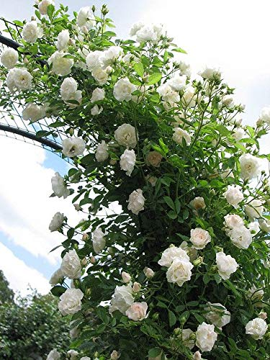
Thanks a lot.

