Slide 1
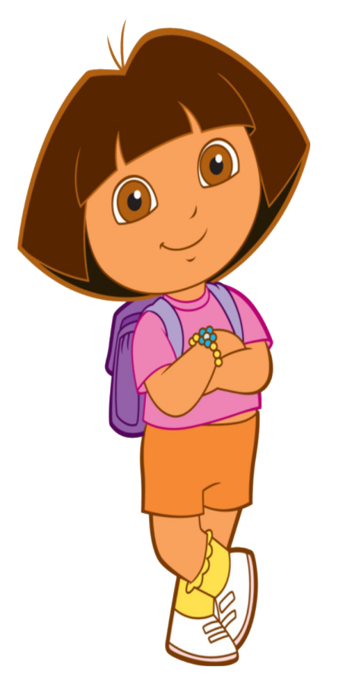

Slide 2
Introduction of the teacher
Md Abdul Kader
Assistant Teacher
Rustompur Govt. Primary School.
Faridgonj, Chandpur.

Slide 3
Introduction of the lesson
Class: Three
Unit: 31
Lesson:1-3
Lesson Title: Punctuation and capital letters.
Today’s Lesson: A. B. & C
Total Time: 30 minutes

Slide 4
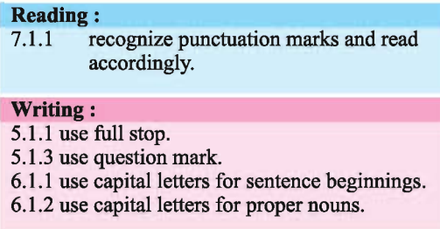
Learning outcomes

Slide 5
Lets watch a video

Slide 6
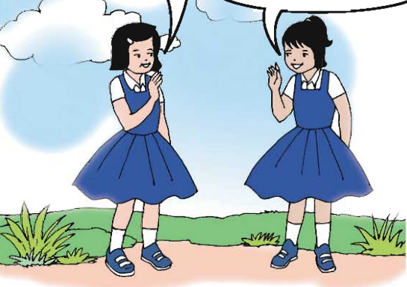
Creating safety environment
What do you see in the picture?

Slide 7
Open at page - 62

Slide 8
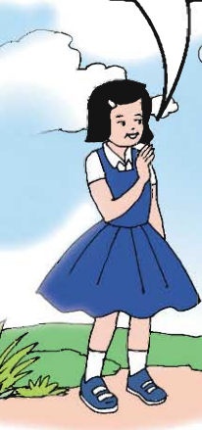
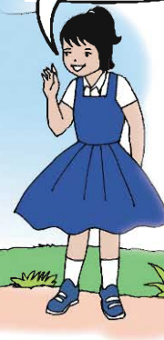
I’m in Class 3.
Are you in Class 3?
Hi ! I’m Riya.
What’s your name?
Yes, I am.
I’m Shanta

Slide 9
talking each other.(Pair work)
Hi ! I’m Riya.
What’s your name?
I’m in class 3.
Are you in Class 3?
Yes, I am.
I’m Shanta

Slide 10
Underline words with capital letter and punctuation mark.

Slide 11
1.Hi! I’m Riya?
2.What’s your name?
3. I’m Shanta.
4.I’m in Class 3.
5. Are you in Class 3?
6. Yes, I’m.

Slide 12
Correct the sentences. Then write them in your cxercise book.
how old are you
is your father’s name anik
my father’s name is ahmed
where are you from
5. i’m from sylhet
How old are you?
Is your father’s name Anik ?
My father’s name is Ahmed.
Where are you from?
I’m from Sylhet.

