Slide 1
Welcome
How are you?

Slide 2
Identity
Md. Faruque Alam
Asst. Teacher, English
Moshoria Emdadia Alim Madrasah
Rajnagar, Moulvibazar
Mobile: 01711-396848
Email: faruquesrg@gmail.com
Class : Six
Subject: English Grammar & Composition
Lesson : Noun

Slide 3
Learning outcomes
Students will learn the definition of noun.
They will identify different kinds of noun.
They will be able to explain noun in details.
They can give example of different nouns.

Slide 4
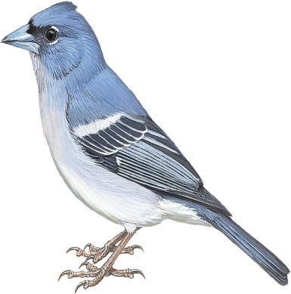
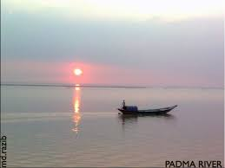
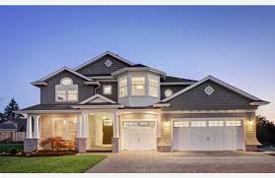
Look at the pictures.
Raju
A Bird(Sparrow
Padma
A flower
A House
What are they?
They are name of a boy, a bird, a river, flower and house.

Slide 5
Can you guess what is our lesson today?
Today our lesson is -
Noun

Slide 6
What is noun?
Name of anything is called noun.
Example: Raju, Mina, Sreemangal, Padma, Meghna, Dhaka, Bangladesh, Man, Boy, Girl, River, Victoria High School, Parabat express, The Daily Independent etc.

Slide 7
Kinds of Noun
Noun
Concrete noun
Abstruct noun
Proper Noun
Common Noun
Collective Noun
Material Noun

Slide 8
Individual Work
How many kinds of concrete noun?
There are four kinds of concrete noun.
Answer

Slide 9
Concrete Noun
Proper Noun
Specific name of anything.
Rahim, Dhaka, Padma, Bangladesh, Victoria High School, Parabat Express etc.
Common Noun
General name of anything.
Man, boy, girl, country, river, city, train, school etc.
Collective Noun
Name of any group or team.
Government, opposition, team, RAB, class, bunch of flower etc.
Material Noun
Name of any elements.
Soil, gold, silver, iron, wood etc.

Slide 10
Pair Work
Identify the material nouns from the following words
Man, Raju, gold, bird, mina, soil, city, silver, town, iron, platinum, river, army, police, school, water.

Slide 11
Concrete Noun
Proper
Common
Collective
Material

Slide 12
Write five example of each noun.

Slide 13
Evaluation
What kind of noun “Raju” is?
How many kinds of concrete noun are there?
Give two example of materials noun.
Ans
Proper noun.
There are four kinds of concrete noun.
Gold, Wood.

Slide 14
Home Work
What is noun? How many kinds of noun are there? Give three example of each noun.

Slide 15
THANK YOU

