Slide 1
Identity
Md. Samim Reza
English Teacher
Teghoria SESDP Model High School
Lakhai, Habiganj
Email: rezasamim4@gmail.com
English 2nd Paper
Class -x

Slide 2
LEARNING OUTCOMES
By the end of the lesson, the Ss will be able to-
Say the definition global warming.
Explain the bad effect of global warming.
Develop a paragraph on global warming.

Slide 3
Warm up
5 min.
Teghoria SESDP Model High School
WELCOME TO MULTIMEDIA CLASS
ENGLISH
Teghoria SESDP Model High School
DHALHARA WESTPARA SECONDARY GIRLS’ SCHOOL

Slide 4
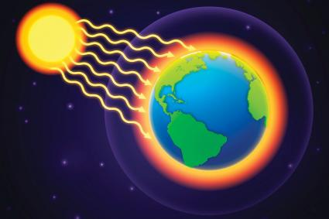
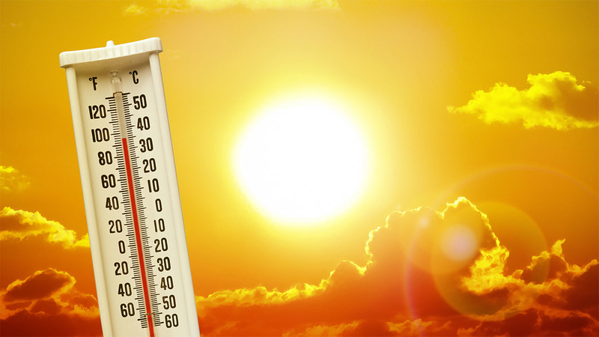
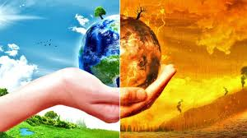
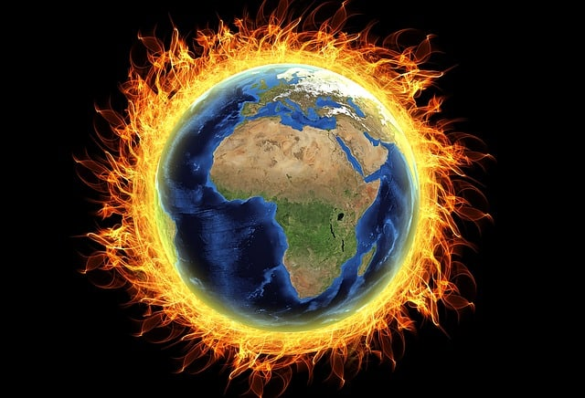
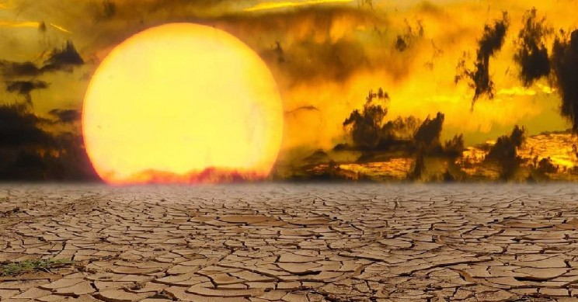
Let’s see some pictures.
Green world
Hot sun ray
Temperature rises
climate changes
uninhabitable
Globe becomes hotter

Slide 5
LET’S SEE A VEDIO CLIP.
https://www.youtube.com/watch?v=s0pv2eNv33U

Slide 6
Could you remind what paragraph is and its criteria .
So , what is paragraph and what are its criteria ?
A paragraph is a group of sentences dealing with a single theme maintain a topic, supporting sentences and a concluding with coherence, unity, variety and good command.

Slide 7
So, what we are going to learn?
PARAGRAPH WRITING ON
GLOBAL WARMING

Slide 8
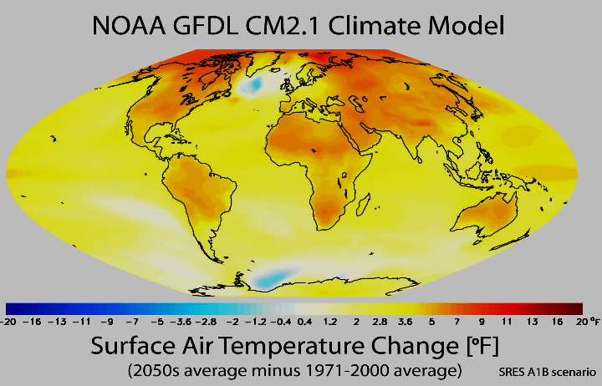
INDIVIDUAL WORK 10 MIN
By asking and answering questions
Global Warming means---------
Global Warming means rising temperature around the world gradually.

Slide 9
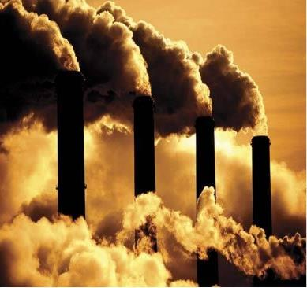
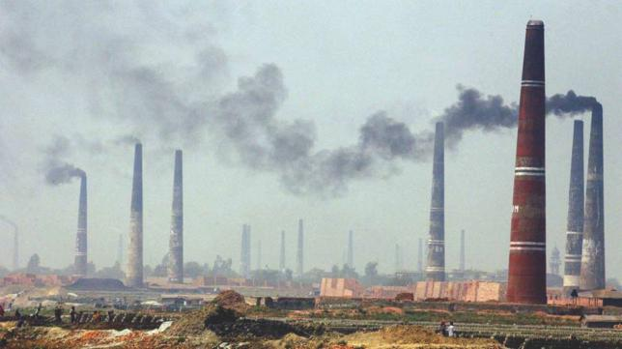
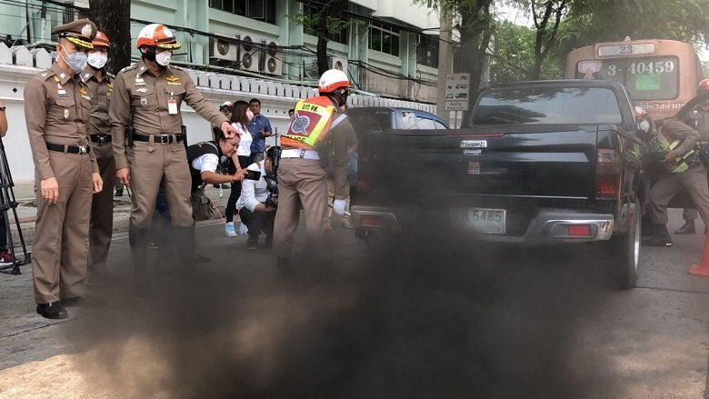
REASONS-----------
huge amount of carbon dioxide resulting from environmental pollution

Slide 10
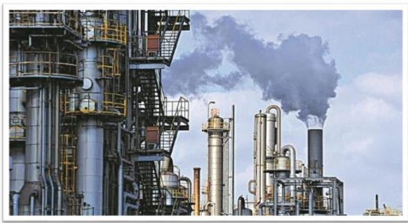
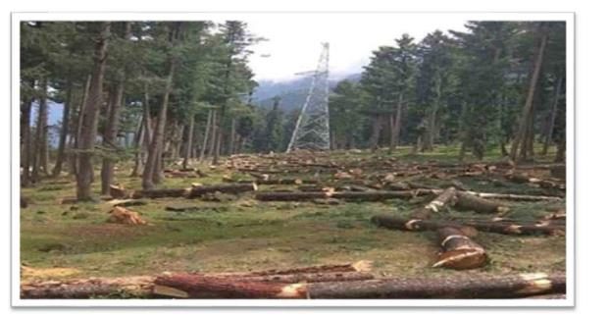
Rapid growth of industries
destruction of forests
use of CFCs in manufacturing and packaging industries
increasing number of vehicles

Slide 11
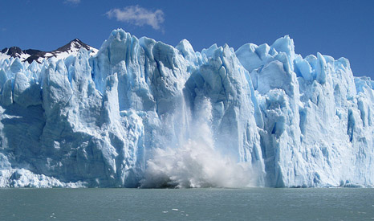
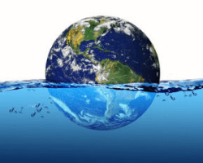
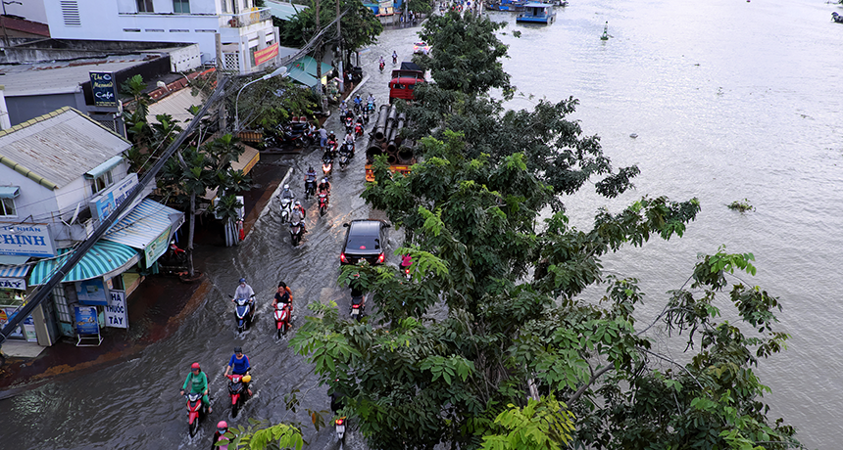
IMPACTS / BAD EFFECTS
Rising sea level
Melting polar ice caps
Submerging coastal area

Slide 12
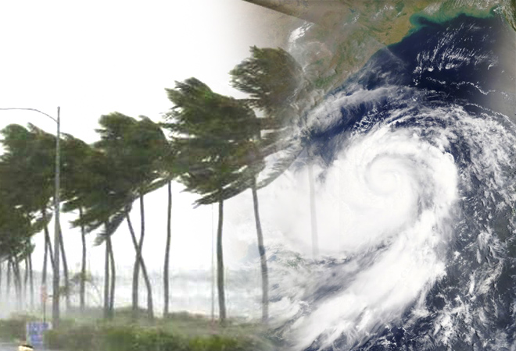
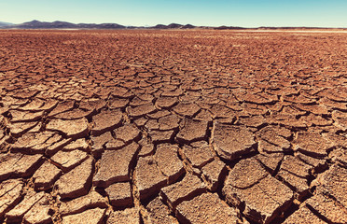
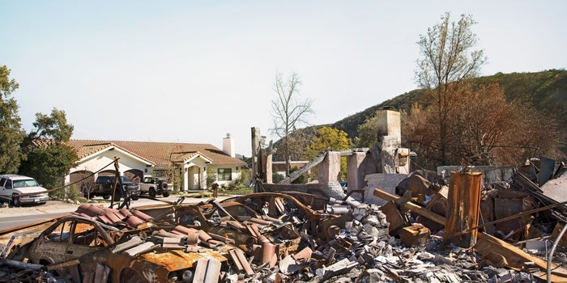
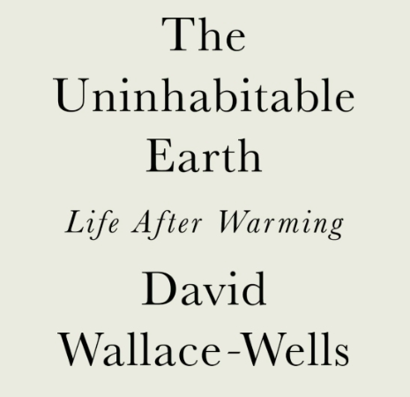
Natural disasters
Natural disasters
Natural disasters

Slide 13
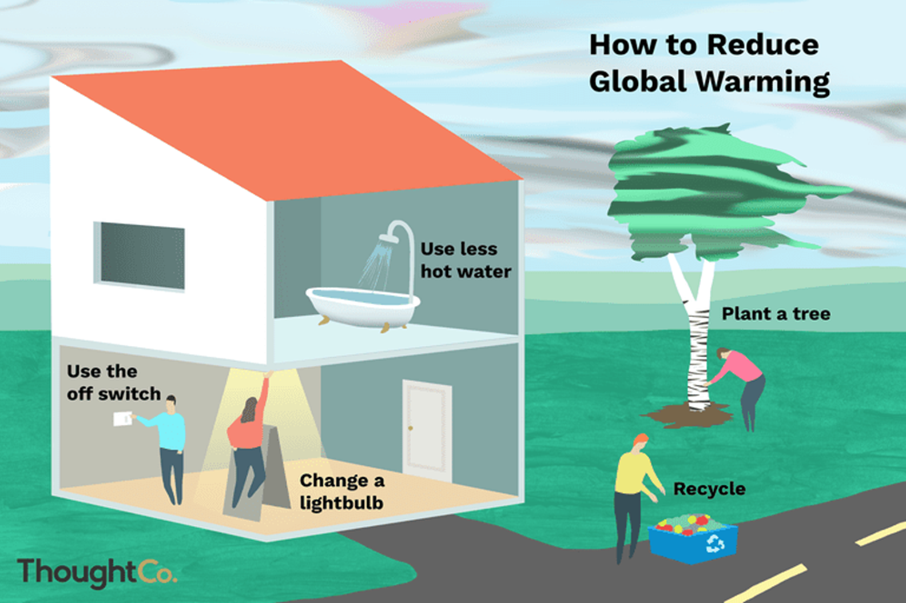
PAIR WORK 10 MIN
By discussing

Slide 14
GROUP WORK 20 MIN
By discussing
Every single group develop a paragraph on
GLOBAL WARMING.

Slide 15
Global Warming
Global warming means the rising of temperature in an average on the surface of the earth. It has affected the environment and whole atmosphere and has resulted into the huge level climate change. There are many reasons behind this increasing global warming. The main reason of global warming is the huge amount of carbon dioxide resulting from environmental pollution. Again the destruction of forests adds to this problem. The growth of industries, increasing number of vehicles and the use of CFCs in manufacturing and packaging industries are also the causes of the rice temperature in the atmosphere. This increase in the world’s temperature has some fatal consequences on humans, animals, and plants. The increased amount of heat will melt the huge ice of the polar ice-caps and thereby, the sea level will rise. Then the salty water of the sea will mix with the river water and will come into the farmlands. Then the fertility of the lands will be lost and man’s ability to grow crops will be reduced. Furthermore, the lower regions of the world including the coastal areas of Bangladesh will go under water. Again, if the temperature rises continuously, many of the species of animals will become extinct forever. So, effective measures must be taken to prevent global warming. Planting more trees and expansion of forestation programmers can go a long way to tackle the situation. Using environment-friendly machines and avoiding the use of CFCs can also reduce the amount of carbon dioxide in the atmosphere. By taking all these steps, we can prevent global warming to make our life danger-free and lead a happy life.

Slide 16
FEEDBACK 5 MIN
1. What is global warming?
What is the main reason of global warming?
What is bad effect of global warming?
How can we reduce it ?
Is it man made? If yes, how?

Slide 17
HOME TASK
Write a dialogue on
GLOBAL WARMING.

Slide 18
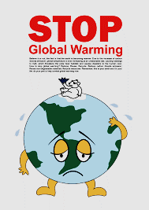
advice

Slide 19
BY
BY BY
BY

