Slide 1
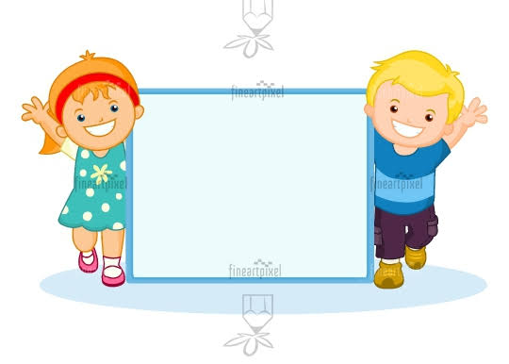
Hi! Welcome to my Class

Slide 3
Hi, my dear students! Today we are going to learn how to make new friends in a new school .

