Slide 1
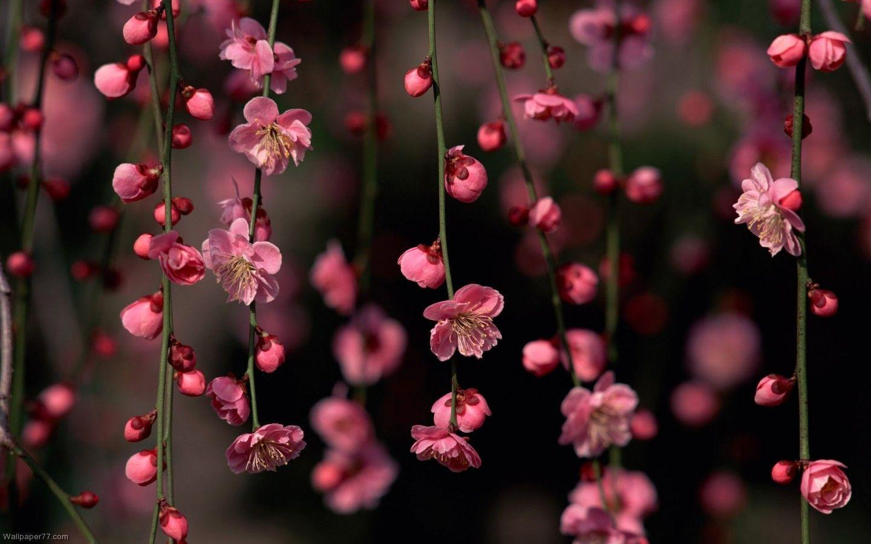
WELCOME
TO OUR ONLINE CLASS

Slide 2
Introduction
Runa bugum
(Assistant Teacher)
Nandia Sangun Ideal Dakhil Madrasah.
Sreepur,Gazipur .
Subject-English 1st paper.
Class- 9-10.
Unit-Five.
Date-14/10/2020

Slide 3
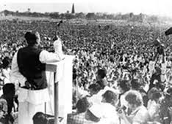
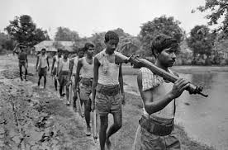
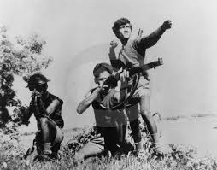
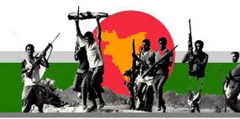
Look at the picture
Picture (2) Freedom Fighters are going to the war.
Picture (1)The Speech of 7th March 1971.
Picture(3)The young are fighting.
Picture(4) Peoples are enjoying Independence.

Slide 4
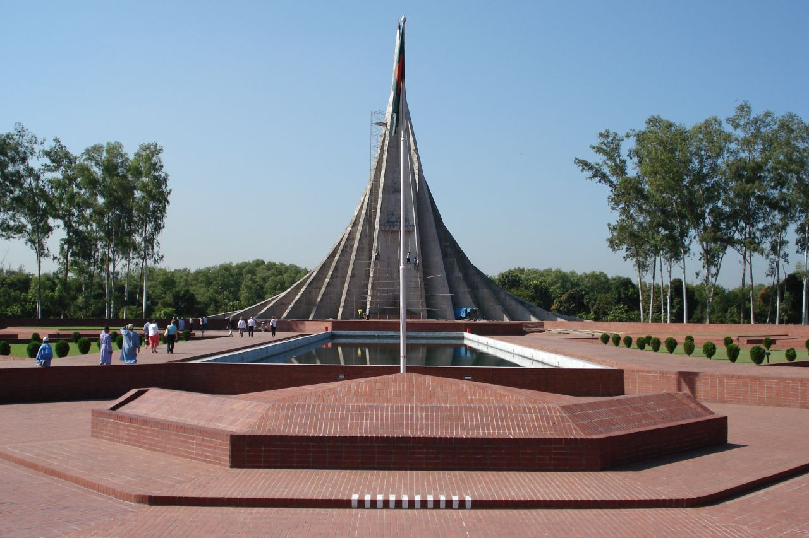
The National Mamorial.

Slide 5
Our Lesson Name is “Independence DAY”

Slide 6
Learning Outcomes
1.Tell The Meaning Of The New Words.
2.Write The Question Answer.
3.Practicing Speaking English.

Slide 7
Word meaning
Wreath = পুষ্পস্তবক অর্পন।
Spectator = দর্শক।
Display = প্রদর্শন করা।
Country = দেশ।
Festival = উৎসব।
Arrange = সাজানো/আয়োজন।
Entertain = চিত্তবিনোদন করা।

Slide 8
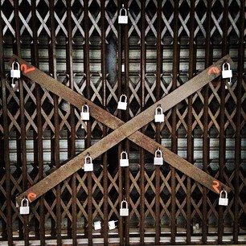
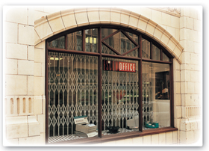
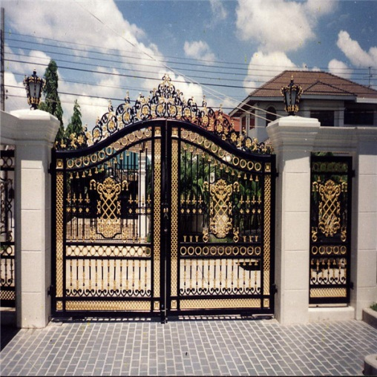
Read About independence day
26 March, our Independence Day, is the biggest state festival. The day is celebrated every year in the country with great enthusiasm and fervour. It is a national holiday. All offices, educational institutions, shops and factories remain closed on this day. The day begins with 31 gunshots.
Shops remain closed
Factories are locked
Offices are closed

Slide 9
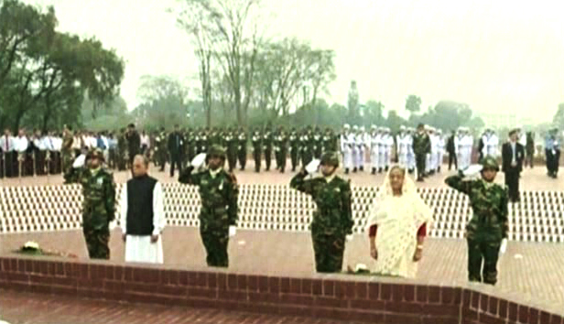
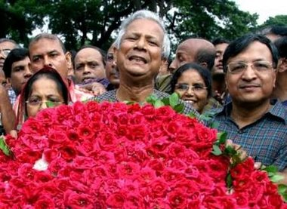
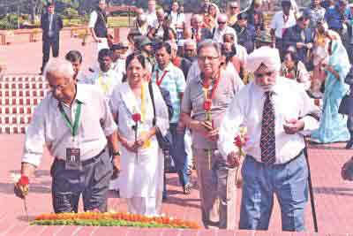
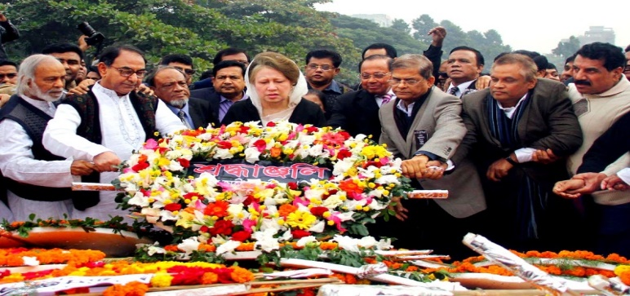
Early in the morning the President and the Prime Minister on behalf of the nation place floral wreaths at the National Musolium at Savar. Then other leaders,diplomats, political parties, social and cultural organisations, and freedom fighters pay homage to the martyrs.
Prime Minister &President
Social organisation
Diplomats
Political Parties

Slide 10
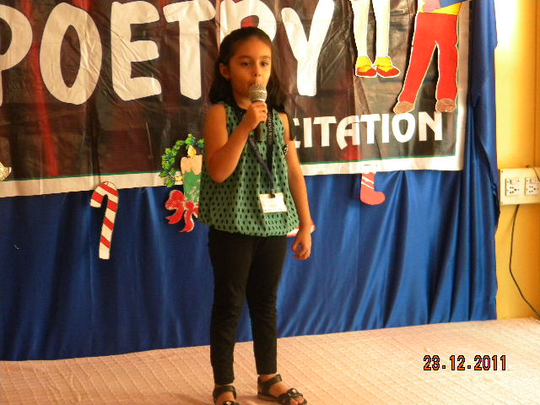
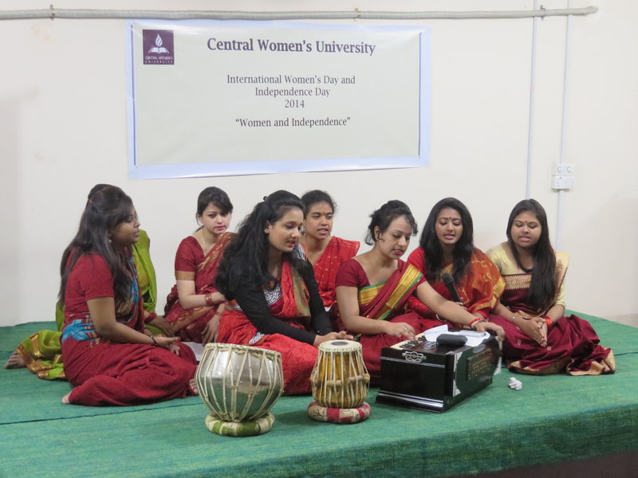
People from all walks of life also come there with rallies and processions.
There are several cultural programmes throughout the day highlighting the heroic
struggle and sacrifice in 1971.
Cultural programmes.

Slide 11
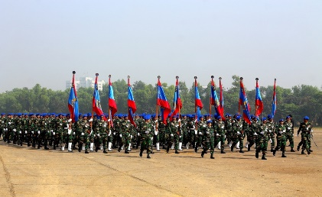
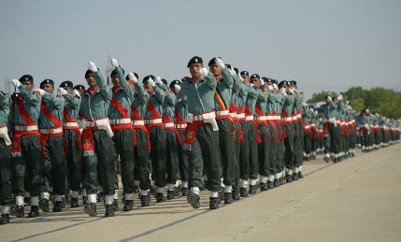
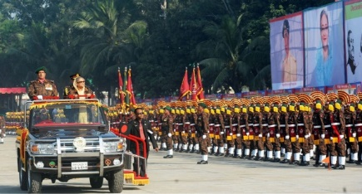
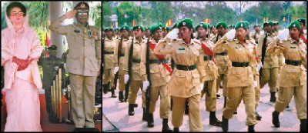
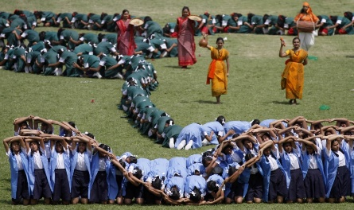
The country also witness a spectacular parade of defence forces, border guards, police, ansars and the VDP (Village Defense Party) at the National Parade Ground near the National Parliament. In Bangabandhu National Stadium, school children, scouts and girl guides take part in various displays to entertain thousands of spectators.
Army
Police
BDB
Ansars
Display

Slide 12
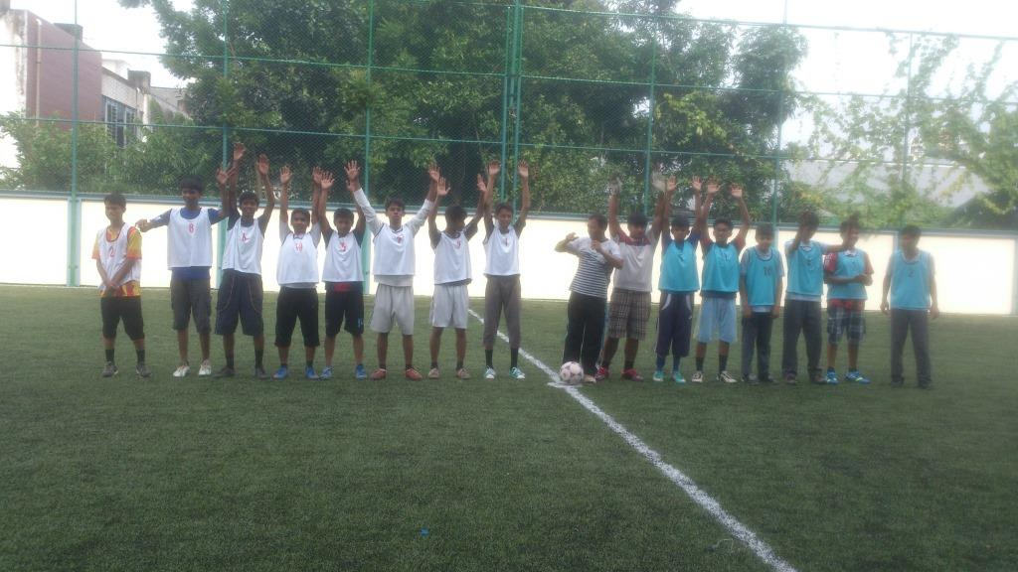
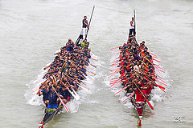
The educational institutions also organise their individual programmes. Sports meets and tournaments are also organised on the day including the exciting boat race in the river of Buriganga.
Tournament
Boat race

Slide 13
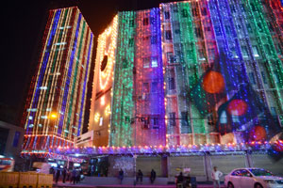
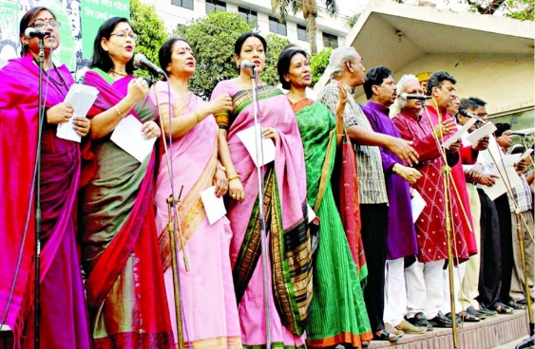
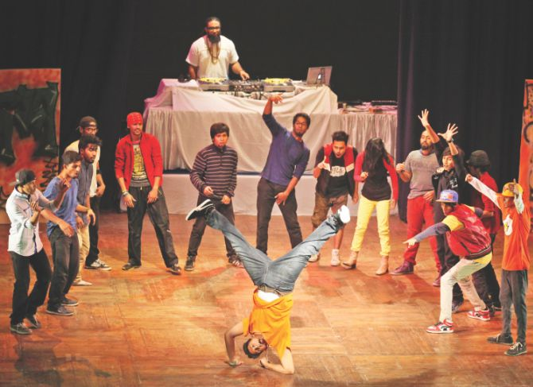
In the evening, all major public buildings are illuminated with colourful lights.
Bangla Academy, Bangladesh Shilpakala Academy and other socio-cultural organisations hold cultural functions. Similar functions are also arranged in other
places in the country.
Major Buildings Illuminated with Colourful Lights.
Musical Ceremony, held by Bangla Academy.
Drama, Arranged by
Shilpakala Academy.

Slide 14
ANSWER THE FOLLOWING QUESTION
1.WHAT IS YOUR DUTY IN THE INDEPENDENCE DAY.
2.WHY DO YOU PAY HOMAGE TO THE MARTYRS.
3.WHAT IS THE SIGNIFICANCE OF INDEPENDENCE DAY.

Slide 15
Evaluation
Choose the best answer -
Our biggest state festival is—
a/ Victory day. b/ Shaheed Dibosh. C/ Pahela Boishakh. D/ Independence Day.
2. The day begins with---
a/ processions b/ gunshots C/ singing d/ dancing
3. The national Mausoleum is ------
On Dhaka university campus b) at Ramna park. c) at Savar d) at medical college
4. How do the people come at savar?
a/ By walking b/ by Rickshaw C/ by bus d/ by launch
5. The major public building are decorated with--
a/ flowers. b/ papers C/ papers and flowers d/ colorful lights.
6. The national parade ground close to------
a/Sangad bhaban b/The National Stadiam c/Rumna Park d/Dhaka University

Slide 16
b) Gunshots
d) Independence Day
3.c) At Savar
4.a) By walking
5.d) Colorful lights
6.a) Sangad bhabon
Answer Sheet

Slide 17
Home Work
* Write about how did you celebrate the Independence day in your Madrasah.

Slide 18
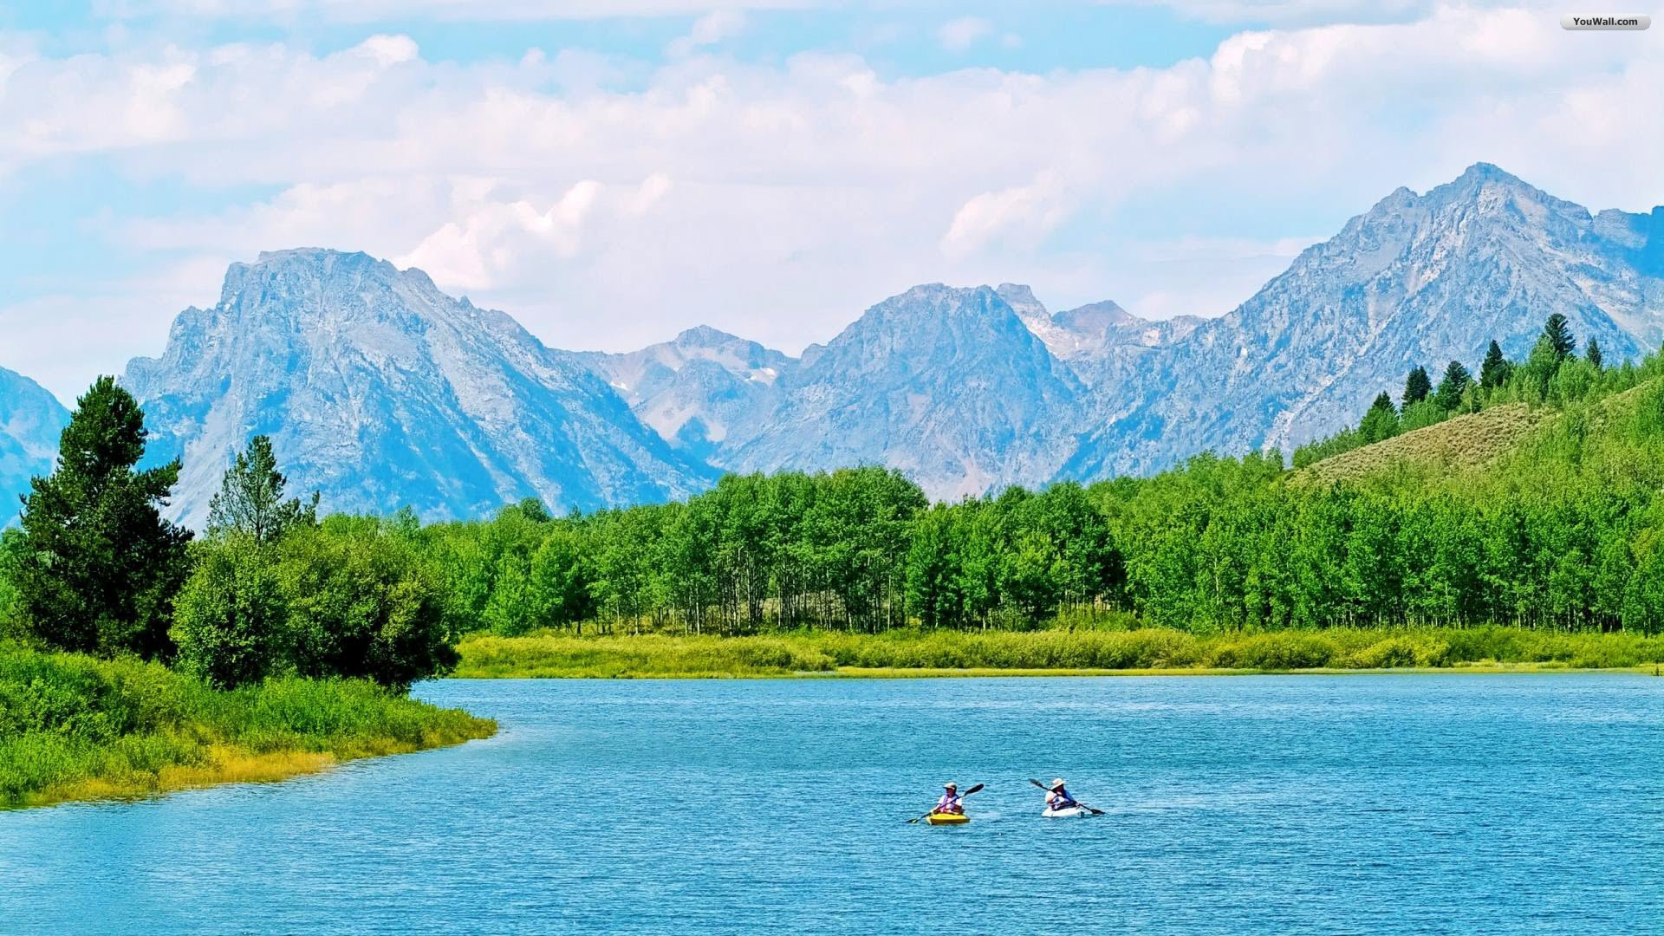
THANK YOU ALL
THANK you
ALL

