Slide 1
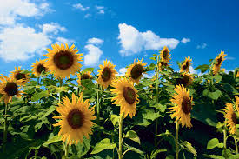
Good morning to all.

Slide 2
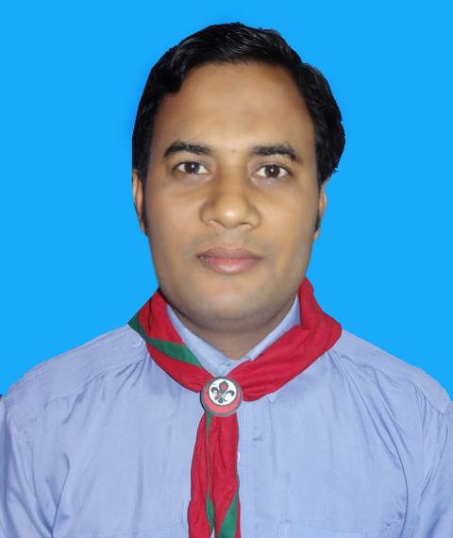
মোঃ আব্দুর রকিব
সহকারী শিক্ষক
ছত্রাজিতপুর সরকারি প্রাথমিক বিদ্যালয়।
শিবগঞ্জ, চাঁপাইনবাবগঞ্জ।
Email: marokibgpst@gmail.com

Slide 3
Lesson identity
Class: Five
Sub: English for today
Today’s lesson: Story
Time: 40 minutes
Date:

Slide 4
Let’s sing a song together.

Slide 5
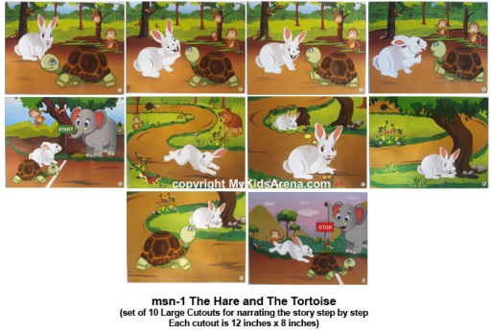
Look at the pictures and think .
What are the pictures about?
The pictures are about a rabbit and tortoise

Slide 6
Today’s lesson is story
‘A rabbit and tortoise.’

Slide 7
Learning outcomes :
At the end of the lesson students will be able to know
and write a story about a tortoise and a rabbit.

Slide 8
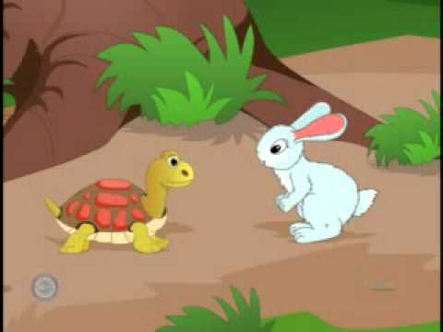
Look at the picture and think about it.
One day , a hare was walking in the forest
when he saw a tortoise. The hare was the
fasted animal in the forest.

Slide 9
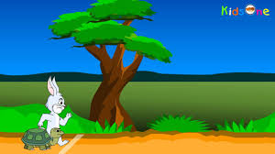
What are you looking ?
The hare always boasted that he
could run faster than the tortoise.

Slide 10
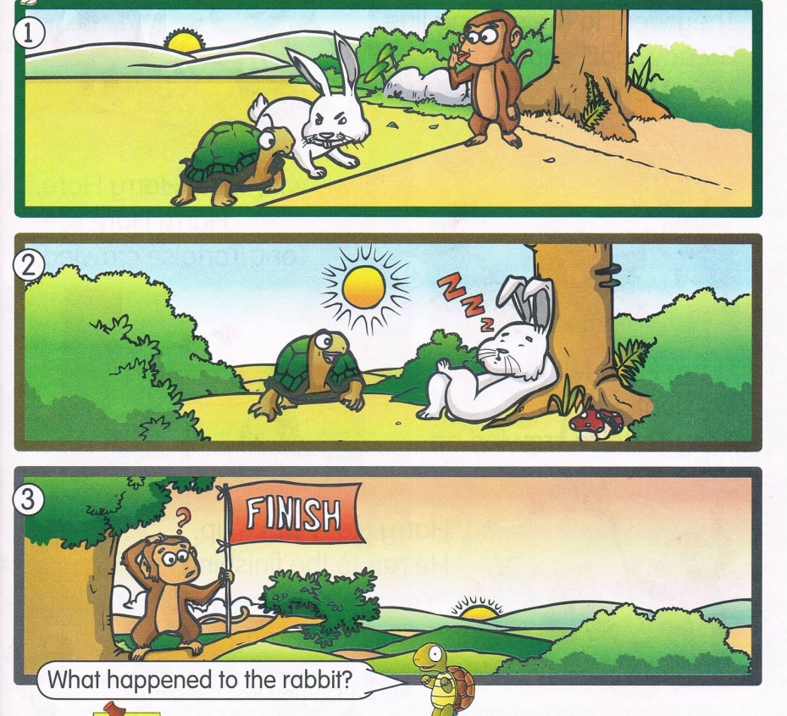
What can you see in the pictures ?
So they decided to have a race . They
chose a starting and finishing point.

Slide 11
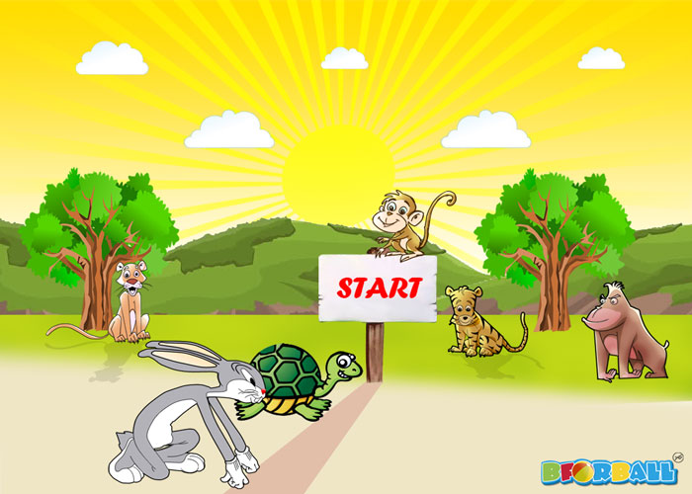
Why did the animals came there?
They were ready to start their race.

Slide 12
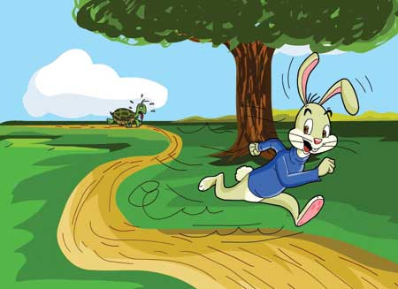
What are you looking in the picture?
The hare ran really fast and soon
left the tortoise far behind.

Slide 13
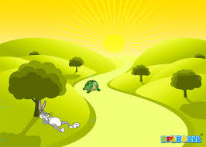
What can you see in the picture?
The hare thought that tortoise is
too slow and he can rest for a while.

Slide 14
Everybody, look at the picture?
So he stopped under a
tree and went to sleep.

Slide 15
What is happening at now?
Meanwhile tortoise kept walking the whole
time and reached the wining point.

Slide 16
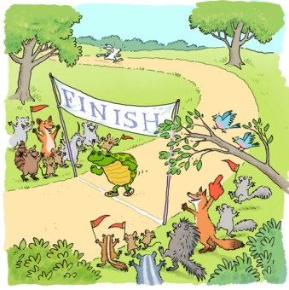
What was happened at last?
When the rabbit woke up he saw that tortoise
has already reached and won the race.

Slide 17
Let’s read the story again.
The Hare and the Tortoise
One day, a hare was walking in the forest when he saw a tortoise. The hare was the fasted animal in the forest. The tortoise was the slowest animal in the forest. The hare called out to the tortoise, “Hurry up! You are so slow! Can`t you walk faster? Can`t you run?”

Slide 18
Group work
Make a logical assemble
with the words-hare, tortoise
started, always, chose, behind,
walking , reached, win .

Slide 19
Evaluation
Write five senteces about
Slow and steady wins the race.

Slide 20
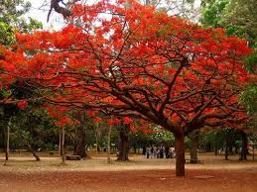
No more today
THANKS TO ALL

