Slide 1
WELCOME TO TODAY’S MULTIMEDIA
CLASS

Slide 2
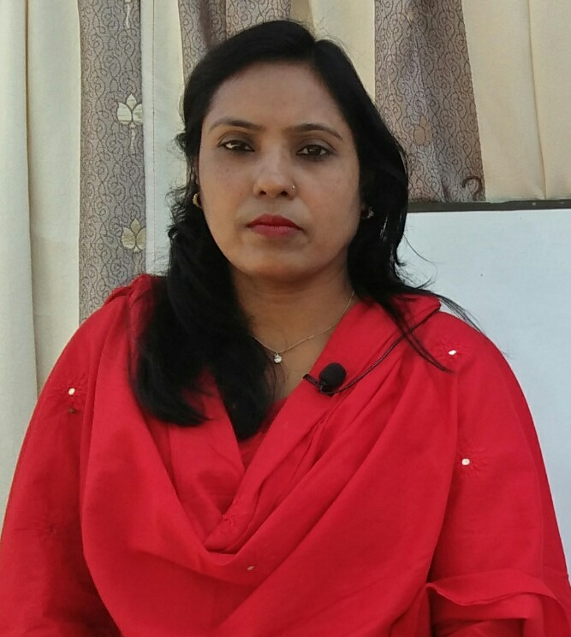
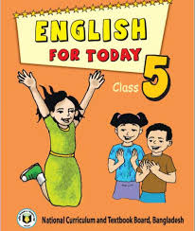
IDENTITY
Lesson Identity
Class: 5
Subject: English For Today
Text: Cyclone Aila
Special Lessons: Babul --------Plastic box.
Page: 95
Time: 40 Minutes
Teacher Identity
Most. Marju Ara Begum
Head Teacher
Dokkhin Balapara Government Primary School
Dimla,Nilphamari.
Email: marjuara1982@gmail.com

Slide 4
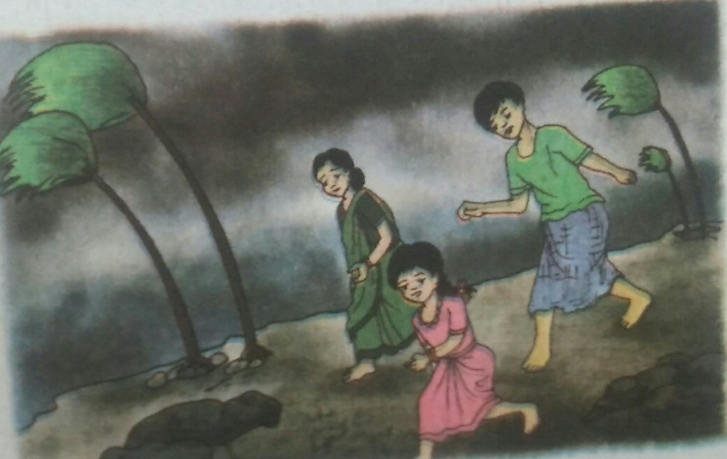
Look at the picture and think about this
What about the picture?

Slide 6
Let’s us now find new words from the text:
Island = দ্বীপ
Remember = স্মরণ করা
Terrible = ভয়ঙ্কর
Grocery = মুদি খানা
Grandparents = দাদা-দাদী
Happened = ঘটা,ঘটানো
Emergency = জরুরি
Extra = অতিরিক্ত

Slide 7
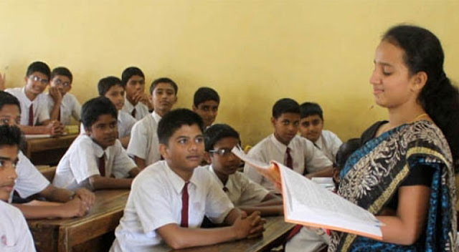
Ideal Lesson

Slide 8
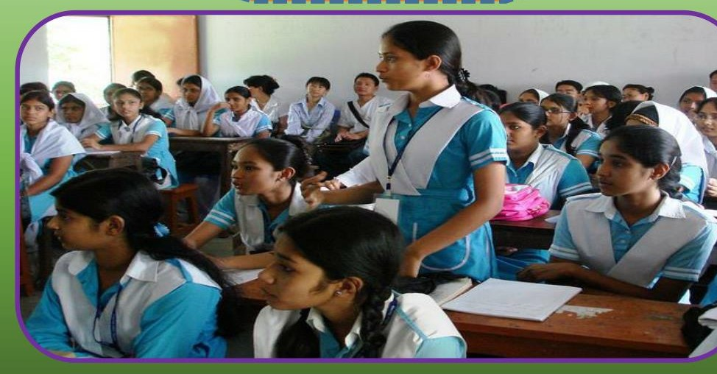
Loud Lesson

Slide 9
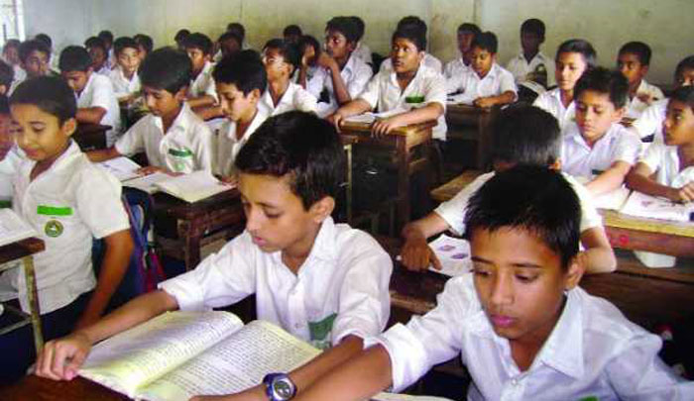
Silent Lesson

Slide 10
Fill in the blanks of the following sentences with words from the above box. There are three more words:
Ampan
Emergency
Island
Extra
Cloth
Remember
Grocery
Saint Martin
Babul and his family live on the ___________ of Dublar Char.
Babul doesn’t ______________ Cyclone Aila.
Babul father had a ___________ shop.
His grandparents cheked the family _____________ kit.
They had _________ batterries .

Slide 11
True/ False? If true,write True and If false, write false.
Cyclone Aila happened May
Babul’s father is a small trader
Babul’s mother worked in a grocery shop
2009

Slide 12
Answer the following questions
What was Babul’s father?
(b) What was Babul’s mother?
(c) How was the day of Aila?

Slide 13
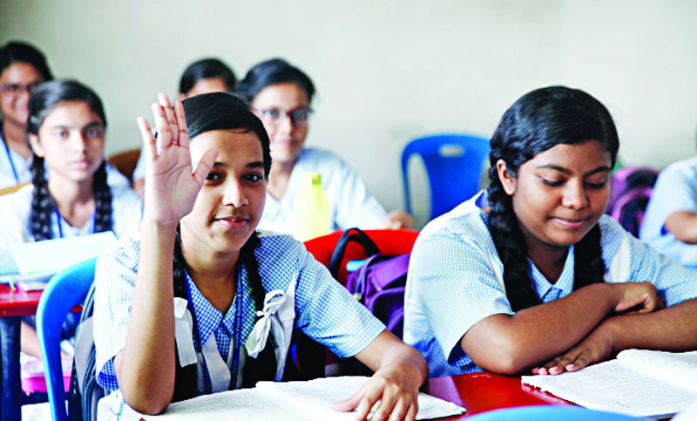
Evaluation

Slide 14
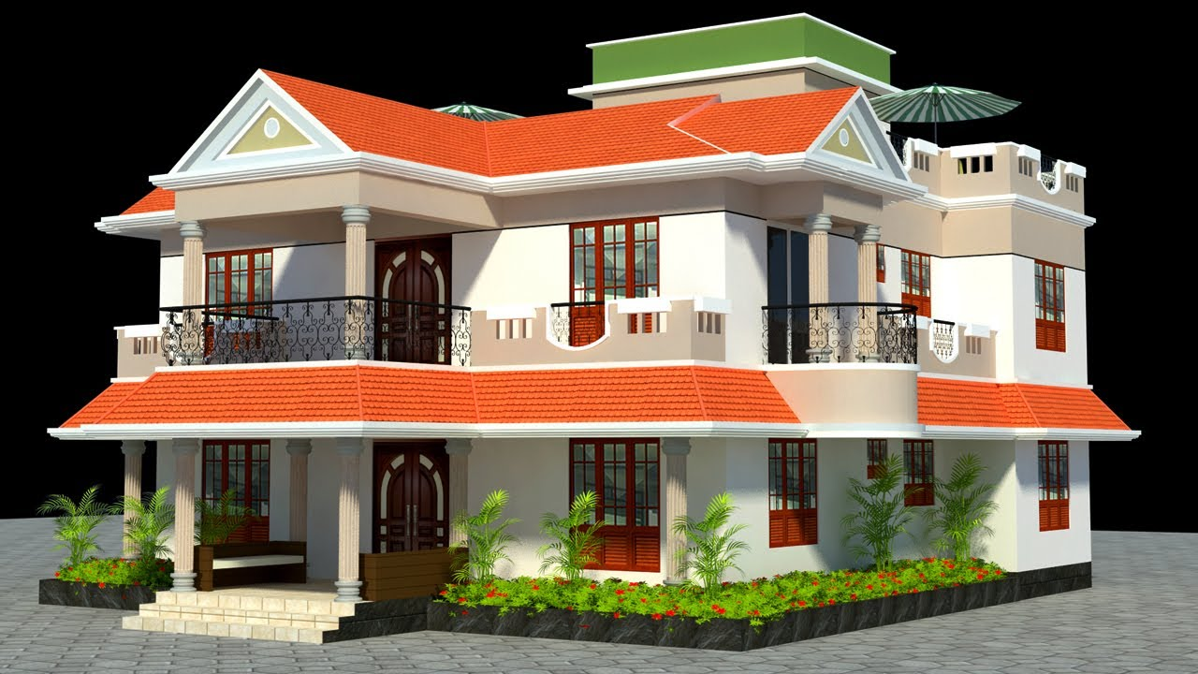
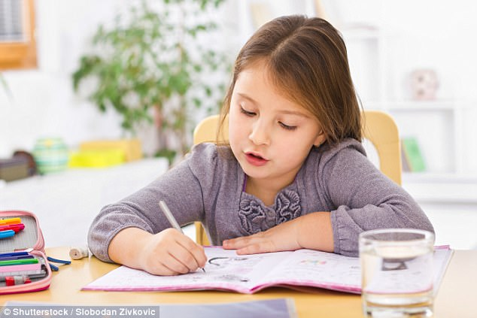
Homework
Write five sentence about cyclone Aila

