Slide 1
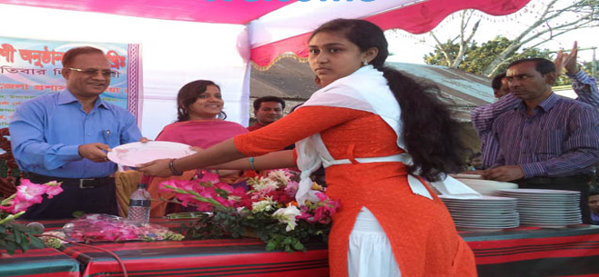
Welcome to all

Slide 2
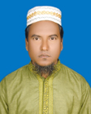
Identity
Habibur Rahman
Asst. Teacher
Barohit High School
Ishwargonj, Mymensingh
Contact No: 01724102270
English For Today
Class : 7
Date : 07/11/2020

Slide 3
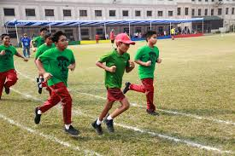
What do you see in the picture?
Some students are running a race during annual sports.

Slide 4
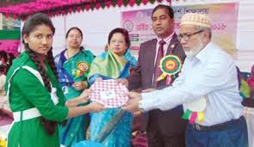
What do you see in the picture?
A participant is receiving prize for good performance.

Slide 5
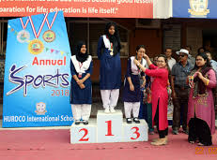
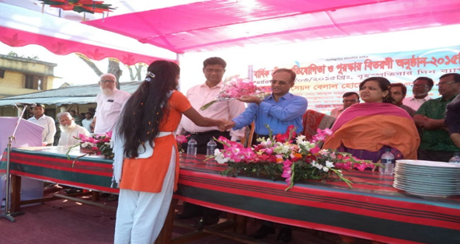
Look at the picture and imagine what may be our todays lesson.

Slide 6
Our today’s lesson is…
Prize-giving day at school
Unit : 3, Lesson: 1

Slide 7
Learning outcomes
After the end of the lessons the students will be able to …….
read and understand the texts
talk about familiar events
ask and answer questions
make sentences using new words

Slide 8
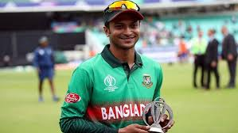
Keywords
Eminent (Adjective)
Meanings: Famous, Important, Renowned, Respected
Antonyms: Notorious
Shakib Al Hasan is an eminent cricketer.

Slide 9
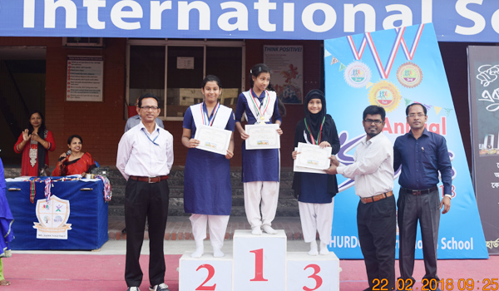
Keywords
Outstanding (Adjective)
Meanings: Great, Unique, Excellent
Antonyms: Ordinary, General, Normal
They got prizes for their outstanding activities.

Slide 10
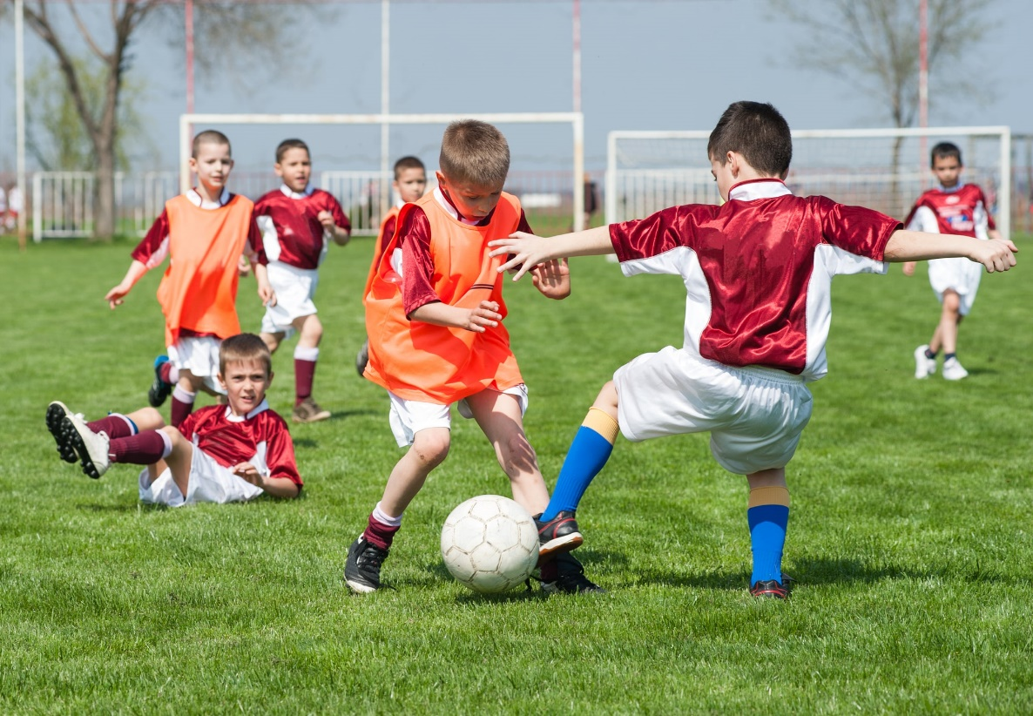
Keywords
Performance (Noun)
Meanings: Skill,
Talent, Achievement,
Antonyms: Inexperience
The children’s performance in the match was eye-catching.

Slide 11
Section B: Read the text and answer the questions.
Farabi is Flora’s best friend. They live in the same area. Also they are both in class 7. But they go to different schools.
It is a school holiday. Flora has come to visit Farabi. They are talking. Flora wants to know about the prize-giving ceremony of Farabi’s school. “Yesterday was our school’s prize-giving day,” Farabi says. “On this occasion our school auditorium and its dais were brightly decorated. Prizes were also neatly displayed on a separate table on the dais. All the students were present at the function. Among others, the guardians and some eminent persons of the locality attended the function, “ Farabi continues. “ The principal of PN College was the chief guest.”
“When did the function start?” Flora asked.
“Oh, it started on time—just at 4 pm,” Farabi says. “Our Head Teacher first read out the annual report. Then the Chief Guest gave a short speech. He highly praised the overall performance of the school and its excellent JSC and SSC Exam results. Then he gave away the prize among the students for their outstanding activities.”
“Did you get any prize, Farabi?” Flora enquires.
“Yes, I did,” Farabi replies. “I’ve got two prizes-----one for regular attendance and the other for good results in the last year-ending exams.”

Slide 12
Individual work
C) Match the words with their meanings.
Visit
Speak highly of somebody or something
Ceremony
Extremely good
Eminent
To go to see a person or place
Praise
Putting something in a place where you can see it easily
Outstanding
function
Display
People having lots of power and influence

Slide 13
Individual work
Match the answer.(Click on the word)
Visit
To go to see a person or place
Ceremony
function
Eminent
People having lots of power and influence
Praise
Speak highly of somebody or something
Outstanding
Extremely good
Display
Putting something in a place where you can see it easily

Slide 14
Pair work
D) Ask and answer in pairs. Make questions and then choose answer from this table.
Questions |  |  | Answers
How | Was Did | the prize-giving function held? | The Principal of PN College.
What |  | the auditorium decorated? | In the school auditorium.
Who |  | the chief guest at the function? | Read out the annual report.
Where |  | the Head Teacher do at the beginning of the function? | Brightly.

Slide 15
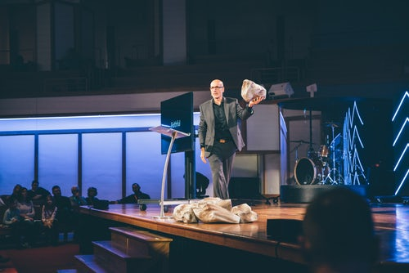
Now think about the picture
Staging one-act play

Slide 16
Group work
E) Complete the passage with the verbs in the box. Give their correct forms.
Be sing speak stage
At the end of the prize-giving function there …………cultural show. The students……....., danced and …………a one-act play. It was so good that everyone…………highly of it.
was
sang
staged
spoke

Slide 17
Home Work
Write a paragraph on
“Sports day at your school”.

Slide 18
Thanks to all.

