Slide 2
WELCOME

Slide 3
Uttam Kumar Das
Assistant Teacher
Taragonj Gov. Primary School
Kapasia, Gazipur.
Mobile no: 01715535350
E-mail: at.uttamkumardas.pt@gmail.com

Slide 4
Class: Three
Subject: English
Time: 40 minutes
Date: 07/11/2020

Slide 5
Lets see some pictures

Slide 6
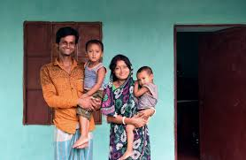

Slide 7
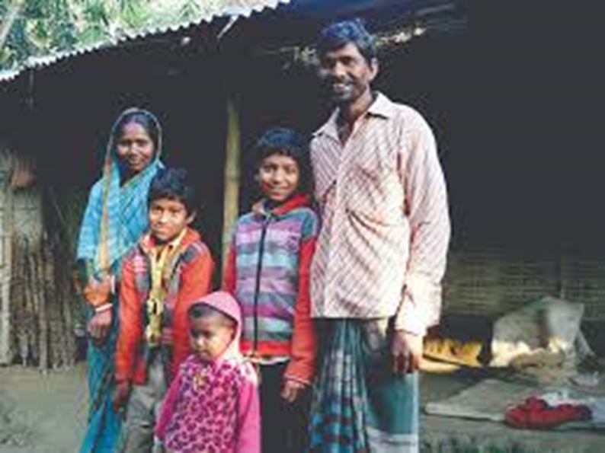

Slide 8
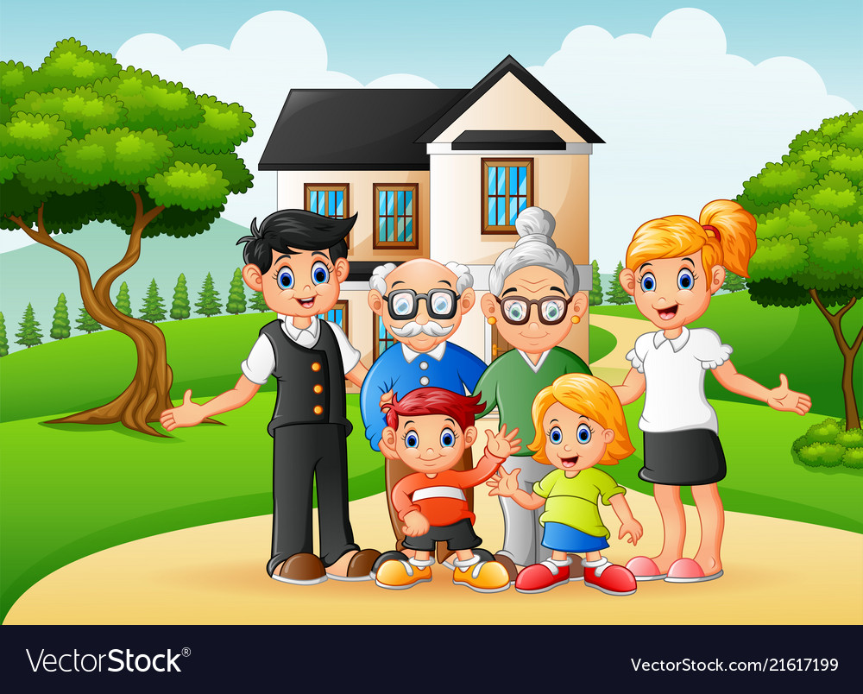

Slide 9
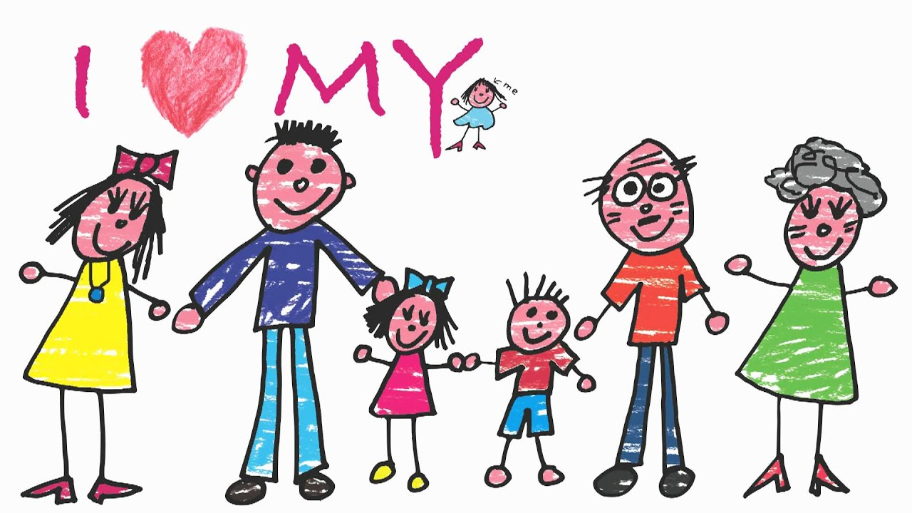

Slide 10
My family

Slide 11
Learning Outcomes:
Students will be able to
4.3.1 enjoy and understand simple stories.
5.1.1 read simple paragraphs.
10.1.1 Write short and simple paragraph by answering a set of questions.

Slide 12
New Words
People
Persons
Teacher
Person who teaches
Banker
Person who works in a bank
Year
About 365 day or 12 month
Old
Age

Slide 13
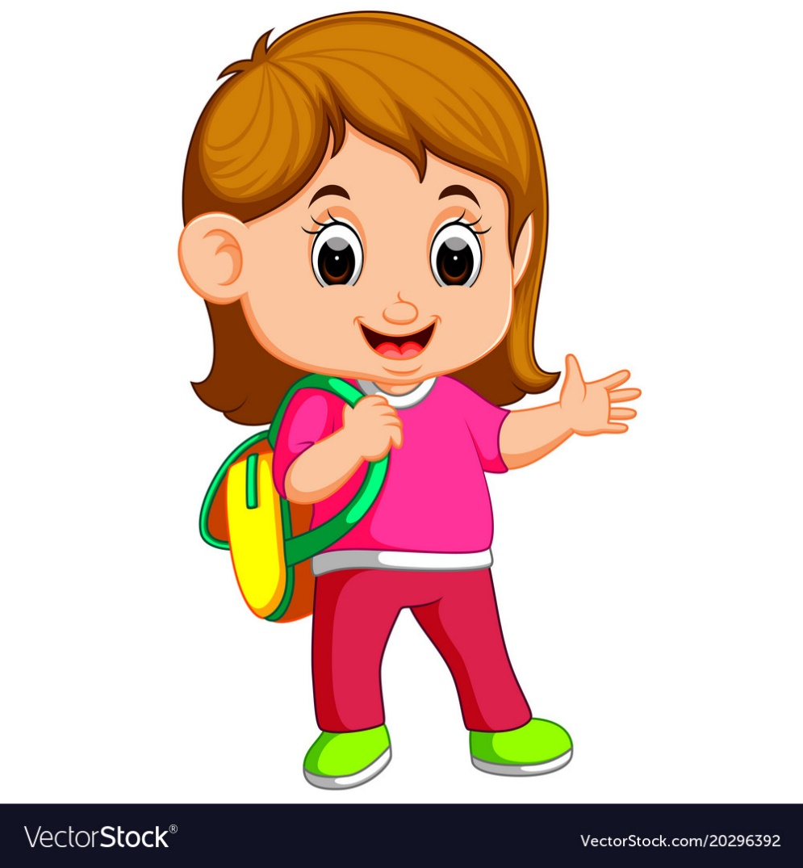
I’m Tisha. I’m a student. I’m in class 3.
.

Slide 14
There are four people in my family.

Slide 15
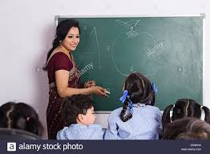
My mother is a teacher.

Slide 16
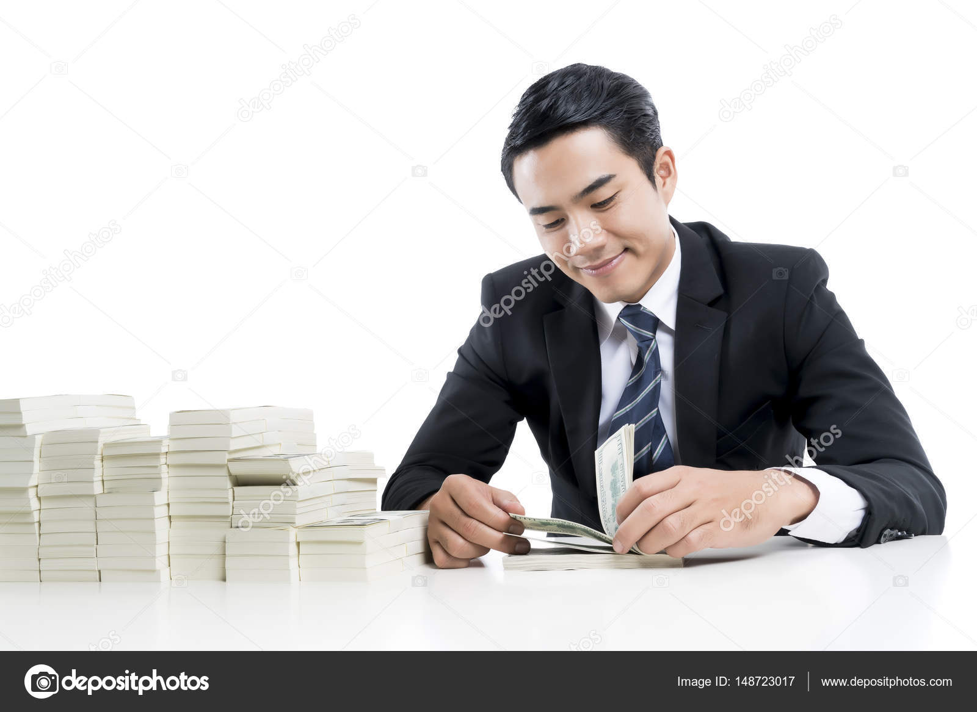
My father is a banker.

Slide 17
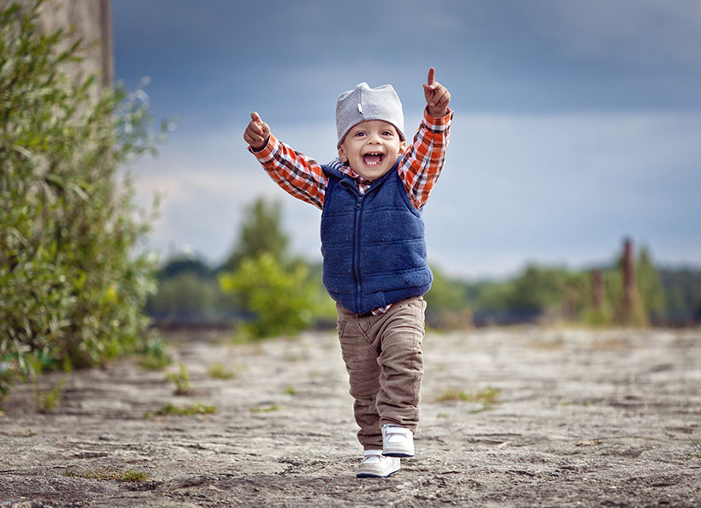
My brother is two years old.

Slide 18
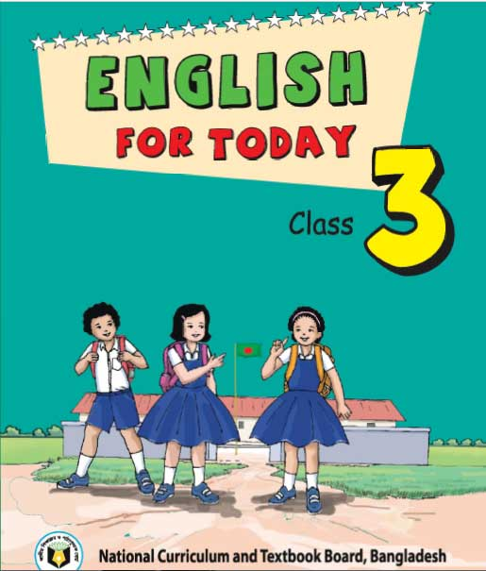
My Family
I’m Tisha. I’m a student. I’m in class 3. There are four people in my family. My mother is a teacher. My father is a banker. My brother is two years old.

Slide 19
Fill in the gaps the with the words.
Tisha is a ----------.
She is in ------------- 3.
Her mother is a ---------.
Her father is a -----------.
teacher
banker
class
student

Slide 20
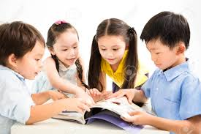
Group A
Group B
Write three sentences about Tisha by answering the following questions.
What is the girl’s name?
What is she?
What class is she in?
Write three sentences about Tisha’s family by answering the following questions.
How many people are there in Tisha’s family?
What is her mother?
How old is her brother?

Slide 21
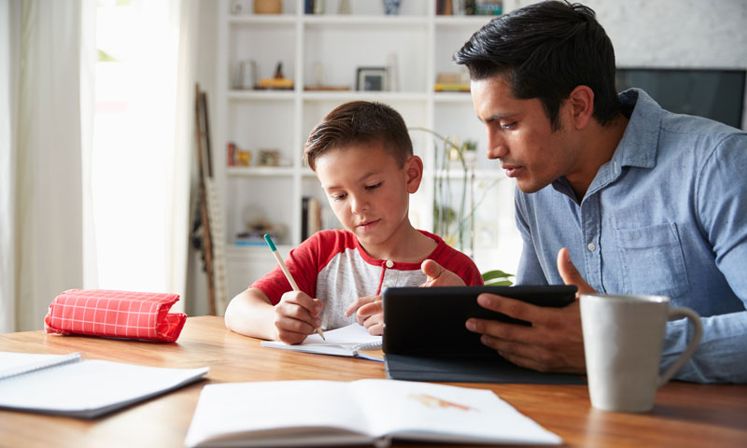
HOME WORK
Write three sentences about your family.

