Slide 1
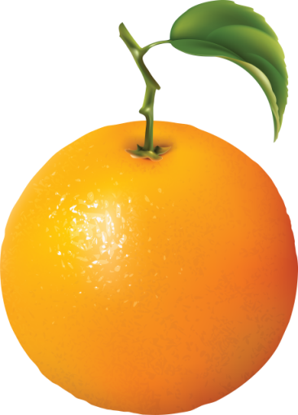
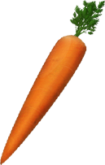
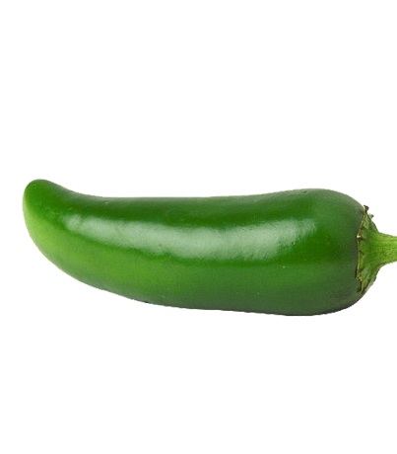
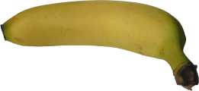
Notes:
This is a food related topic. So to transfer ideas about food these pictures are added. Just one click.

Slide 2
PREPARED &PRESENTED BY:
MD. MANSURUL HOQUE PIEAL
Assistant Teacher
BAMNI ADARSHA HIGH SCHOOL
RAIPUR, LAKSHMIPUR

Slide 3
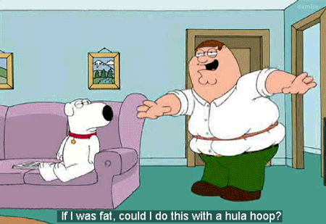
Notice the pictures and sentences:
The girl was crying and I saw her.
The man is very fat but active.
Read attentively or you will fail in the exam.

Slide 4
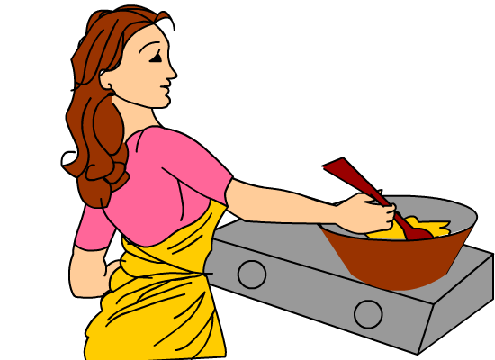
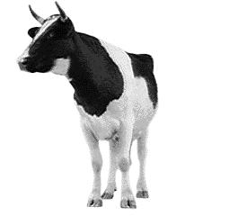
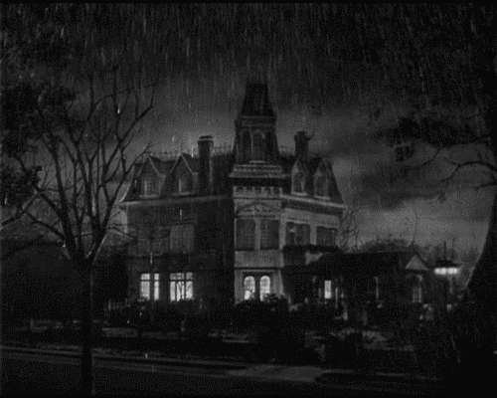
Notice the pictures and sentences:
The boy who is playing is my brother.
The woman who is cooking is my aunt.
This is the cow which I bought yesterday.
It rains heavily when it is rainy season.

Slide 5
TODAY OUR TOPIC IS
Changing Sentence
Complex
to
Compound
Part-2

Slide 6
Learning Outcomes
By the end of the lesson, students will have
been able to understand Complex & Compound Sentence.
been able to identify Complex & Compound Sentence.
3. learnt to make Complex & Compound Sentence.
learnt to identify Principal Clause & Sub-ordinate Clause.
learnt to change from complex to compound.

Slide 7
5. Complex: If + Past Indefinite, would/could + V1
Compound: and so/and (If the clauses are
affirmative, they will be negative, If the clauses are
negative, they will be affirmative)
Complex: If he worked hard, he would succeed.
Dependent Clause
Independent Clause
Subordinating conjunction
Compound: He did not work hard
and so
he could not succeed.

Slide 8
Complex: If he did not waste his time, he could finish the work by evening.
Dependent Clause
Independent Clause
Subordinating conjunction
Compound: He wasted his time
and so
he could not finish the work by evening.

Slide 9
Complex: so that/in order that + Sub. +
may/might, can/could
Compound: Sub. + want to/ wanted to +
extension + and so + another clause
Complex: He ran fast so that he could win the race.
Sub.
Subordinating conjunction
Compound: He
wanted to
win the race
and so
he ran fast.

Slide 10
Complex: She goes to the library so that she can read.
Sub.
Subordinating conjunction
Compound: She
wants to
read
and so
she goes to the library.

Slide 11
7. Complex: that (Noun Clause)
Compound: 2nd clause + and + 1st clause + it/this
Complex: She believes that charity is a great virtue.
1st clause
2nd clause
Subordinating conjunction
Compound: Charity is a great virtue
and
she believes
it.

Slide 12
Complex: Everybody knows that Abir is intelligent.
1st clause
2nd clause
Subordinating conjunction
Compound: Abir is intelligent
and
everybody knows
it.

Slide 13
8. Complex: As/Since/When
Compound: so/and so
Complex: Relative Pronoun (who, which, where etc.)
Compound: and + personal pronoun
Complex: As he was tired, he went to bed early.
Dependent Clause
Independent Clause
Compound: He was tired
and so
he went to bed early.

Slide 14
Relative Pronoun
Complex: I helped a man who was blind.
Independent Clause
Dependent Clause
Compound: I helped a man
and
he
was blind.

Slide 15
Relative Pronoun
Complex: I had killed the bird which made the winds blow.
Independent Clause
Dependent Clause
Compound: I had killed the bird
and
it
made the winds blow.

Slide 16
Pair Work
Change the following complex sentences to compound.
I have a cow which is red.
2. Though he is poor, he is honest.
3. We eat so that we may live.
4. I saw a bird which sat on the roof.
5. As the old man killed the bird, he was punished.

Slide 17
Individual Work
Change the following complex sentences to compound.
You will shine in life if you work hard.
2. He worked hard so that he could prosper in life.
3. I know that he is honest.
4. Although he has riches, he leads a poor life.
5. If you do not do, you will die.

Slide 18
Home Work
Change the following complex sentences to compound.
As I was ill, I could not go to college.
2. I was so young that I did not learn to say ‘no’.
3. Jerry was a boy who was honest.
4. When the door opened, Jim stepped in.
5. If you do not walk fast, you cannot get the train.

Slide 19
THANK YOU ALL

