Slide 1
Welcome students

Slide 2
Teacher Identity
Md. Mizanru Rahman
Assistant Teacher
Kartala Govt. Primary school
Chandina, Cumilla.
01723316682
.

Slide 3
Subject Identity
Class : Five
Subject:English
Unit:06
Time: 40minutes.

Slide 4
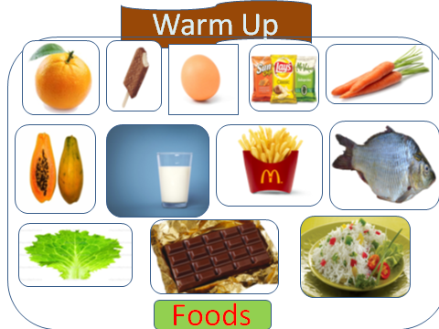

Slide 5
Lesson Declaration
Eat healthy
Page:22

Slide 6
Learning Outcomes
1.1.1.Student will be able to recongnize ,say proper sound and stress.
3.3.1. Classify the healthy and unhealthy foods.

Slide 7
Milk
Rice
They are healthy food.

Slide 8
Orange
papaya
They are healthy food.

Slide 9
Fish
Lettuce
They are healthy food

Slide 10
Carrot
Egg
They are healthy food

Slide 11
Chips
Chocolate
They are unhealthy food

Slide 12
Ice cream
Fries
They are unhealthy food

Slide 13
This is unhealthy food.We should not eat this.

Slide 14
Groupwork
A
B
Write the names of healthy food to see the text book.
Write the names of unhealthy food to see the text book

Slide 15
Evaluation
Orange is ………..
Chips is …………
Papaya is …….
Chocolate is …...

Slide 16
THANKS

