Slide 1
mmwewwwwwe
Welcome

Slide 2
Md. Mizanru Rahman
Assistant Teacher
Kartala Govt. Primary school
Chandina, Cumilla.
01723316682

Slide 3
Class:3
Subject:English
Unit:21
Lesson:3
Time:40 minutes

Slide 4
SONG
WE SHALL OVERCOME ,WE SHALL OVERCOM…

Slide 5
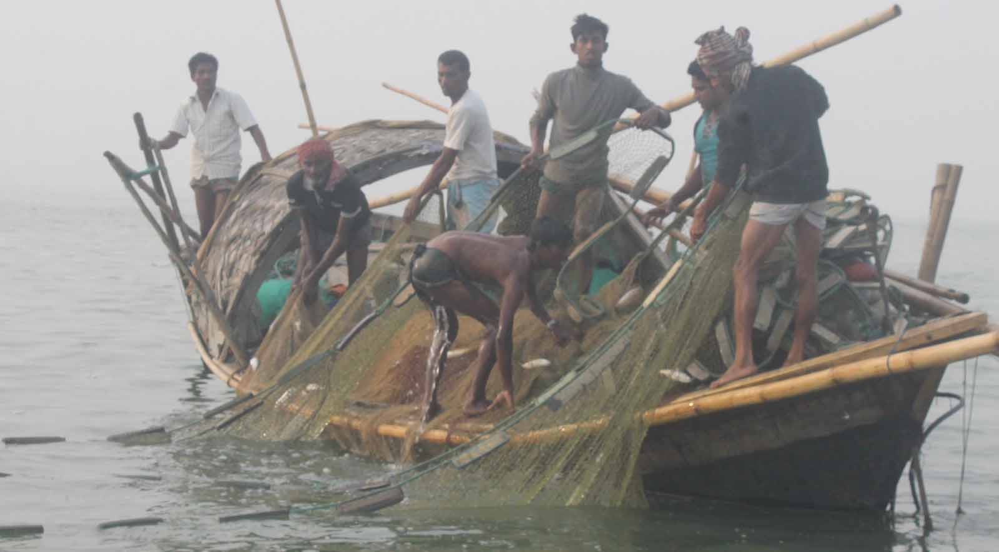
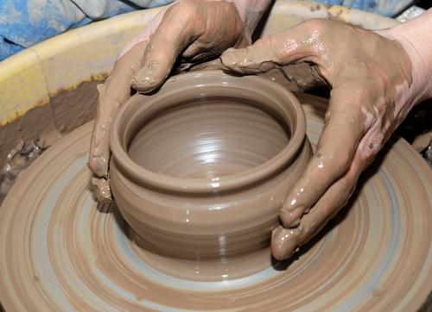
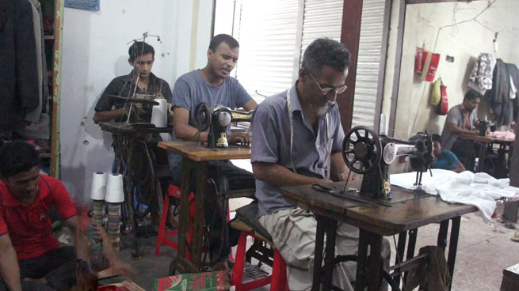
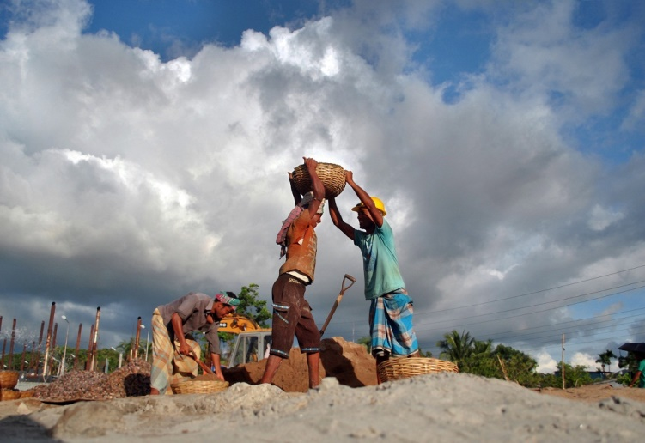

Slide 6
OCCUPATIONS
Lesson tittle:-
Page no-43

Slide 7
Learning outcomes
Students will be able to:
8.1.1 write words from the
Textbook or model.

Slide 8
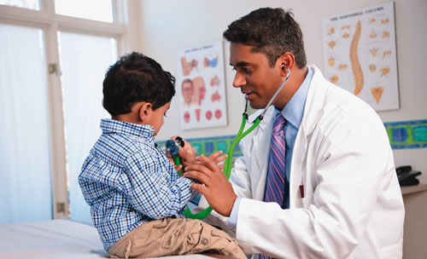
Doctor

Slide 9
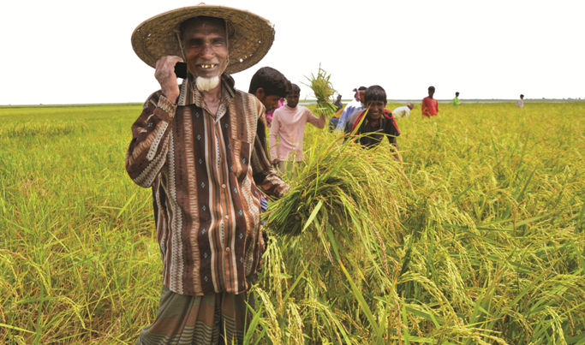
Farmer

Slide 10
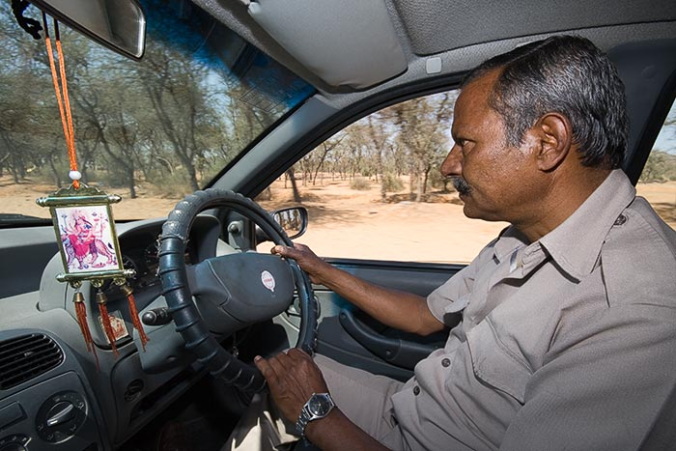
Driver

Slide 11
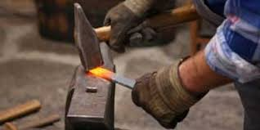
Blacksmith

Slide 12
Ooccupations
Driver
Farmer
Doctkor
Blacksmith

Slide 13
MATCH THE PICTURES WITH WORDS
Doctor
Blacksmith
Driver
Farmer

Slide 14
Group-A
Group-B
G
R
O
U
P
W
O
R
K

Slide 15
EVALUATION
Write the name of four occupations :-

Slide 16
HOME WORK
Read with spelling and writing the name of todays four occupations .

Slide 17
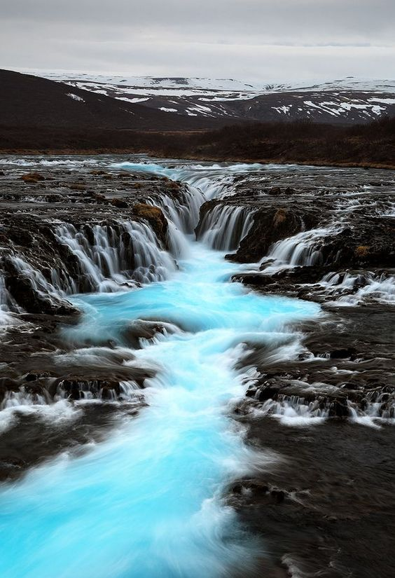
THANK YOU

