Slide 1
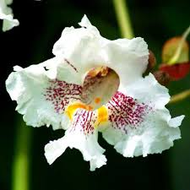
WELCOME

Slide 2
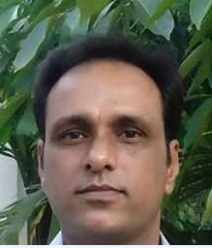
INTRODUCTION OF THE TEACHER
Ranadhir Das
Assistant teacher
Dokkhin sangor Govt primary school
Baniyachang, Habiganj.

Slide 3
Class: Two
Subject: English for today
Unit: 2
Lessons: 3

Slide 4
LEARNING OUTCOMES:
1.1.1 become familiar with English sounds by listening to common English words.
1.1.2 repeat after the teacher simple word and phrases with proper sounds and stress.

Slide 5
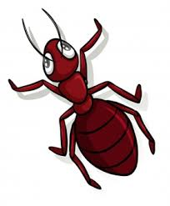
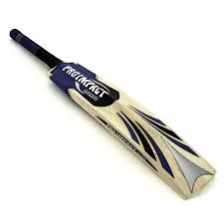
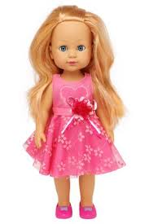
Let’s see some picture

Slide 6
Today’s lessen
Alphabet

Slide 7
Ant

Slide 8
Bat

Slide 9
Cup

Slide 10
Doll

Slide 11
A
B
C
D

Slide 12
Bat
Ant
Doll
Cup

Slide 13
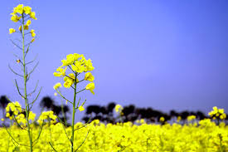
Thanks

