Slide 1
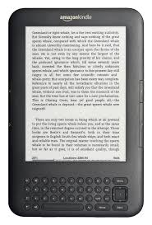
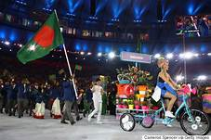

Slide 2
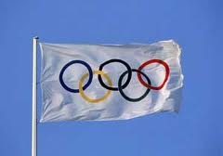
Welcome
to
Olympic
Games

Slide 3
Md. Shamsunnnoor
Head teacher
Murergaon govt.primary school Companiganj, Sylhet.
email : shadmanheya@gmail.com
Contact : 01712-307039

Slide 4
Class Five
English for Today
Lesson : 5-6, Page : 68
Unit: 17

Slide 5
Students will be able to :
read the lesson with correct pronunciation and stress.
2) Know more about The Olympic Games.

Slide 6
Safe learning environment :
by watching video clip

Slide 7
Announcinng Lesson-

Slide 8
The Olympic games

Slide 10
Teachers loud reading

Slide 11
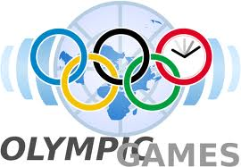
The Olympic Games is the biggest sports competition of the world

Slide 12
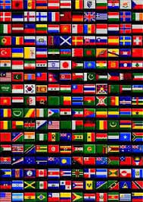
More than 200 nations participate in it.

Slide 13
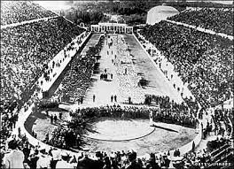
It occurs every four year. The tradition of the olympic games comes from Greece. The Greeks first held it at the foot of the Mount Olympus. That was almost 3000 years ago.

Slide 14
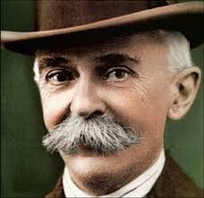
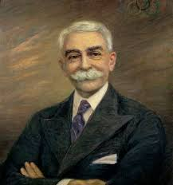
Baron Pierre de Coubertin , a French man , is the father of the modern Olympic games. He founded the International Olympic Committee (IOC) in 1894.

Slide 15
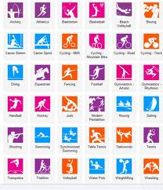
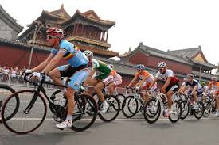
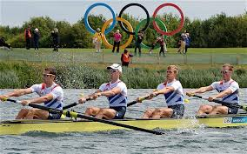
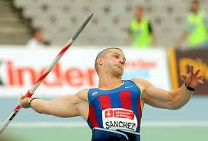
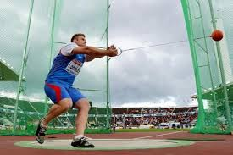
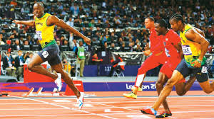
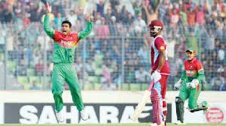
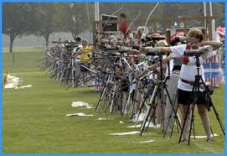
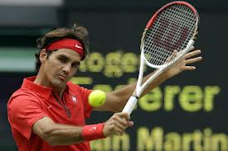
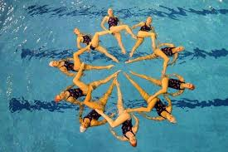
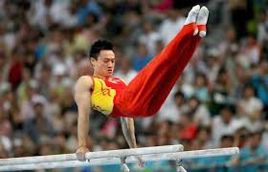
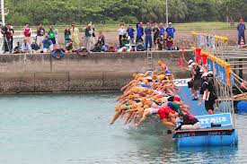
Now over 13000 athletes compete in 33 different sports in the Olympic Games.

Slide 16
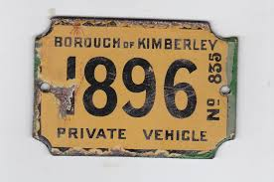
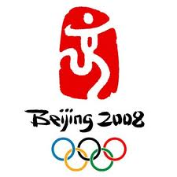
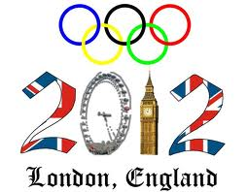
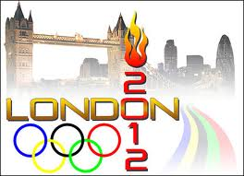
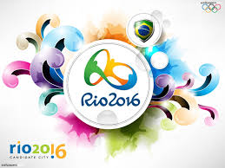
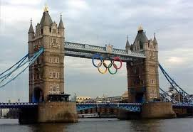
The world has already seen 29 Olympic games. The 30th Olympic Games took place in London, in 2012

Slide 17
Silent reading

Slide 18
Multiple choice question :
1) How many nations participate in the Olympic Games?
a) 200 b) 250 c) 300 d) more than 200.
2) Where does the tradition of the Olympic Games come from?
a) France b) Bangladesh c) Greece d) German.
3) Who is the father of modern Olympic Games?
a) Maradona b) Baron Hay man c) Baron Pierre de Courbertin
4) What did he found ?
a) OIC b) IOC c) OPEC d) ICC.
5) Where did the 30th Olympic Games take place ?
a) In Rome b) In Paris c) In London d) In Athens

Slide 19
Fill in the gaps:
four
1) The Olympic Games occurs every…… years.
2) The Olympic Games is the ..……..sports competition.
3) That was almost .......... years ago.
4) The .................. of the Olympic Games comes from Greece.
5) Now over ................ athletes compete in the Olympic Games .
biggest
13000
3000
tradition

Slide 20
Answer the following questions :
(1) What is the biggest sports competition of the world ?
2) How many nations participate in it ?
3) When does Olympic Games occur ?
4) Who founded the IOC ?
5)How many events are there in Olympic Games ?
Questions Answer :
(1) What is the biggest sports competition of the world ?
(2) How many nations participate in it ?
(5) How many events are there in Olympic Games ?
(3) When does Olympic Games occur ?
(4) Who founded the IOC ?
More than 200 nations participate in it .
The olympic games is the biggest sports competition of the world
Olympic Games occurs every four year.
Baron Pierre de Coubertin founded the IOC.
There are 33 events in Olympic Games.

Slide 21
Pair Work
(2) How many events are there in Olympic Games ?
(1) What is the biggest sports competition of the world ?
Answer :
The Olympic Games is the biggest sports competition of the world.
Answer :
There are 33 events in Olympic Games .

Slide 22
Individual Work
Who founded the IOC ?
Answer :
Baron Pierre de Coubertin founded the IOC .

Slide 23
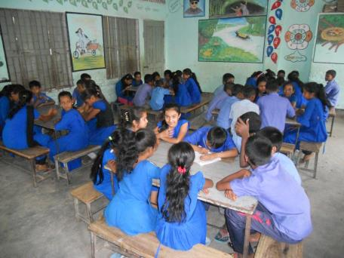
Evalution
Who founded the IOC ?
When does Olympic Games occur ?

Slide 24
Home work.
Write a small paragraph about The Olympic Games.

Slide 25
Thanks my dear students.
see you
next class.

Slide 26
End of the Lesson.

