Slide 1
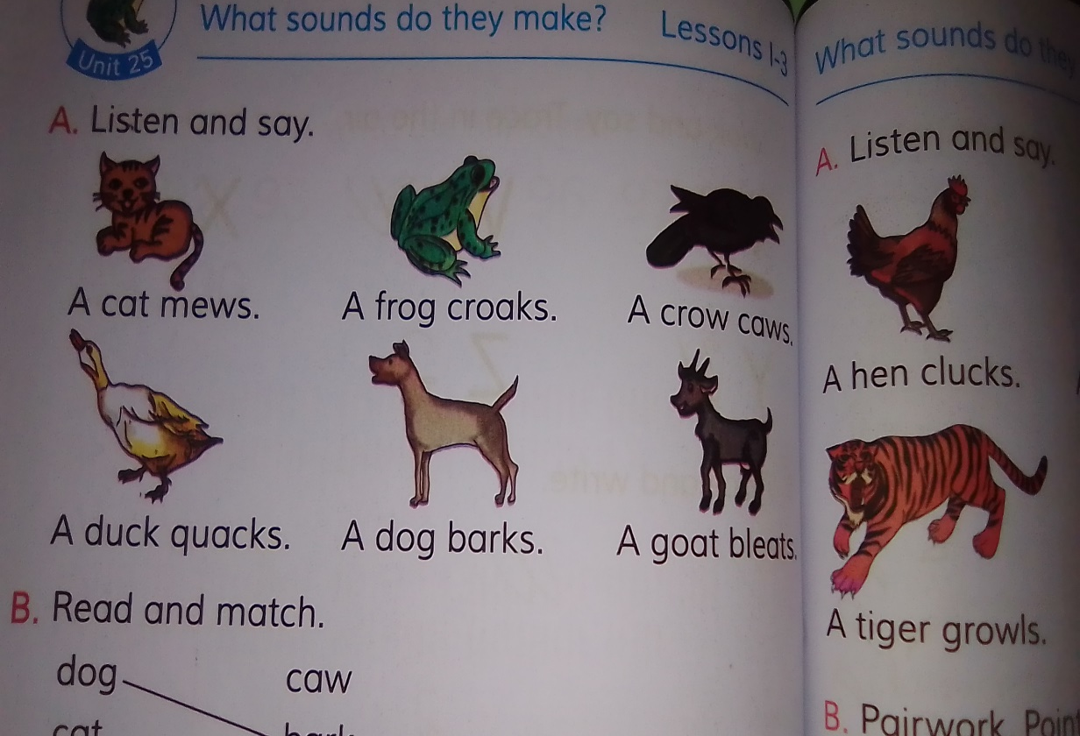
CLASS: 3(THREE) Subject: English Unit: 25 Page:50
WHAT SOUNDS DO THEY MAKE ?

Slide 2
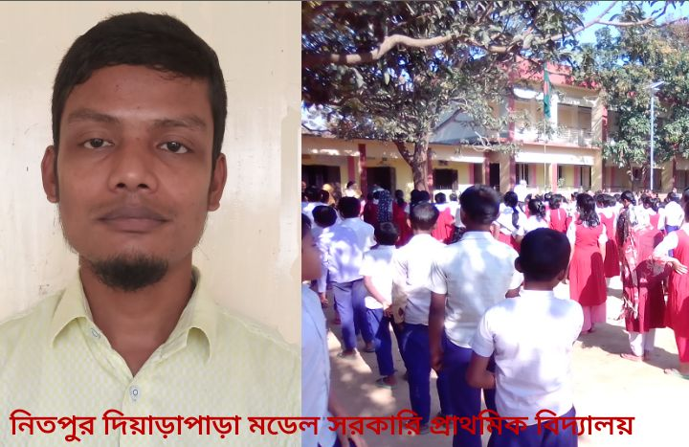
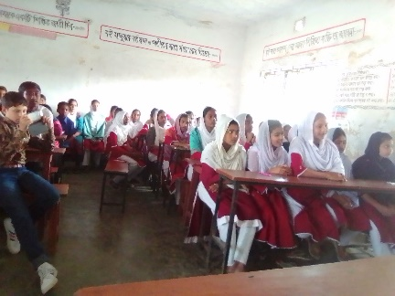
IDENTITIES
MD. SADEQUL ISLAM
BSc(Honours),MSc(Mathematics)
Assistant Teacher
Nitpur Diarapara Model Government Primary School
Porsha,Naogaon

Slide 3
Listen and say
A Cat mews
A Cat

Slide 4
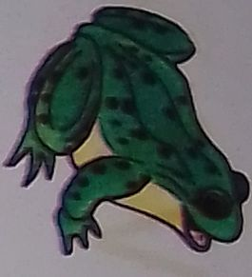
A Frog croaks
A Frog

Slide 5
A Crow
A Crow cows

Slide 6
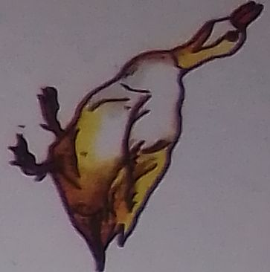
A Duck
A Duck quacks

Slide 7
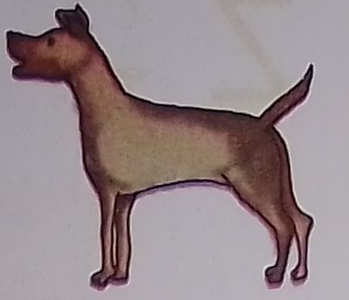
A
Dog
A Dog barks

Slide 8
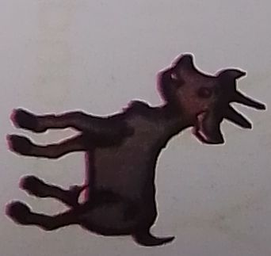
A Goat
A Goat bleats

Slide 9
Read and match
Dog
Cat
Crow
Goat
Duck
Frog
Caw
Bark
Quack
Croak
Bleat
mew

Slide 10
Read and write in your exercise book
A

Slide 11
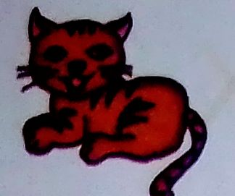
A

Slide 12
A

Slide 13
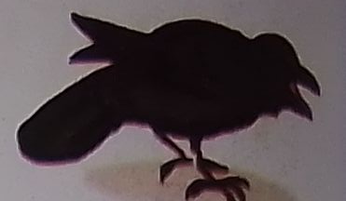
A

Slide 14
No more today
Thank you,See you again

