Slide 1
Wellcome to
everybody

Slide 2
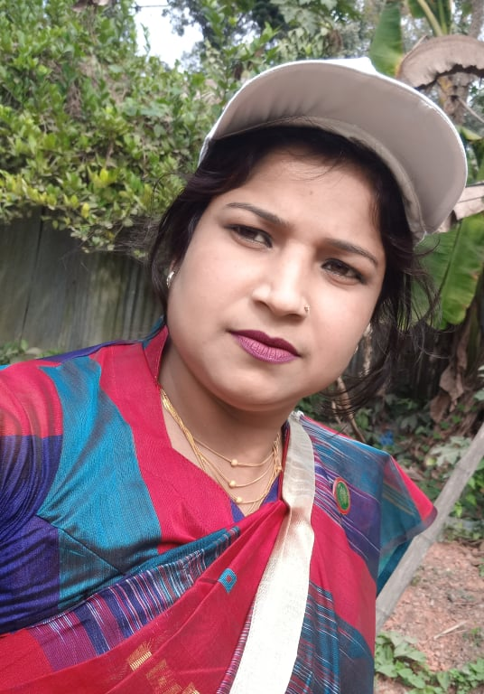
Nasima Akter
Assistant teacher
Chatia Chala Gov:
Primary School
Sakhipur,Tangail.

Slide 3
Introduction 0f lesson
Class: One
Sub: English
Unite: 11
Lesson: 4-6
Lesson title: Alphabet
Page: 23
Time: 40 minutes

Slide 5
Let’s see a video

Slide 6
Today we will learn
Aiphabet – ( I )

Slide 7
Before that now we will learn a--
One day one word
How
কত, কেমন, কিভাবে ।

Slide 8
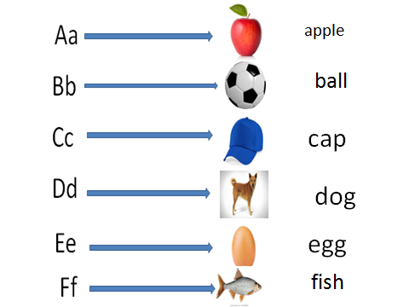
Testing previous class

Slide 9
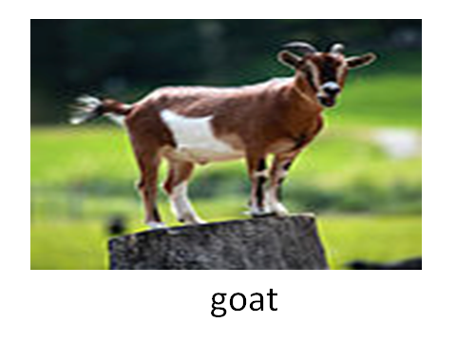
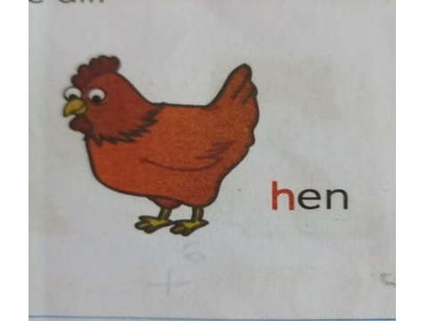
Gg
goat
Hh
hen

Slide 10
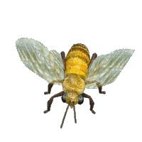
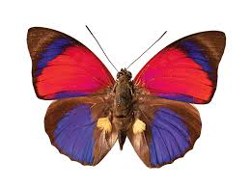
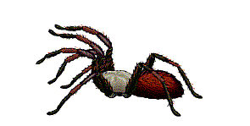
Whole class work
Let’s see some picture

Slide 11
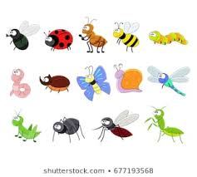
What can you see in these picture?
Insects

Slide 12
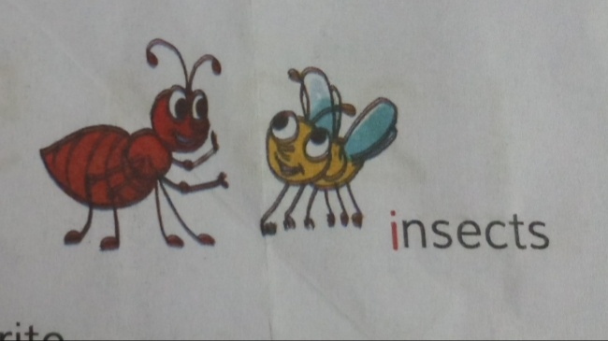
These are insects

Slide 13
insects

Slide 14
Every body say with me--
insects

Slide 15
It’s first letter is----
i
nsects

Slide 16
I
i

Slide 17
I
i
This is small letter ---i
This is capital letter -----I

Slide 18
I
i
Also I for icecream
I
i
I for inkpot

Slide 19
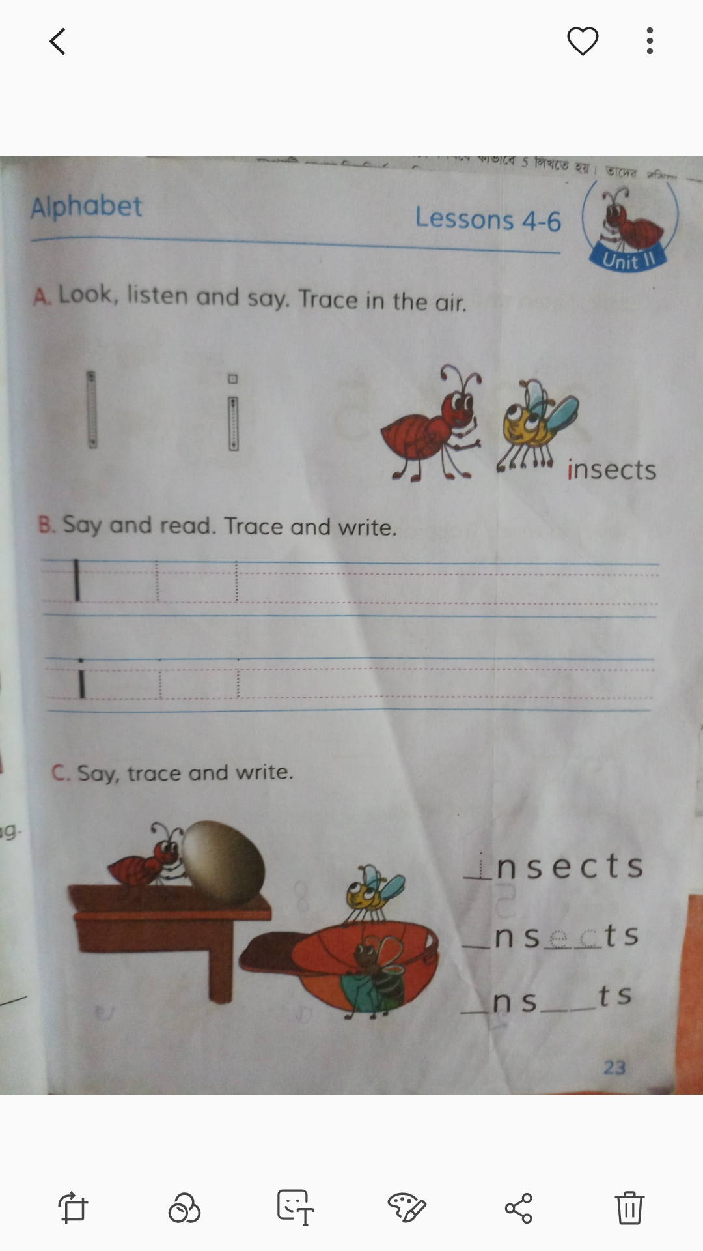
Open your book page no -23

Slide 20
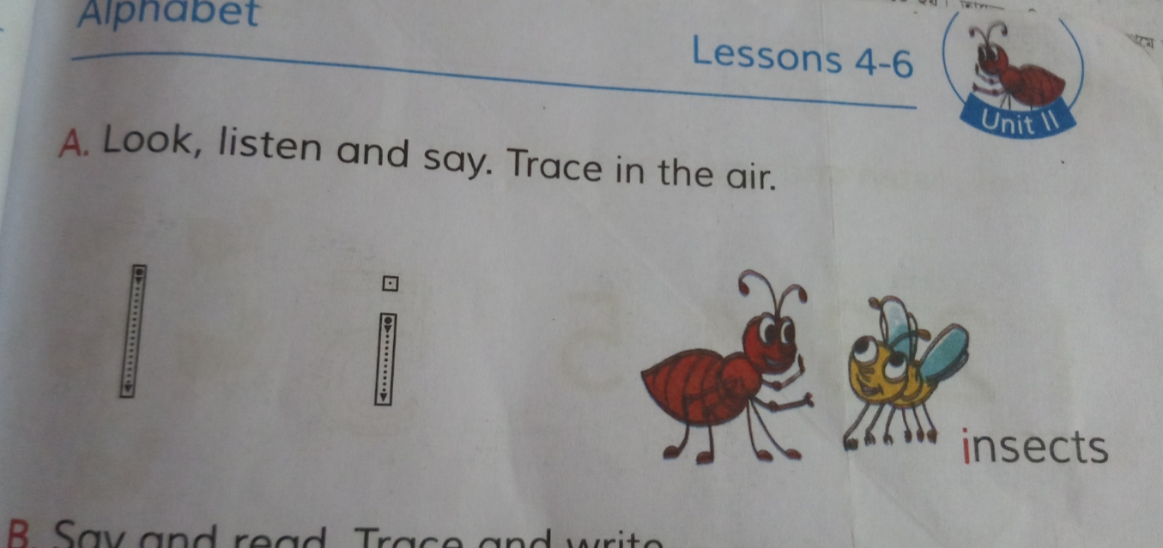
Pair work
I will make pair with each two students and I will say them
Read the letter and word with

Slide 21
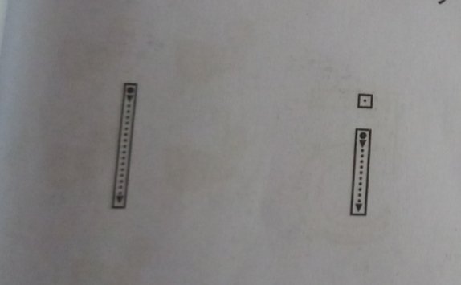
Now we will practice how to write letter --i

Slide 22
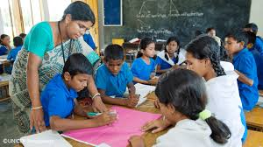
Group work
I will make group with each five students.And they
Will trace and write letter –( I ) of activity B in group.

Slide 23
Card game
I will give some card of a,b,c,d,e,f,g,h,I
the students .Each students will read
letter of card in his/her hand
And say word with that letter.

Slide 24
Individual Work
Some students come infront of
class and they will read
alphabet ( I )And insects
from letter chart
one by one.

Slide 25
Evaluation
Some students come infront of
class and they will write on the
Board alphabet ( I )And insects
one by one.

Slide 26
Home work
The students will write letter Ii in this way
I
I
I
i
i
i

Slide 27
Thank you

