Slide 1
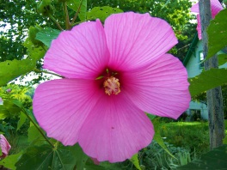
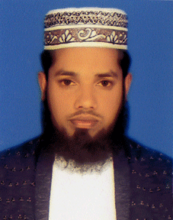
W
E
L
C
O
M
E
INTRODUCTION
MD. SHAH ALOM
ASSISTANT TEACHER ICT
JURANPUR KARIMUNNESA HIGH SCHOOL
DAUDKANDI , COMILLA

Slide 2
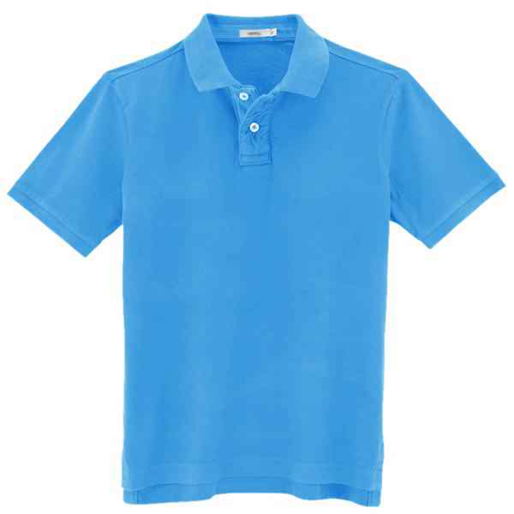
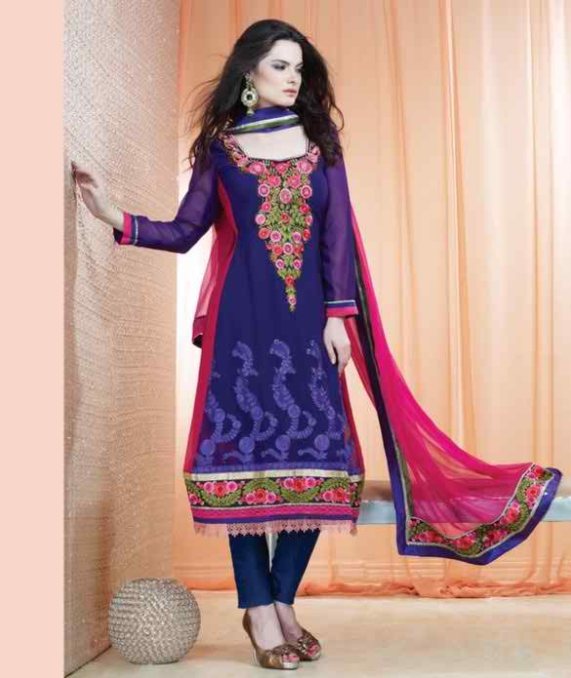
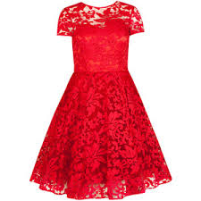
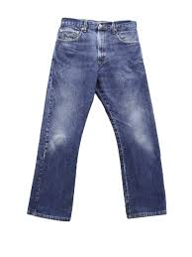
Look at the pictures and discuss

Slide 3
Learning out comes After completing the lesson students will be able to- 1. Read and understand conversations. 2. Use the words- trouser, jacket, saree, pant, cap, polo shirt, frock, jeans, T-shirt, salwar. 3.Ask and answer questions on dressing.

Slide 4
Teaching -Learning Activities 1 Pair work: - Practicing conversation between two students from text book.

Slide 5
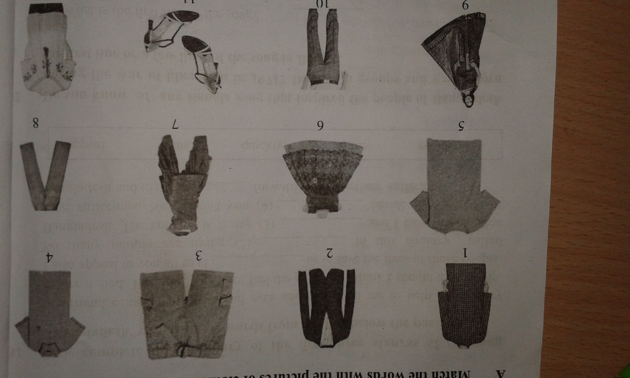
Teaching-Learning Activities 2
Look at the pictures Practice asking & answering their name, brand, size & price.

Slide 6
Dialogue slide Tanvir: Have you ever been to a clothe shop? Tomal: Yes. I have recently been to a clothe shop to buy a shirt for me . Tanvir: very nice . Did you go by yourself? Tomal: Oh, no. I went with my mother. She took me to choose my clothes. Tanvir: what did you see there? Tomal: There I saw clothes of different colors and sizes. It was really amazing to see. So many dresses there. Tanvir: what is your favorite color? Tomal: My favorite color is maroon. Tanvir: Thank you for your discussion. Myself: Thank you too.

Slide 7
Single work complete the sentences- 1. Excuse me , where are the--------? (polo shirts/ trousers/ socks/shoes) 2. Do you have the kinds without---? (buttons/lace/hooks) 3. Do you have these in a different---? (colour/size/design) 4. How much is /are --------? (this/these/the shirt/the trousers)

Slide 8
Answer slide 1. a. excuse me, where are the shoes ? b. excuse me where are the polo shirts ? c. excuse me where are the trousers ? d. excuse me where are the socks ? 2. a. do you have the kinds without lace ? B. do you have the kinds without buttons ? C. do you have the kinds without hooks ? 3. a. do you have these in a different size ? B. do you have these in a different colour ? C. do you have these in a different design ? 4. a. how much is this ? B. how much are these? C. how much is the shirt ? D. how much are these socks ? E. how much are the trousers ?

Slide 9
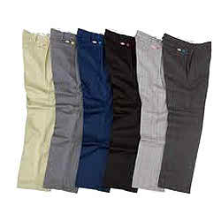
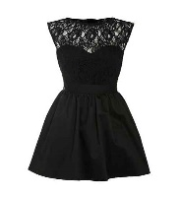
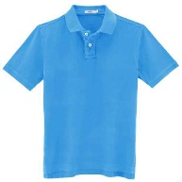
Assessment 1. Pronounce the words: Trouser, Shirt, blue, Sky,Height. 2. Describe your own dress. 3. Identify the dresses:

Slide 10
Home Work (Handwriting): Write a dialogue between a buyer & a seller on buying a Panjabi.

Slide 11
Good Bye

