Slide 1
Welcome to
Multimedia class

Slide 2
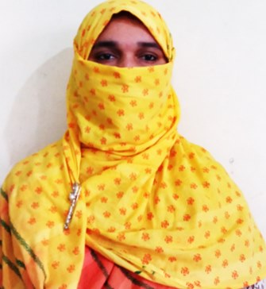
Teacher
Mosammat Nelufa Afrose (Bithi)
Lecturer in English
Khilbaisa Rahmania Fazil(Degree) Madrasah
Sadar, Lakshmipur
E-mail:nelufa.afrose@gmail.com

Slide 3
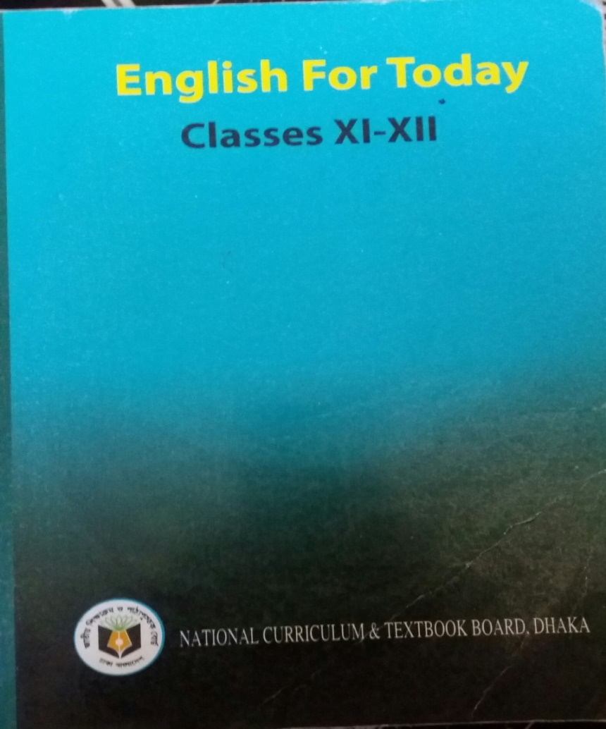
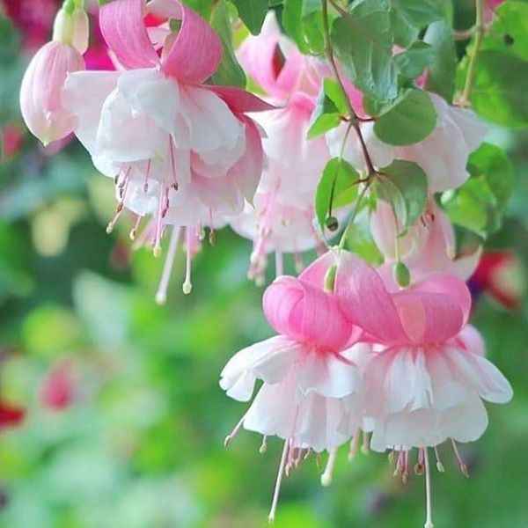
English First Paper
Unit-1, Lesson-1

Slide 4
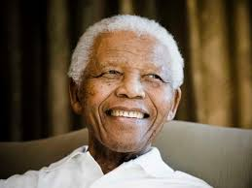
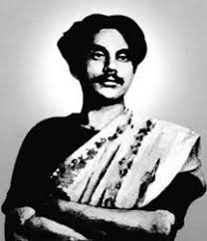
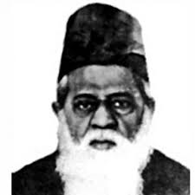
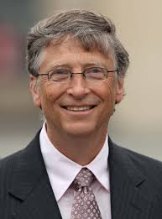
Who are the people in the pictures?
Why are they famous?
Nelson Mandela
Kazi Nazrul Islam
Dr. Muhammad Shahidullah
Bill Gates

Slide 5
We shall learn from
Unit–1,
People or Institutions Making History

Slide 6
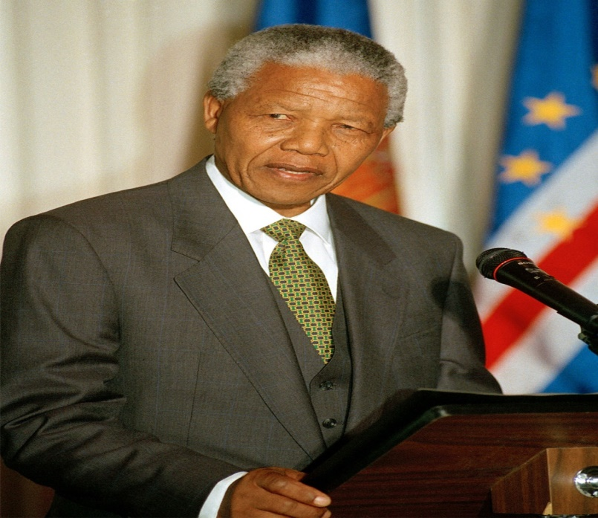
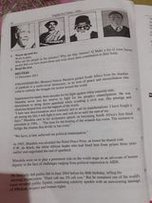
The topic of our today class is
Lesson -1, Page no-10
Nelson Mandela, from Apartheid Fighter to President .

Slide 7
What are we going to learn today-
Watch a video on Mandela.
Read and understand the text properly.
The short life sketch of Nelson Mandela.
Some new words from the text.

Slide 8
Let’s watch a video

Slide 9
The text is a report by a famous news agency, Reuters on 15 December 2013.

Slide 10
Reading Skill
JOHANNESBURG (Reuters) - Nelson Mandela guided South Africa from the shackles of apartheid to multi-racial democracy, as an icon of peace and reconciliation who came to embody the struggle for justice around the world.

Slide 11
Imprisoned for nearly three decades for his fight against white minority rule, Mandela emerged determined to use his prestige and charisma to bring down apartheid while avoiding a civil war. His prestige and charisma helped him win the support of the world.

Slide 12
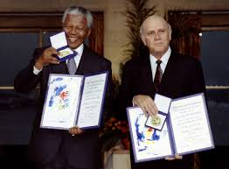
Frederik Willam de Klerk was a South African politician who served as the State President of South Africa. He negotiated with Nelson Mandela the end of apartheid. He also was awarded Nobel Peace Prize with Nelson Mandela.

Slide 13
The short life sketch of Nelson Mandela.
Name: Rolihlahla Mandela
Born :18 July, 1918
Clan :Madiba
Surname: Nelson
Nationality : South Africa
Education: BA & LLB, from the University of South Africa.
Died :5 December, 2013

Slide 14
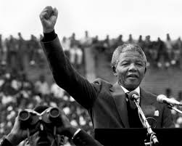
Vocabulary
Guided (V2 & adj):
Meaning: Indicate the way someone.
Synonym: Conducted, Driven
Antonym: Unguided

Slide 15
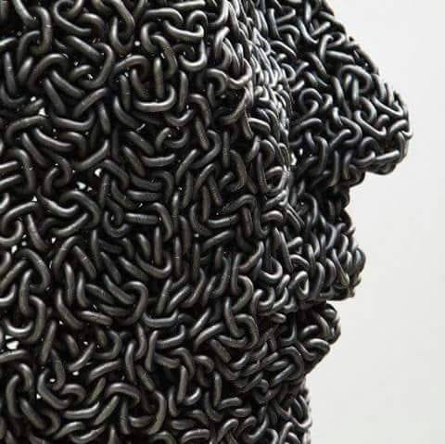
Shackles(n):
Meaning: A situation that restrains someone.
Syn: Chain/restrictions
Ant: freedom

Slide 16
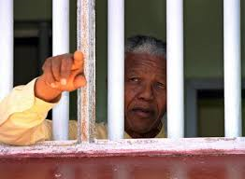
Imprisoned (adj) :
Meaning: Kept in prison
Syn: Jailed/caged/detained
Ant.: Freed

Slide 17
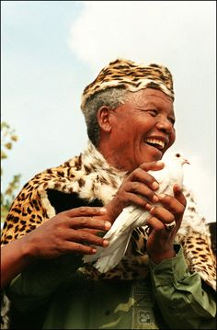
Emancipation (n):
Meaning: The process of giving people social or political freedom or rights.

Slide 18
Evaluation
Where was Mandela born?
South Africa
When did he become president?
1994
When was he awarded the Novel Peace Prize?
1993
Who did share the Novel Peace Prize with him?
de Klerk
When was Mandela charged with capital offences?
1963
Notes:
Evaluate the students by asking some short questions.

Slide 19
Individual Work
Make a list of ten famous people that you have heard about and write about their contribution.

Slide 20
Pair Work
Make a flow chart on activities and achievements of Nelson Mandela.
First one is done for you.
1.
Fight against white minority rule
2.
3.
4.
5.
6.
Notes:
Give them Home Work.

Slide 21
Home Work
Write a summary on the life of Nelson Mandela.

Slide 22
Thank you

